Slide 1





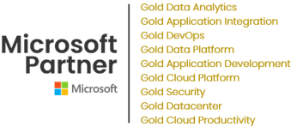
Technical Proposal
For
Data & Advanced Analytics Transformation
Proposal Effective Date | 23rd July 2024
Proposal Expiration Date | 30th August 2024
Elite Partner

Slide 2
Contact Information
Address of Headquarter | F-202-204, RIICO Industrial Area, Mansarovar, Jaipur - 302020, Rajasthan, India
Address of Dubai Office | 39th Floor, Office Space 11 One Tower Building Dubai Internet City Metro Station Dubai-UAE
Contact Information | Mradul Nagpal (Primary Contact)
 | Senior Executive Sales
 | mradul.nagpal@celebaltech.com
 | +91-8005507416
 | Abhishek Goyal
 | VP – Sales (CEMA)
 | abhishek.goyal@celebaltech.com
 | +971-585112076

Slide 3

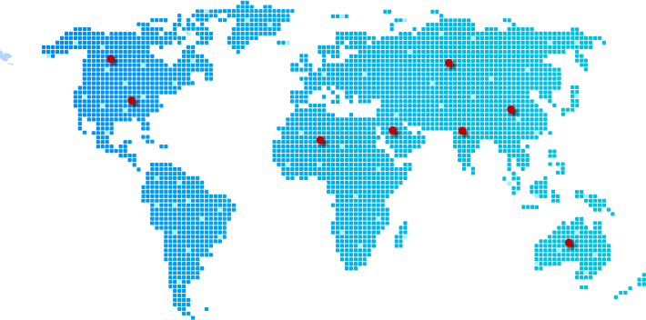



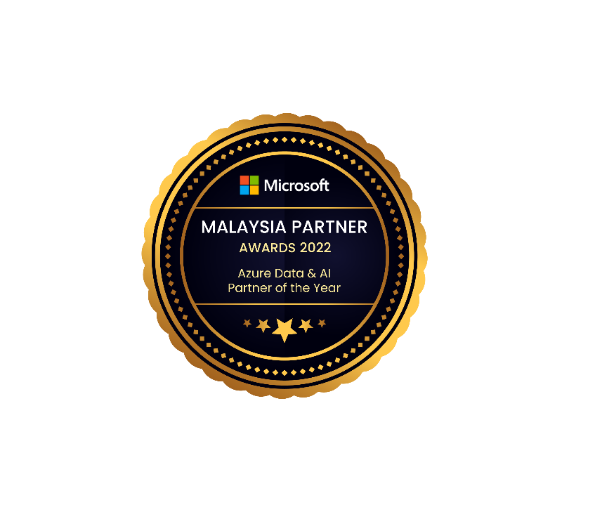






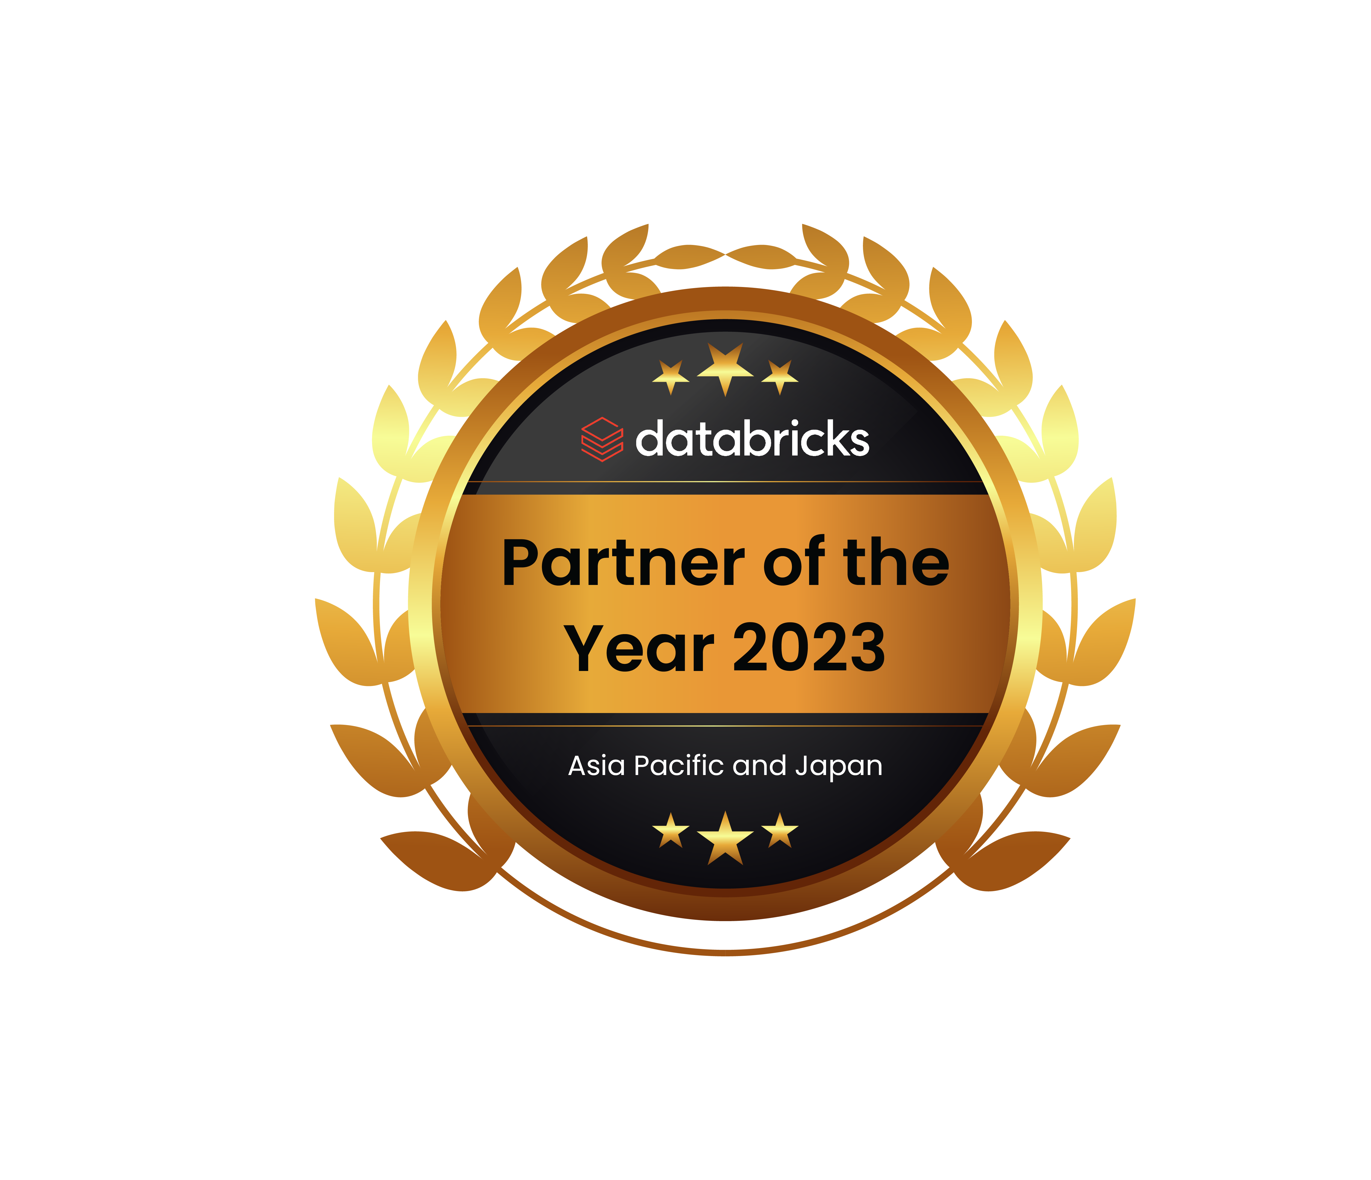
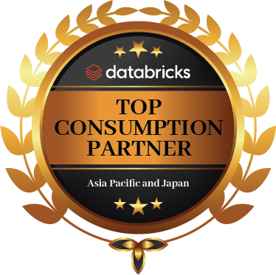
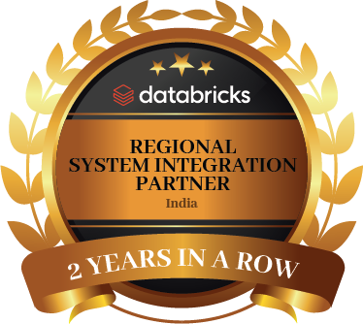




Our Specialization and Strength
Partnerships
Elite Partner
Advanced Specialization
INDIA | USA | CANADA | APJ
| MIDDLE EAST | AUS
AI & Machine Learning
Advanced Analytics
Infra Migration to Microsoft Azure
Kubernetes
Cloud Security
SQL server and Windows Migration server and Windows Migration
Top Industries We Serve
Manufacturing
BFSI
Retail & CPG
Telecom
Energy &
Sustainability
Healthcare &
Life Sciences
Media &
Entertainment
Government
Institution

Slide 4
Table of Contents
Background & Objective
Problem Statement
Use cases
Scope of Work (SOW)
Deliverables
Prerequisites
Volumetrics
Out of Scope
Assumptions
Solution Architecture
Assessment Approach (Gap Analysis)
Project Timeline
Platform Capabilities
Resource list & Profiling
Resource Pool
References
Delivery and Project Methodology Approach
Quality Assurance
Escalation Matrix
Risk & Mitigation Strategy
Terms & Conditions

Slide 5



Background & Objective

Slide 6
Background & Objective
Introduction
The Abu Dhabi Chamber of Commerce & Industry (ADCCI) is a prominent organization dedicated to supporting and promoting economic growth, trade, and investment in the Emirate of Abu Dhabi, United Arab Emirates. Established in 1969, the ADCCI serves as a vital platform for businesses operating within Abu Dhabi, offering various services such as business registration, advocacy, networking opportunities, and economic research. It plays a crucial role in facilitating partnerships between local and international businesses, fostering entrepreneurship, and contributing to the overall economic development of Abu Dhabi. The ADCCI is instrumental in representing the interests of the business community to government entities and policy-makers, ensuring a conducive environment for business growth and prosperity in the Emirate.
Objective
The aim is to establish the strategic imperative for businesses to systematically pinpoint critical deficiencies (gaps), then actively pursue specialized knowledge and advanced analytical capabilities tailored to address these gaps. This approach not only enhances the ability to make well-informed decisions based on thorough analysis and reliable data but also enables effective long-term planning that considers diverse scenarios and optimizes resource allocation. Moreover, by bolstering these capabilities, organizations are better equipped to identify and mitigate risks proactively, thereby safeguarding against potential disruptions and ensuring sustained operational resilience in an increasingly complex and competitive business landscape.

Slide 7
Problem Statement

Slide 8




Problem Statement
Challenges
Data Privacy and Security
Legacy Systems Compatibility
Optimizing Data Quality
Ensuring scalable system
The confidentiality and integrity of sensitive business data is paramount. Ensuring stringent data protection regulations and guard against potential data breaches and unauthorized access.
Compatibility issues with older systems can impede new analytics solutions integration, complicating efforts to ensure regulatory compliance.
Inconsistencies, inaccuracies, and incomplete data from various sources, which hampers the reliability of analytics and the ability to draw meaningful insights.
Ensuring cost-effective scalability, managing complexity, optimizing performance, maintaining robust security and compliance, and ensuring integration compatibility are challenges in investing in scalable cloud infrastructure for real-time analytics and decision-making.
Solution
Leveraging ADCCI data for informed decision-making entails overcoming challenges such as ensuring data accuracy, identifying critical gaps, acquiring specialized analytics expertise, and integrating insights effectively into planning and risk management processes. This requires implementing robust data governance practices, harnessing advanced analytics capabilities, and aligning these efforts with organizational goals. Successful strategies will enable businesses to translate data insights into actionable strategies, facilitating effective decision-making and proactive risk management tailored to the dynamics of the ADCCI data landscape and industry context.

Slide 9
Problem Statement
Solution
Data Architecture & Design Documentation: Detailed blueprint outlining data sources, flow mapping, architecture diagrams, tech stack recommendations, and integration specifications for seamless data flow.
Unified Data Integration: seamlessly, enabling real-time updates and ensuring consistent data flow across platforms.
Data Quality Assurance: Establish rigorous validation processes and regular audits to maintain high accuracy and reliability of ADCCI data. Develop a Data Quality and Validation Framework to standardize processes and ensure data integrity throughout its lifecycle.
Advanced Analytics Capabilities: Utilize advanced tools like machine learning to extract actionable insights and develop custom algorithms for precise forecasting and strategic planning based on ADCCI data.
5. Scalable Infrastructure: Invest in scalable cloud infrastructure to handle increasing data volumes and optimize performance for real-time analytics and decision-making.
6. Advanced Analytics Models & User-Friendly Reports: Developed ML models, statistical analyses, and data mining techniques documented, along with user-friendly reports and dashboards for clear insights and decision-making.
7. Centralized Data Catalog: Establishment of a repository documenting all data assets, metadata, ownership, and access controls for easy data discovery and utilization.
8. Disaster Recovery Plan & Procedures: Development and implementation of strategies for data backup, recovery, and business continuity to ensure data integrity and minimize operational disruptions.

Slide 10


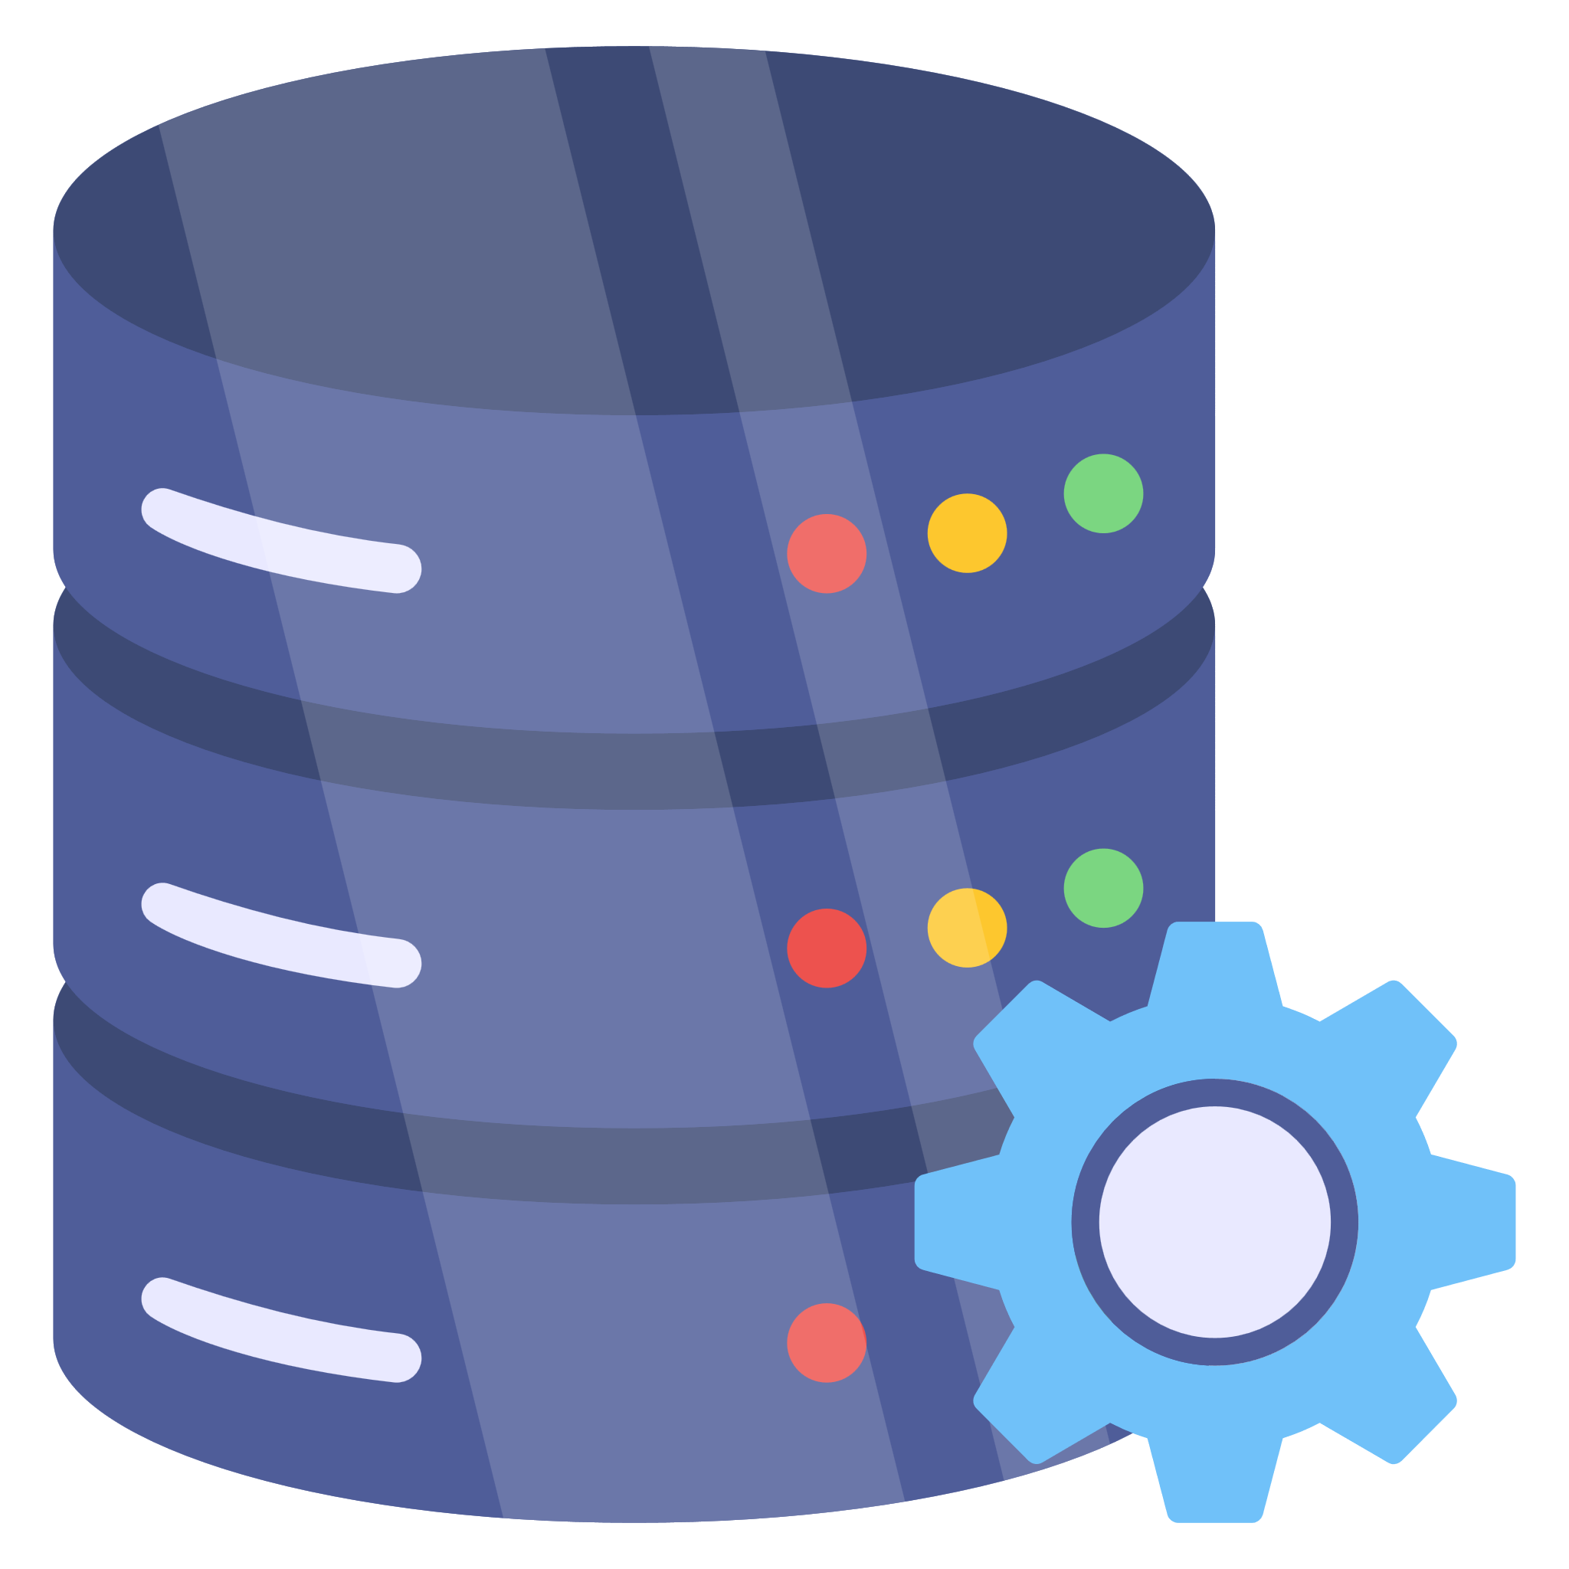


Project Benefits
Improved accessibility to critical data fosters collaboration and accelerates insights across departments.
Advanced analytics and real-time data empower agile decision-making, enabling rapid responses to market dynamics.
Leveraging Power BI for automation and analytics streamlines operations, reduces manual efforts, and significantly boosts productivity.
Scalable technology solutions ensure readiness for future challenges and opportunities in a dynamic digital environment.

Slide 11

Business Value Add-On
Improved Customer Experience: Enhancements in products, services, or processes that directly benefit customers, leading to increased satisfaction, loyalty, and retention.
Increased Revenue and Profitability: Initiatives that drive revenue growth, such as expanding market reach, introducing new products or services, or optimizing pricing strategies, resulting in improved financial performance.
Operational Efficiency: Streamlining of internal processes, automation of repetitive tasks, and optimization of resource allocation, leading to cost savings, higher productivity, and faster time-to-market.
Competitive Advantage: Adoption of innovative technologies or strategic initiatives that differentiate the organization from competitors, positioning it as a leader in the industry and attracting customers and talent.

Slide 12
Technical Delivery Approach
We will take a Phased delivery approach to deliver this project. It will help -
Realize incremental value throughout the development lifecycle.
Deliver functionality or features in iterative way to provide early wins
Demonstrate progress along the way
Phase 1 (3 Months)
Scale-Out (4-5 Months)
Architecture assessment, gap analysis & Design evaluation
Full System Audit to understand dependencies and complexities
Prototyping of Proposed Architecture Components
Framework Design and Automation
Build one use case/Report end to end
Deployment & Parallel Runs
Data Reconciliation
Connect Reporting layer to Fabric
Perform Benchmarking test to meet user SLA
Refine proposal and for Scale out phase
Build at scale with multiple use cases.
Development of all data/ reports/ jobs to Fabric & BI Platform Integration
Build ML use-case on the proposed Architecture
Conduct user acceptance testing with business users
Optimization Approach
Conduct user acceptance testing with business users
Production Cut-Over
Assess Data Platform for future analytics road-map

Slide 13
Implementation Approach
Infrastructure and Access
Requirements and Analysis
Build and Test
Deploy
Gathering access of Azure, VDI & all necessary resources and team onboarding
Identification of various data sources, data quality rules to be implemented, existing systems and finalizing the Scope of Work besides project plan
Develop and implement Data Quality framework, ETL processes and Reporting of Quality metrics besides other reports
Deployment solution, documentation and sign-off
STEP 01
STEP 02
STEP 03
STEP 04
STEP 02

Slide 14
Use Cases

Slide 15
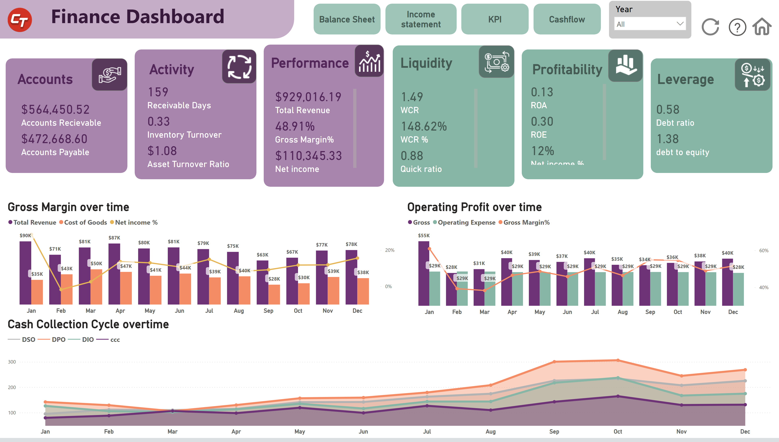
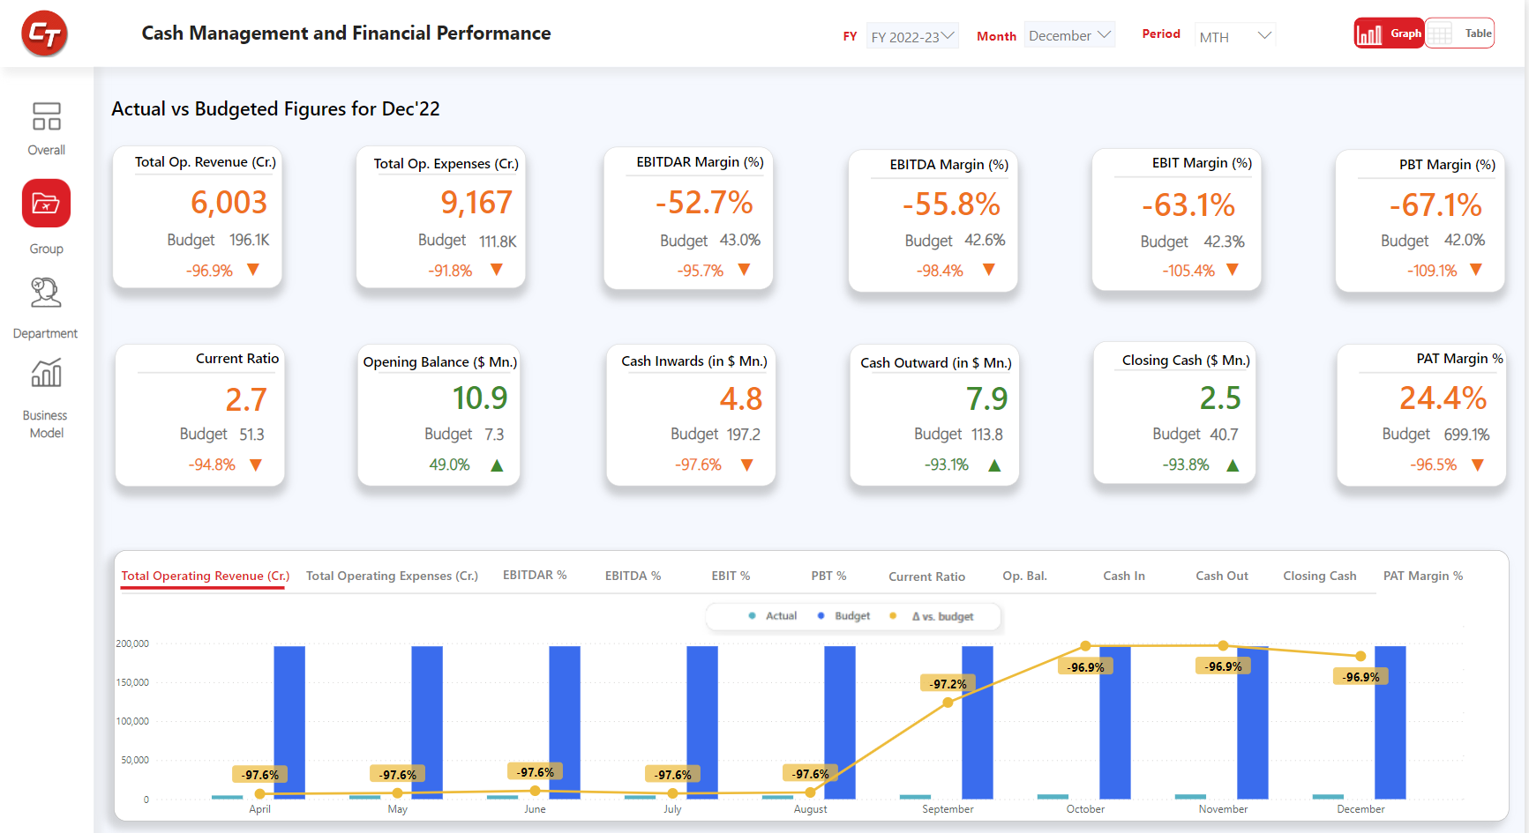
Use Case 1 - In-depth Analysis of Financial Statements
Business Scenario
The client was seeking comprehensive financial statement analysis to drive strategic decision-making. They require detailed reports covering Ratio Analysis, Budget vs Actuals, Risk Assessment, Trend Analysis, and Comparative Analysis.
Due to unavailability of centralized data warehouse, major challenge was to manage multiple data sources for same set of data as it was maintained by multiple stakeholders
Solution and Benefits
Celebal Tech team understood the challenges & provided an end-to-end holistic solution which allows the client to ingest data from multiple sources, transform & apply business logic at a centralized data warehouse and finally visualize the data for better decision making.
Azure services such as Azure Data Factory, Azure Data Lake, Azure Synapse is utilized for data ingestion, storage, preparation & creation of curated reports. Implementation was done to address the keying concerns fixing the data integrity issues.
Our solution streamlines the financial analysis process. It enables stakeholders to make data-driven decisions promptly, identify potential risks, align budgets with actual performance, and spot trends that influence strategic directions.

Slide 16
AI Use Case
Use case – AI-powered Investment Portfolio Optimization and Risk Management
Data Integration & Analysis:
Integrate data from market feeds, financial reports, industry trends, and economic indicators for a holistic view.
Establish clear data governance policies to ensure data ownership, access control, and data security throughout the integration and analysis process.
Implement robust data security measures to protect sensitive financial information and comply with relevant regulations.
Utilize data exploration techniques to understand the characteristics and relationships between different data sets.
Utilize Natural Language Processing (NLP) to extract insights from news, analyst reports, and social media data to understand market sentiment and potential risks.
Portfolio Optimization & Risk Assessment:
Implement ML models to analyze investment performance, identify correlations between assets, and assess overall portfolio risk.
Utilize portfolio optimization algorithms to recommend adjustments to the investment portfolio based on risk tolerance, market conditions, and potential opportunities.
Develop AI-powered stress testing capabilities to simulate various economic scenarios and assess portfolio resilience against potential market downturns.
Predictive Analytics & Opportunity Identification:
Utilize Machine Learning to identify emerging trends and predict future market movements based on historical data and current market conditions.
Recommend potential investment opportunities that align with the portfolio's risk profile and long-term investment goals.
Leverage AI to analyze vast amounts of data and identify previously overlooked investment options with high potential returns.
Integrate Explainable AI (XAI) techniques into the system to enhance transparency and trust in the AI's predictions.
Please note: Above mentioned use case would be considered in next phases and is not a part of this quotation.

Slide 17
Scope of Work - Phase 1

Slide 18
Major aspects of Implementation– Data Engineering and Infrastructure
1. Requirement Gathering & Gap Analysis Assessment
Configure Azure Monitor to collect telemetry data, performance metrics, and audit logs from deployed Azure services ​
Integrate Azure Log Analytics for centralized log aggregation, analysis, and troubleshooting.​
Assign RBAC roles to groups or users for specific resources​
Set up alerts and notifications to proactively monitor service health, resource utilization, and security incidents, ensuring timely response and mitigation
Integration and Sanity Testing of Infrastructure. ​
Conduct a thorough evaluation of the existing system infrastructure at ADCCI to understand strengths, weaknesses, and areas for improvement.
Develop a comprehensive roadmap outlining the future state of data analytics for the organization, including target architecture and desired outcomes.
Analyze and recommend the appropriate technology stack and tools required to achieve the future state.
Create a detailed implementation plan, covering phases of deployment, necessary services, resource requirements, and timelines.
Identify the necessary resources, including personnel, skills, and budget, and establish a clear timeline for the implementation of the proposed roadmap.
Identify all stakeholders and Single Points of Contact (SPOCs) relevant to the ADCCI and the CT (presumably, a technology or project delivery team) for the project.
3. Data Integration and Ingestion
Integrate with existing systems and data sources while maintaining current integrations without disruption.
Gather historical data for identified indicators over a specific time period.
Design mechanisms for loading processed data into the target data storage systems for Batch load and implementing incremental/delta load.
Developing Event hubs streams for streaming/near to real time data load while incorporating incremental/delta load logic on data streaming pipelines .
Organize and maintain a comprehensive database of identified data.
Support integration with multiple data sources, including cloud and on-premises systems and real-time applications.
Enable connections to Oracle, on-premises DB, cloud DB, API, JSON, streaming, FTP, MS Dynamics.
Support CDC capabilities, built-in data mapping and transformation tools, real-time and batch integration, API and web services integration, and data replication and synchronization.
2. Azure Infrastructure Setup
Procurement of IP address/CIDR ranges for virtual network creation.​
Deployment of Infrastructure Resources manually through Azure Portal.​
Deployment and configuration of SHIR and Power BI On-Prem Data gateway Virtual Machine ​
Deployment of private endpoints for PaaS Services.​
Deployment of Fabric Capacity Units with finalized SkU.​
Create connections for data sources.​
Verify connectivity with the data sources.
Implementing Microsoft Defender for Cloud for vulnerability assessment.

Slide 19
Major aspects of Implementation– Data Engineering and Infrastructure
4. Data Cleansing, Transformation & Quality Assurance
6. Data Migration, Model and Design
Document data cleansing techniques, such as outlier detection, data deduplication, and data standardization procedures.
Create guidelines for data transformation processes, including aggregation, calculations, and deriving new metrics.
Ensure data quality and accuracy through data cleaning and validation processes.
Develop data quality checks and validation processes to maintain high standards of data accuracy and consistency.
Develop a migration plan and cut-over strategy, ensuring a smooth transition.
Delve into the intricacies of the source system, understanding data models, and the relationships between different data entities.
Evaluate the effectiveness of the current data modeling techniques and their alignment with business requirements.
Develop appropriate data models, ETL pipelines, data marts, and data lakes.
Optimize data processing pipelines to ensure efficient extraction, transformation, and loading (ETL) processes.
Conduct initial data validation from the old architecture to the new post-migration.
Implement a data migration approach with a parallel run and validate the migrated data.
5. Data Management and Storage
7. Data Governance, Security, and Compliance
Support multiple data formats (structured, semi-structured, unstructured) including tables, CSVs, JSON, XML, streaming data, and videos.
Ensure scalable storage capacity, easy-to-use data import/export features, data compression and encryption, access controls, audit trails, and data archival and backup.
Configure CI/CD pipelines to automate build, testing, and deployment processes.
Cataloging Metadata and Establishing a centralized repository or catalog serves as a single source of truth, where all metadata is stored and managed is essential.
Regularly updating metadata, refreshing data assets, and retiring obsolete data assets ensure that the catalog remains accurate and up-to-date.
Establish robust data governance practices, defining clear ownership, responsibilities, and accountability for data assets.
Ensure data accuracy, understand data granularity, and outline migration timelines.
Adhere to data privacy regulations (e.g., GDPR, HIPAA) and industry standards.
Develop and document data policies, Include retention policies, access controls, and data lifecycle management.
Deploy robust data encryption algorithms and access control mechanisms to safeguard sensitive information.
Use data encryption, access control mechanisms, and provide disaster recovery and business continuity features.
Develop data quality checks, validation processes, and monitoring tools.
Include features for data lineage, audit trails, and metadata management.

Slide 20
Major aspects of Implementation– BI Analytics
1. Requirement Gathering/Project Kick-Off
2. Theme finalization and Wireframe creation
Celebal Technologies, hereinafter referred to as ‘CT’, shall kick-start the project with an introduction to the project team: project manager, tech team, and business analyst.
The client shall share the required details with the CT Team which shall include but not be limited to the following:
Sessions with Business users for the understanding of KPIs and logics.
A detailed document (Requirement gathering document) outlining the Business Requirements Document or Concept Note, desired outcomes, and high-level requirements. And sign-off on the documents/KPIs/Logics from business users.
Details pertaining to Row-level Security- User roles and Permissions and Security rules and policies.
Branding Guidelines such as Logo usage, color schemes, font style, and sizes (if any).
CT shall review the requirement document/details, Plan for KT sessions, and further, Q&A sessions will also be organized to get clarity on the requirements.
CT and ADCCI teams will identify the necessary data sources for Power BI reporting, ensuring compatibility and data integrity.
Planning for integrating additional data sources, data extraction, transformation, and loading processes. Ensuring data quality and consistency.
A detailed KPI Document & Review from ADCCI team would be provided so that the data and logic validation can be done smoothly.
Finalizing Power BI Report User Interface (UI) and sign-off from the ADCCI team will help us to facilitate a smooth development process.
Modifying & Customizing themes followed by obtaining sign-off will be conducted in a maximum of two iterations to ensure timely delivery of the project.
Creation of Wireframes, incorporating changes (if any) and its sign-off. This includes gathering inputs on visual preferences and specific design requirements.

Slide 21
Major aspects of Implementation– BI Analytics
3. Power BI Reports Development
4. Testing and Quality Assurance
Maximum 1 Power BI Report will be developed for visualization.
Considering 4-5 KPIs per report and 6-7 pages per report will be considered.
Facilitating regular reviews and discussions with the management team to address any updates or modifications to the KPI framework.
Implement any necessary calculations or business logic within the reports using DAX (Data Analysis Expressions).
Implement minor Power Query transformations within Power BI for transforming data in required format if necessary.
Power BI Functionalities such as Drill Down, Drill Through, Bookmarks, What-if Parameters, Row-Level-Security (RLS), etc. will be implemented. Implementation of functionalities may vary according to the requirement.
Implement advanced inbuilt Power BI AI features like Q&A, Key Influencer, and Decomposition Tree based on business requirements. These features are built into Power BI and do not require external tools.​
Committing to continuous improvement by regularly assessing the relevance and effectiveness of the established KPIs and proposing refinements as needed.
Sanity testing of the complete report from Celebal team to ensure the implementation of logics, wireframe and UI meets the customers expectation.
Deployment of report on Power BI service.
Implement Schedule refresh to keep the data updated.
UAT of report from ADCCI team business stakeholders to provide their feedback and its implementation.
Verify that each component is functioning as expected and meets the defined requirements such as connectivity of linked services with PaaS components.
Azure-managed operation works followed by the setting of source system connectivity, test connections, testing of the workload, and credentials checks.
Conduct security scans of the Azure infrastructure and the data platform components to identify and address any potential security weaknesses.
Developing comprehensive UAT test scenarios covering various aspects of Pipelines, Power BI dashboards, and user interactions.
Develop detailed test cases covering all aspects of the solution, including functionality, data accuracy, performance, and security.
Creating a UAT Environment and allow access to the Client for detailed testing. Categorize issues based on their severity and priority to address the most critical problems first.
Obtain formal sign-off from end-users and relevant stakeholders after successful UAT completion.
Migration to the production environment post business sign-off is received.
Sharing testing document before Go-Live.

Slide 22
Major aspects of Implementation– BI Analytics
4. Data Visualization
6. Data Visualization
17. Testing and Quality Assurance
6. Training & Handover
5. Go-Live & Hypercare
Address and resolve any issues or queries promptly, ensuring a smooth transition to the new system.
Facilitate knowledge transfer sessions to key stakeholders, ensuring they have an in-depth understanding of the system.
Providing training on the pipelines created an end-to-end understanding of how the implemented system works including edge cases.
Giving users the know-how to consume the Power BI Reports and self-service BI. Establish a feedback mechanism to gather insights from users.
Preparation and providing a detailed handover document to the Client at the time of Project Closure and handover.
Develop comprehensive UAT test scenarios covering various aspects of data ingestion, data warehouse, Power BI dashboards and user interactions.
Prepare realistic and diverse test data sets to simulate different scenarios, ensuring thorough coverage of UAT and QA scenarios.
Conduct UAT sessions involving end-users to validate data ingestion, data quality, and Power BI dashboard usability.
Obtain formal sign-off from end-users and relevant stakeholders after successful UAT completion.
Offer Training Sessions: As part of our scope, we will conduct training sessions to accommodate diverse learning preferences. The training plan is attached for your reference
Develop Tailored Training Materials: We will create customized training materials tailored to different user groups. These materials will be designed to align with the skill levels and job roles of each user group, ensuring relevance and effectiveness.
Provide Comprehensive Technical Documentation: Our scope includes delivering comprehensive technical documentation covering all aspects of Power BI functionalities, features, best practices, and troubleshooting guidelines. This documentation will serve as a valuable reference resource for users to deepen their understanding and maximize their proficiency with Power BI.
Deliver Elaborated User Manual: Within our scope, we will create a detailed and elaborated user manual covering various aspects of Power BI usage, including data modeling, report creation, dashboard design, and data analysis techniques. This user manual will serve as a comprehensive guide for users to navigate through Power BI's functionalities effectively.
CT will provide KT sessions over the implemented solution.
A training schedule shall be planned along with the Go-Live schedule. Considering training to be provided to relevant stakeholders.
Provide training to relevant staff members on how to use and maintain the data quality framework.
Establish regular monitoring and maintenance routines to ensure ongoing data quality compliance.
2. Azure Infrastructure Setup
3. Data Ingestion
5. Language Translation
8. Knowledge Transfer
6. Deployment in Development Environment

Slide 23
Major aspects of Implementation– BI Analytics
7. Documentation
Document the system architecture, including infrastructure diagrams and component interactions.
A detailed Handover document shall be prepared and given to the Client at the time of Project Closure and handover.
Maintain detailed documentation for UAT and QA processes, including test plans, test cases, and defect logs.
Implement clear documentation and metadata to enhance data understanding & Solicit feedback from stakeholders to identify areas for improvement in data usability.
Document each data quality rule clearly, including its purpose, conditions, actions, and expected outcomes.
Ensure that stakeholders understand and agree upon the defined data quality rules before implementation.

Slide 24
Major aspects of Implementation– DevOps
1. DevOps Implementation
Setting up the Azure DevOps Organization, and Azure DevOps project, and initializing Azure Repos.
Setting up Azure Repos for ADF and Power BI & Setting up Branching strategy and branch policies.
Integration and configuration of repositories with ADF.
Integration and configuration of Self-Hosted Agent in Azure DevOps.
Setting up Service Connections for Different environments in Azure DevOps.
Configure build and release pipelines for the deploying resources such as Azure Data Factory and Power BI to UAT and PROD environments.

Slide 25
Self-Service Analytics Training
Power BI - Self-Service Analytics Training Timeline
Topics | Details | Audience | Duration (1- Hour)
Introduction to Power BI | Power BI Portfolio | Creators/Business Users/Administrators | Session-1
 | Introduction to Power BI - Basic Understanding
Data Connectivity | Getting data in Power BI and various modes of connections | Creators/Business Users/Administrators | Session-2
 | Data Source Settings, Accessing Preview Features
ETL (Extract, Transform & Load) | Data Preparation, Cleaning and transformation | Creators/Business Users/Administrators | Session-3
 | Pivot & Unpivot, Merging & Appending Tables
 | Data Formatting & Cleaning Functions
Data Modeling | Data Modeling, Cardinalities, Cross filtering Direction | Creators/Business Users/Administrators | Session-4
Visualization and Features ( Slicing & Dicing) | Power BI Visuals (Market Place, Maps, filters, custom visuals) | Creators/Business Users/Administrators | Session-5
 | Drill Down & Drill through, Controlling Interactions
 | Edit interaction, Bookmarks, Selection Pane, Page Navigation
 | Themes, Page View, Edit Interaction, Visual Arrangments |  | Session-6
 | Alignment & grouping visuals
 | Correct visual selection & formatting, Report Formatting
 | Page Level, Visual Level, Field Level filters Custom sorting

Slide 26
Self-Service Analytics Training
Power BI - Self-Service Analytics Training Timeline
Topics | Details | Audience | Duration (1-Hour)
DAX Calculations | DAX Functions, DAX Variables , DAX Patterns | Creators/Business Users/Administrators | Session-7
Power BI Service Portal - Introduction | Power BI Objects (App, Workspaces, Datasets, Dataflows, Reports, Dashboards) | Creators/Business Users/Administrators | Session-8
 | Data Source Connectivity
 | Deployment Pipelines
 | Data Alerts, Usage Metrics, Subscribe in Email
 | Usage Metrics, Analyze in Excel, Export reports in PPT, PDF & Excels
 | Comments & Feedbacks
Advance Analytics (Including AI) | Integration with other Microsoft Services. | Creators/Business Users/Administrators | Session-9
 | Q&A, Key Influencers, Decomposition Tree
 | Quick Insights, View Insights, Forecast, Copilot
Power BI Governance | Data Access Restriction & Security | Creators/Administrators | Session-10
 | Manual & Schedule Data Refresh
 | On-Premise Data Gateway
Power BI Governance (Administrators) | Tenant Setting Configuration | Administrators | Session-11
 | Organization Visual Deployment
 | Embedding Code Management
 | Workspace & Role Access Control
 | Datset Certification & Sensitivity Labelling
Question & Answers Sessions | Question & Answers Sessions | Creators/Business Users/Administrators | Session-12

Slide 27
Data Source Details
ERP/Core Enterprise Systems (On-Prem and Cloud – Oracle, IBM, Azure, Google)
Azure Data Lake
Oracle RDS (Retail Data Store), SQL Server
Cloud Data Sources (AWS, Azure, GCP)
Social media, Internet, e-Commerce (brandsforless.com)
Flat File, Excel sheets, HDFS
SQL based DB like Postgres SQL, Couch, Mongo, or Cosmos DB
Video, Audio, Streaming Apps
IoT, Sensor Data (RFID data)
3rd party apps
Other internet and cloud services
qq

Slide 28
Deliverables

Slide 29
Deliverables | Data
GAP ANALYSIS REPORT - Report for Comprehensive study and assessment of ADCCI's current resources, infrastructure, data management practices, data quality, data catalogues, databases, compute power, programs, and integrations with internal and external entities/authorities.
Migration Strategy Document
ERD (Entity-Relationship Diagram) documents.
Create a comprehensive plan for meeting the to-be architecture's data integration expectations, ensuring seamless integration across different environments.
Establishment of Azure environments with networking and security best practices.
One Power BI use case identified for Phase 1, remaining use cases to be considered for later stages.
Establish Data ingestion metadata driven Pipeline/Framework for batch and streaming load data sources.
Implement data management strategies to be scalable for any further use cases.
Establish a robust data governance framework specifying data ownership, access controls, and data privacy considerations.
Implement a unified interface to manage all data management capabilities, including data lineage, audit trails, and metadata management.
A well-established single source of truth Onelake platform.
All the datasets finalized post-discovery session.
All the necessary documents to be handed over alongside Knowledge Transfer.

Slide 30
Deliverables
Ongoing performance optimization for data processing and analytics and Continuous assessment of the platform's scalability, evaluating and addressing requirements for future data growth.
Implement approved enhancements, such as data pipeline modernization, integration with relevant tools, and data storage improvements.
Develop 1 interactive Power BI report for insightful reporting and Provide self-service BI capabilities for end-users.
All the datasets finalized post discovery session.
All the necessary document to be handed over alongside Knowledge Transfer.
Functional requirement document and business requirement document
User Training Materials and Documentation
Support and Maintenance Documentation
Azure Infrastructure and Network Topology
Setup and configuration of Azure resources such as compute instances, PaaS Services and data transformation services need to update.
We will setup the Azure private endpoints for the private connectivity of Azure PAAS services and Azure AI Services.
Detailed documentation outlining the architecture of the Azure Enterprise Data Platform infrastructure including network, security postures, analytics, and visualization components.
Establishment of Azure environments with networking and security best practices and to ensure seamless transformation/execution of jobs and pipelines.

Slide 31
Pre - Requisites

Slide 32
Prerequisites
Required resource providers need to be registered on the Subscription level
Walkthrough of current setup and sources to the Celebal Team.
Microsoft Entra IDs creation in ADCCI tenant for CT team members to access the Azure Portal followed by formalizing the Entra Groups as per the roles and responsibilities.
Owner access on Resource Group for Infra Engineer and Contributor access on Resource Group to other Developers.
Requirement of IP CIDR Address Ranges - The address range should not conflict with the existing network range.
The CT Team requires VPN/VDI/Bastion access to access the Azure resources privately which will be provided by the ADCCI Team.
Required RBAC access will be provided to the CT users and Managed Identities.
Naming Convention and Tagging will be provided by the Client.
App Registration with “Grant Admin Consent” enabled and add this to S2S apps in Power Apps Portal with “Appopener” role.
All the credentials required to connect to data sources or connector establishment.
To understand the structure of the system’s data, schema information for each table is required in addition to KT sessions for the same.
A detailed document of Data Quality standards expected by the stakeholders
The logic of the data models and incremental load conditions are required from the client in order to perform a similar ETL (Extract, Transform, Load) process.
The client’s business and technical teams must collaborate with the implementation team throughout the project to address any technical challenges and provide necessary support.
Availability of pre-requisites on day zero will ensure the project gets executed in a timely manner. Any delay will impact the timelines​.
All the data domains are clearly defined by the client.​
Client team will provide the actual required documents and all required data access prior to the 1st week of engagement.
Access on Azure DevOps Organization as a Project admin, Installation of Required Extensions, Service principal, SHA VM, and Azure Portal access with appropriate permissions.
Power BI Whitelisting of IPs / URLs will be done by client

Slide 33
Prerequisites – BI Analytics
Category​ | Pre-requisites ​during Week 0 | Comments​
Basic Pre-requisites​ | VDI/VPN Access for all Developers | ADCCI Team
Data Sources Pre-requisites​ | Data Source Access, All data sources understanding & Business Logics for KPIs should be provided by client during requirement gathering phase.​ | ADCCI Team
Power-BI Pre-requisites​ | Power BI Pro licenses for each Developer.​ | ADCCI Team
Pre-Requisites Details
VDI/VPN Access for all developers. : VDI is similar to a cloud-based personal computer accessible from any device, offering flexibility, security, and a familiar desktop experience, regardless of one’s location or the device one uses. We can connect to the virtual desktop using a remote connection tool, like VMware Horizon or Citrix XenDesktop.
2) Power BI Pro licenses for each developer :
The client usually needs to provide Power BI pro licenses to CT Developers as CT developers cannot use their own licenses for a client project to ensure utmost security and privacy.
Post-project completion, the licenses provided by the client are handed back to the client by CT
3) Power BI Desktop should be installed on VDI : Power BI Desktop is a Business Intelligence tool used by the developers to fetch data from data sources and generate reports/dashboards. Hence it will be a must to install the software on VDI.

Slide 34








Prerequisites – BI Analytics
Power BI licenses for BI Developers to publish Power BI Reports will be provided by the customer within 1st week of engagement.
ADCCI team to provide required access to CT team for analyzing client environment
Installation of Power BI Desktop, MS Office and other necessary products (if required) for communication purpose like MS Teams, Outlook, etc.
Calculations, details regarding Row-level Security and data example for the relevant KPIs shall be made available by ADCCI Team.
Before starting the Development of Power BI Dashboard, ADCCI team needs to provide Business logics & understanding.
Remote access to all data sources will be made available for Development team.
Full-time dedicated core users shall be available with the consultant for business inputs and testing.
Availability of pre-requisites on day zero will ensure the project gets executed in a timely manner.

Slide 35
Volumetrics

Slide 36
Volumetrics
Volumetrics
Number of Data Sources | Approx. 2
Types of Sources | Databases, Files, APIs
Data Volume to be extracted (from data sources) | Approx. 3 TB
Volume Of Incremental Data | Approx. 1 GB daily

Slide 37
Out of Scope

Slide 38
Out of Scope
Whitelisting of IP, Port, and URL on the Azure and Corporate Firewall.
Configuration changes in any existing Infrastructure on the On-Premises or other Cloud or Azure.
Application level/Data Level changes in the sources.
The installation of any applications, third-party virtual appliances, or external tools on the servers is out of scope..
Additional Data Sources: Any other sources apart from the mentioned ones in Data Matrix section is beyond the scope of this project.
Data governance, data ingestion and data quality framework: Is to be limited for and only Azure Fabric environment and will not extend to any other on-premises or cloud platform. Implement AI/ML model for Quality score and Extending cleaning process outside fabric is out of scope
Integration of 3rd Party Tool: Any integration of 3rd party tool or interaction with such vendors for any reason will be considered out of scope work.
Discovery Phase to be consider Final Assumption: All finalizations and re-structuring made in discovery phase will be considered as final SoW and will be treated accordingly.
Optimization of Existing Pipelines: Pipelines are to be built/deployed from scratch, there shall be no optimization done on any existing pipelines.
Unspecified Tasks: Any tasks or activities that are not explicitly mentioned in the project's scope document will be considered out of scope and will not be undertaken as part of this project and can be taken as CR.

Slide 39
Out of Scope – BI Analytics
Addition of new reports or dashboards will be out of Scope.
In Phase-1 we will be considering one BI use case, other than that will be considered as out of scope.
Revamping of existing reports which was already developed by the client will be considered as out of Scope.
Any Dynamic change in the flow will be considered as a change request.
All analytics to be performed only on Power BI. Development on any other tool will be out of scope.
Mobile friendly report will be considered as out of scope.
Anything not explicitly mentioned in the scope will be considered as out of scope.

Slide 40
Assumptions

Slide 41
Assumptions - Infrastructure
The CT Team will get VPN / VDI / Bastion access to work on the Azure environment.
ADCCI Team will be responsible for DNS record creation and resolution from Hub.
Naming Convention and Tagging will be provided by the ADCCI.
As per the CT team's understanding, Data Sources are oracle database & Dynamics on Cloud.
Virtual network IP Address range for spoke deployment will be provided by the ADCCI (This should not overlap with the existing IP address ranges)
Required RBAC access will be provided to the CT users and Managed Identities.
Deployment will be done manually by Portal.
DNS, Proxy, and Domain Controller will be managed by the ADCCI.
Logging will be done on the Application Layer (Centralized Logging)
Virtual Machine (SHIR, SHA & Power BI VM's) Hardening, Patching, and update management will be managed by the ADCCI.

Slide 42
Assumptions – Data Engineering
Data sources as shared are batch load sources: Microsoft ERP and Microsoft CRM and not more than 2 sources, which will be discovered later.
The tables will not exceed more than 100 per database with such 10 databases from all identified sources. And for semi-structured and un-structured the files will not exceed 0.3 million for all identified sources.
If user count increases, it will impact TPM and latency. If TPU is available, we can consider that after having a discussion call with ADCCI and the MSFT team.
Data volume is approximately 2 TB data in Dynamic Microsoft sources and daily 1 GB data. The exact Volume is to be defined after the discovery phase is conducted.
Monitoring and maintaining Data quality is limited to the Azure Platform and doesn't extend to source applications like Microsoft ERP and CRM etc.
Exact definitions and descriptions of ETL, data cleansing, and data quality will be defined post-discovery phase.
ADCCI's functional team members will be available for us to walk-through of their current setup, which would provide us with KPIs to be build.
Currently there is no production environment, so an implementation of complete CI/CD is expected.
Project timelines and scope of work may be subject to revision post-discovery phase
For data load from sources, no other third-party applications are to be used.
Integration with 3rd party applications is to be made using API connectivity, given all 3rd party applications support REST API connectivity.
A complete agile framework is to be followed and will be considered while designing the architecture for ADCCI.
The project will comply with all relevant Microsoft Azure, regulations, and industry standards.
As per global industry best practices data protection procedures are required.- Data Engineering
A complete agile framework is to be followed and will be considered while designing the architecture.
As per global industry best practices data protection procedures are required.

Slide 43
Functional Assumptions
Requirement Discovery: The specification of Key Performance Indicators (KPIs), business logic, and expectations for analytical reports will be determined during the discovery phase.
Project Deliverables: The primary deliverables include the development of dashboards, analytical reports, data ingestion framework, data quality framework, and machine learning models, as outlined in the project's scope of work.
Security Definition: Security rules at the row level and user-based access for dashboards and analytics will be established post-discovery, aligning with business requirements.
Iterative Landscape Refinement: Landscape refinement may be integrated as part of the ongoing work, adapting to insights gained during the initial phases of the project.
No of Reports: Only we are assuming 1 use case in 1 report to be considered for the development any change in the same may impact the timeline & efforts.
Power Bi Capacity & No Pro Licenses: It is assumed that the ADCCI team does not have Power Bi capacity & Power Bi pro licenses.
KPI Limitation: Each dashboard and analytical report will focus on a set of 4-6 Key Performance Indicators (KPIs) and 6-7 pages per report. The number might differ by +/- 10%.
Report Persona: We are assuming the category of users will be executive to consume the reports which will be finalized post the discussion.
Usability: The dashboards and analytical reports will be designed with a user-friendly interface, allowing business users to interact with and understand the data easily.
Scalability: The system will be designed to accommodate future growth and additional data sources, ensuring scalability to meet evolving business needs.
Feedback Loop: A feedback mechanism will be established to allow business users to provide input and suggest improvements to the dashboards and reports.

Slide 44
Assumptions – BI Analytics
The proposed solution and efforts are based on the RFP shared by the ADCCI team.
Necessary permissions and access rights to the data sources are available for integration.
The licensing supporting the Power BI solution is scalable to accommodate future growth in data volume and user base.
Potential delays or challenges may arise if any of the data sources are unavailable or require additional permissions or access.
We assumed that 1 Report is required to be built where the Report will not have more than 6 to 7 pages and 4-5 KPIs.
Total Historical data to be considered for reporting is approximately 2 TB, which is 30% to 35% of the total suggested data for reporting after Data Lakehouse implementation.
Upon implementing a multi-layered data lake infrastructure comprising bronze, silver, and gold layers, we assumed a reduction in data volume by approximately 20% from a reporting standpoint.
Power BI reports will directly connect to the Prod environment.
We are assuming that the current license will suffice the incremental data refresh. If not, then either ADCCI team must reduce the size of data or must upgrade the license as per the requirement.
In case of any deviation in the mentioned points & post detailed requirement understanding, the solution approach & efforts may be changed on an actual basis.
All the prerequisites and access required are targeted for the Week 0 post which Project will be considered as kicked off.​
Delays in achieving the following pointers will affect the timeline, considering to be completed in week 0:
Achieving Pre-Requisites
Data source Access
All stakeholders (responsible for report metrices) shall give a sign-off on metrices before Celebal Tech creates the reports.​
Power BI licenses for each Developer will be provided by the client.
Remote access to all databases/data sources will be made available for Celebal Tech team.​
Timelines may have to be revised (Increased or decreased) if the number of KPIs change after consulting period.
Testing & sign-off shall be required from the Client team on each created module.

Slide 45









Project Timelines & Consulting Fees Assumptions
Celebal Tech shall provide a dedicated number of resources as mentioned in Resource List.
In case any problem occurs in the client tools then the resolution within agreed upon timeline, is client’s prerogative
A dedicated Team member shall be the coordinator between the Celebal Tech and the client team, throughout the project life cycle.
Business Team feedback turn-around time is 1-2 working days for each Report. Any delay beyond 2 days, will have a direct impact on the project timelines.
Maximum 2 iterations of changes shall be taken from the business team. Any more changes will be considered only (if approved) in C.R. Project Timelines will be revised accordingly.
In case the client gives feedback after the Stage has been deemed closed (ref point above), that shall be counted as a Change Request. The Project timelines shall also be extended accordingly. CT shall take approval from the client on the Change Request before proceeding to make the required changes.
An increase in the Project timelines, due to delay in feedback, or delay in approval/ rejection of Change Request beyond 10% of the given Project timeline shall be automatically considered a Change Request.
Unless approved in change management, we will follow the time-frames mutually decided for each action prior to the project.
Celebal Tech will be the PAL partner for the Azure Subscription.- https://docs.microsoft.com/en-us/azure/cost-management-billing/manage/link-partner-id (Celebal Tech does not get any monetary/partnership benefits from Microsoft, but this is required for compliant access of client’s Azure Account). (Partner Admin Link (PAL), enables Microsoft to identify and recognize partners who drive Azure customer success)

Slide 46
Solution Architecture

Slide 47


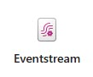


















Proposed Technical Architecture
Data Sources
Data Ingestion
Enterprise Data Platform
Visualization
Streaming Sources
1
Microsoft Fabric
Data Management
Data Governance | Data Catalog
Lineage Tracking | Data Insights
Azure Purview
Metadata Scans
Data Ingestions & Data Quality framework
Batch Sources
Fabric Lakehouse
Fabric Warehouse
Pipelines
Bronze
Silver
Gold
Silver
Fabric ​Data Factory (Data Ingestion, Batch Data)
As-Is Data
Transformed
KPI building
2
3
4
6
Curated Zone
Power BI
Raw Zone
Enriched Zone
Data from single domain. No transformations to be applied
Data Quality implemented on Data. Standardized structure as Model
Star/Snowflake schema implemented. Combination of various domains
OneLake
Integrated with Fabric, centralized data storage; ensuring seamless operation across various experiences.
Platform
MS Entra ID
Azure RBAC
Azure Monitor
Azure DevOps
Azure Key Vault
MFA

Slide 48



Future State Architecture
Data Sources
Data Ingestion
Enterprise Data Platform
Visualization
Streaming Sources
1
Microsoft Fabric
Data Management
Data Governance | Data Catalog
Lineage Tracking | Data Insights
Azure Purview
Metadata Scans
Data Ingestions & Data Quality framework
Batch Sources
Fabric Lakehouse
Fabric Warehouse
Pipelines
Bronze
Silver
Gold
Silver
As-Is Data
Transformed
KPI building
Fabric ​Data Factory (Data Ingestion, Batch Data)
2
3
4
6
Raw Zone
Enriched Zone
Curated Zone
Power BI
Data from single domain. No transformations to be applied
Data Quality implemented on Data. Standardized structure as Model
Star/Snowflake schema implemented. Combination of various domains
OneLake
Integrated with Fabric, centralized data storage; ensuring seamless operation across various experiences.
5
Data Science Platform
Predictive Analytics
ML/ AI use case
Forecasting
Version tracking, CI/CD
Synapse Data Science
8
Azure Translator
Azure Open AI
Platform
MS Entra ID
Azure RBAC
Azure Monitor
Azure DevOps
Azure Key Vault
MFA

Slide 49














Network Architecture
Data Sources
Azure Subscription
Azure Subscription
Resource Group
Network Resource Group
Streaming Sources
Hub Virtual Network
Virtual Network
AzureBastionSubnet
Private Endpoint Subnet
Compute Subnet
Azure Bastion
VNet
Peering
Private Endpoint Subnet
namespace
Vault
SHA
PBI
Batch Sources
ingestion
vault
Subnet
Purview SHIR
Compute Resource Group
Data Platform Resource Group
Power BI
Private DNS Zones
SHA VM
PBI VM
Key Vault
Event Hub
Microsoft Fabric
Purview Resource Group
Microsoft
Purview
Purview
SHIR VM
Purview Key Vault
Governance and Compliance
Azure DevOps
Azure RBAC
MS Entra ID
Azure Monitor
Microsoft Defender for Cloud

Slide 50
Architecture Components
Capability​ | Service Name​ | Usage​
Integration and ingestion | Data Factory​ | Data Factory empowers you with a modern data integration experience to ingest, prepare and transform data from a rich set of data sources.
Data Storage​ | One Lake​ | One Lake is a set of capabilities dedicated to data analytics, built on Azure Blob Storage.​
 | Fabric Lakehouse​ | It is the optimized storage layer that provides the foundation for storing data and tables in the Fabric.​
Analytics​ | Fabric Warehouse ​ | Apache Spark based engine for big data and analytics. This service can be used to build Medallion Architecture, once developed using Spark SQL/ Py Spark it shall be the backbone of the Lakehouse platform.​
Business Intelligence​ | Power BI​ | Power BI is a managed BI tool that allows creating and consuming interactive reports. All reports will be migrated/build to Power BI interactive dashboards.​
Data Governance​ | Azure Key Vault​ | Azure Key Vault is a cloud service for securely storing and accessing secrets. API keys, passwords, certificates, and cryptographic keys are examples of things you might want to keep private.​
 | Azure Monitor​ | Azure Monitor provides comprehensive cloud and on-premises monitoring for applications, infrastructure, and network.​
 | Azure AD​ | Azure AD (now Microsoft Entra ID) is a cloud-based identity and access management service that allows you to securely manage user access to various Microsoft applications and services​
 | Microsoft Purview | Azure Purview is a cloud-based data governance service that helps you manage and govern your enterprise data across on-premises, multi-cloud, and SaaS sources.
UI | Azure Web App | Azure App Service is an HTTP-based service for hosting web applications, REST APIs, and mobile back ends. You can develop in your favorite language, be it .NET, .NET Core, Java, Node.js, PHP, and Python. Applications run and scale with ease on both Windows and Linux-based environments.
AI/ML | Azure Translator | Translate text, documents across more than 100 languages with high accuracy and fluency. Ideal for applications requiring multilingual support, such as QnA chatbots.
 | Azure OpenAI Model | Access advanced capabilities of OpenAI's embeddings model for embeddings generation and large language models for tasks like text generation, translation, code generation, and answering your questions in an informative way.
 | Azure AI Search | Provides secure information retrieval at scale over user-owned content in traditional and conversational search applications.
 | Semantic Kernel | A popular open source LLM framework for Python and JavaScript/TypeScript working as an orchestrator to interact with LLMs.
 | Synapse Data Science | Provides a powerful environment for data exploration, preparation and cleansing to experimentation, modeling, model scoring and serving of predictive insights to BI reports.

Slide 51
Architecture Components- Infra
Capability​ | Service Name​ | Usage​
Networking | Azure Bastion | Azure Bastion is a fully managed service that provides more secure and seamless Remote Desktop Protocol (RDP) and Secure Shell Protocol (SSH) access to virtual machines (VMs) without any exposure through public IP addresses.
Networking | Virtual Network | An Azure Virtual Network (VNet) is a network or environment that can be used to run VMs and applications in the cloud.
Networking | Network Security Group | Azure network security group is used to filter network traffic between Azure resources in an Azure virtual network. A network security group contains security rules that allow or deny inbound network traffic to, or outbound network traffic from, several types of Azure resources.
Compute | Virtual Machine | An Azure virtual machine gives you the flexibility of virtualization without having to buy and maintain the physical hardware that runs it. It will be used to run SHIR, on-prem data gateway and will act as a Jump server.
Networking | Private Endpoint | A private endpoint is a network interface that uses a private IP address from your virtual network. This network interface connects you privately and securely to a service that's powered by Azure Private Link. By enabling a private endpoint, you're bringing the service into your virtual network.
Networking | Private DNS Zone | Azure Private DNS provides a reliable, secure DNS service to manage and resolve domain names in a virtual network without the need to add a custom DNS solution.
DevOps | Azure DevOps | Azure DevOps is a comprehensive CI/CD (Continuous Integration/Continuous Deployment) platform that facilitates efficient management of software development pipelines for both backend and frontend applications.

Slide 52
Architecture Flow
A. Data Sources
Data will be ingested from 25 university systems and 3 databases i.e. SQL Server, My SQL, Oracle, etc.
B. Data Ingestion(Extract and Load)
Historic data will be loaded from data sources to One Lake through the Fabric data factory. The daily data (incremental or snapshot) will be loaded from the sources mentioned.
If necessary, Azure Data Factory will be used to ingest the data from specific data sources.
C. Data Transformation and Modeling(Transform)
Data is fetched from Lakehouse to Fabric spark raw zone.
The Raw Zone consists of data from various sources as the single source of truth. There will be no transformations performed in the Raw Zone.
The Enriched Layer will have Data Validation and Quality checks. This data will be in a Data warehouse type model.
The Curated Zone will implement Data warehousing schema and it will be the layer consumed for BI reports.
Establishing robust data governance using Azure purview.

Slide 53
Best Practices
Define Business Objectives Clearly: Ensure that the project's objectives align with the organization's strategic goals.
Engage Stakeholders Actively: Involve business users consistently throughout the project to gain a deep understanding of their requirements.
Maintain Data Quality: Enforce robust data governance practices and quality checks to uphold data reliability.
Design for Scalability: Create solutions capable of accommodating increased data volumes and user demands
Develop Effective Data Models: Craft data models that accurately represent the business domain.
Prioritize Data Security: Implement security measures, including role-based access control and data-level security.
Continuously Optimize Performance: Regularly assess and enhance data pipelines and reports for optimal performance.
Embrace Automation: Leverage ADF to automate workflows and scheduling, minimizing manual tasks.
Handle Change Effectively: Document and communicate changes transparently to ensure seamless transitions.
Foster Documentation and Training: Maintain comprehensive documentation and provide training resources for users.
Thorough Testing and Validation: Conduct rigorous testing and engage users in acceptance testing.
Proactive Monitoring and Alerts: Set up monitoring systems and alerts to identify issues promptly.
Compliance Adherence: Ensure compliance with regulatory requirements and data privacy laws.
Measure Performance via Key Metrics: Define Key Performance Indicators (KPIs) to assess the solution's effectiveness.
Iteratively Enhance: Continuously gather feedback and make improvements to align with evolving needs.

Slide 54










Data Flow – Future State
Data Governance
Data Preparation – Silver Layer
Data Pre processing
Model Schema(EDW)
Data Catalog
Data Ingestion
Data Staging
Data Quality
Discovery with Business
Bronze Layer
Data Match Rules
Data Lineage
In Memory
Processing
Data Mart
Analytics
Data Governance
Data Survivorship
Materialistic Views
1 Descriptive Power BI report in Phase-1 (MVP). Subsequent reports will be decided during the development of Phase-1.
Data Privacy & RBAC
KPI sheet Filling
Batch Processing
RBAC
Data Cleansing
Serving Layer Ad-hoc
Policy Management
Advance Analytics
Executive View Dashboard
Financial Reports
Profitability Analysis
Cash Flow Forecast
Point of Sale Analytics
Curriculum Analytics Dashboard
Ticket Monitoring
Digital Marketing Analytics
Operational and Tactical Dashboard
Hypercare
Support
Training
Maintenance
HR Analytics , Attrition Prediction
Workforce Planning
Quality of Hire
Sales Performance Dashboard

Slide 55
Assessment Approach (Gap Analysis)

Slide 56

Assessment Approach
Scope for Infra Assessment
Access to ADCCI Subscription
Review the structure of Azure subscriptions, including resource groups, naming conventions, and tagging.
Identify and evaluate all Azure resources and services currently deployed in the client's environment.
Evaluate network configurations, including virtual networks, VPN connections, and network security groups to ensure proper communication.
Identify gaps, inconsistencies, or potential security vulnerabilities in the current Azure setup.
Identify and segregate shared services and client-specific services.
Identify and access management, role-based access control to centrally manage access for authentication and authorization for applications and End users.
Recognize and oversee centralized monitoring and alerting solutions for all service management.
Review storage configuration, redundancy, and backup solutions.
Evaluate the decision trees for any updates in their current infrastructure
Evaluate the traffic Flow between Azure services Deployed in existing Architecture
Review the Name resolution of all the service deployed in the existing Architecture
Compile all assessment findings and discuss with ADCCI Team

Slide 57
Deliverables
WORK PRODUCTS | WORK PRODUCTS DESCRIPTION | Celebal | CLIENT
High-level Project Plan | A detailed work plan including the interview and workshop schedule as well as a list of stakeholders Format: Microsoft word | Primary | Assist
Current State Overview | Reflects a summary of the current state in terms of functionality provided, architecture, application size, data usage and integration points based on the information provided Format: PowerPoint | Primary | Assist
SWOT | At the end of assessment phase, the team will create a SWOT assessment PowerPoint document that will feed the Analyze and Recommendation phases of work. S: Strength W: Weakness O: Opportunities T: Threats Format: Excel | Primary | Assist
Solution Architecture | End to End designed solution on the Cloud with moderiization state mapping with Devops, Infra and Application Deployment steps. Format : PNG | Primary | Assist

Slide 58
Deliverables
WORK PRODUCTS | WORK PRODUCTS DESCRIPTION | Celebal | CLIENT
Target State Recommendation | Recommendation on what the future state of “the system” Format: PowerPoint | Primary | Assist
Technical Gap Assessment | Technical gap assessment highlighting areas of risk and technical deficiencies of the current state based on the information provided Format: PowerPoint | Primary | Assist
High-Level Roadmap | Recommendation for a prioritized roadmap to get “the system” from the current state to the future state based on the information provided (taking into consideration technical, operational, and business readiness) Format: PowerPoint | Primary | Assist
Business case | A supporting business case that is aligned to the agreed upon roadmap Format: Excel & PowerPoint | Primary | Assist

Slide 59
Project Timelines

Slide 60
Timeline: 1/3
Task ID | Description | W0 | W1 | W2 | W3 | W4 | W5 | W6 | W7 | W8 | W9 | W10 | W11 | W12 | W13 | W14
Phase 1
1 | Onboarding and Requirement Gathering
1.1 | Onboarding of CT team in ADCCI's infra and getting all the necessary accesses resolved
1.2 | Conducting sizing activity for Production, Development and Testing​
1.3 | Restructing and providing a approach for ETL ingestion and processing framework based on discovery​
1.4 | Defining business glossary alongside BUs and Identifying and modeling RBAC​
1.5 | Document data cleansing techniques, such as outlier detection, data deduplication, and data standardization procedures.​
1.6 | Define Unit testing strategy, User acceptance testing use-cases, analysis of success criteria and code acceptance parameters​
1.7 | Documenting the findings and observations and Re-Defining the technical scope of work, if any change arise​
2 | Technical Discovery & Infrastructure Planning
2.1 | Gap Analysis, Design & Roadmap
2.1.1 | Assessment of the current system at ADCCI
2.1.2 | Details Level Assessment, Identify gaps, issues and challenges related to network security, identity and access management, Governance and Compiance, Tagging and Naming Convention
2.1.3 | Discussion on Network Requirements and Connectivity Architecture
2.1.4 | Proposing a future state roadmap covering the data analytics journey for the organization and advance analytics use cases for further phase releases
2.1.5 | Detailing out the architecture, technology landscape assessment report and recommendation
2.1.6 | Implementation roadmap including implementation services, resource requirements, and timelines etc.
2.1.7 | Develop a migration plan and cut-over strategy, ensuring a smooth transition.​
2.1.8 | Subscription Level Access
2.1.9 | Update Requirements and Design Document
2.1.10 | Solution Design Review And Sign-off
3 | Infrastructure Implementation- Develop And Deploy
3.1 | Hub (Centralized) Infrastructure setup
3.1.1 | Creation of Private DNS Zones
3.1.2 | Setup the peering between hub and Transit virtual network
3.1.3 | Creation and configuration of Microsoft Purview
3.1.4 | Setup Purview SHIR VM and Azure Key Vault for Purview
3.1.5 | Creation and configuration of private endpoints for Microsoft Purview and Key Vault
3.2 | Spoke Dev Resource Deployment
 |  |  |  |  | DEV |  | UAT |  | PROD
3.2.1 | Procure IP address CIDR block tailored for spoke virtual network
3.2.2 | Creation of the resource group
3.2.3 | Deployment and Configuration of the required networking components for the enviornment
3.2.4 | Deployment and Configuration of the required Azure PaaS services for the environment
3.2.5 | Deployment and Configuration of the private endpoint for all the azure paas services
3.2.6 | Creation of A records in Private DNS Zones in centralized location (Hub)
3.2.7 | Configuration of SHIR, SHA VM, Onprem Data Gateway and installation of required softwares
3.2.8 | Assign RBAC roles to groups or users for specific resources
3.2.9 | Creation of connections for the data source in Microsoft Fabric
3.2.10 | Setting up of Logging and Monitoring - Diagnostic Settings, Resource Health Alerts, Metric Alerts
3.2.11 | Sanity Testing of the complete environment
3.2.12 | Enable Microsoft defender for continuous monitoring, threat detection, and security recommendations

Slide 61
Timeline: 2/3
Task ID | Description | W0 | W1 | W2 | W3 | W4 | W5 | W6 | W7 | W8 | W9 | W10 | W11 | W12 | W13 | W14
Phase 1
4 | Data Platform Enablement
4.1 | Data Integration, Processing & Storage (ETL/ELT)
4.1.1 | Establish Data ingestion metadata driven Pipeline/Framework for batch and incremental load data sources.​
4.1.2 | Design mechanisms for loading processed data into the target data storage systems for Batch load and implementing incremental/delta load.​
4.1.3 | Developing Event hubs streams for streaming/near to real time data load while incorporating incremental/delta load logic on data streaming pipelines​
4.1.4 | Enable connections to Oracle, on-premises DB, cloud DB, API, JSON, streaming, FTP, MS Dynamics. & real-time sources
4.1.5 | Defining SCD and CDC as per data requirements​
4.1.6 | Design transformation logic to cleanse, validate, enrich, and aggregate data according to business requirements for data marts
4.2 | Data Quality and Validation
4.3 | Implementing the identified DQ rules, contraints, parameters and creating DQ and validation framework.
4.4 | Creating the necessary schema and one view table
4.5 | Working with sample table and synthetic data for testing the framework with wrong values
4.6 | Implementing error handling and notification rules
4.7 | Orchestrating the DQ framework by refactoring the pipelines
4.3 | Data Management & Warehousing
4.3.1 | Develop a migration plan and cut-over strategy, ensuring a smooth transition.​
4.3.2 | Develop appropriate data models, ETL pipelines, data marts, and data lakes.​
4.3.3 | Design transformation logic to cleanse, validate, enrich, and aggregate data according to business requirements for data marts
4.3.4 | Ensure scalable storage capacity, easy-to-use data import/export features, data compression and encryption, access controls, audit trails.
4.3.5 | Ensuring data readiness to be consumed by data scientist and visualization experts .
4.3.6 | Conduct initial data validation from the old architecture to the new post-migration.​
4.3.7 | Implement a data migration approach with a parallel run and validate the migrated data.
4.3.8 | Implementing fabric best practices for the development model​
4.4 | Data Governance (Data Cataloging, Profiling, Glossary)
4.4.1 | Identify attribute definitions, entity relationships
4.4.3 | Import glossary, create relationships within metadata and Associate glossary to metadata information
4.4.4 | Cataloging Metadata and Establishing a centralized repository or catalog serves as a single source of truth, where all metadata is stored and managed is essential. ​
4.4.5 | Deploy robust data encryption algorithms and access control mechanisms to safeguard sensitive information.
4.4.6 | Implementing enterprise data catalog, data governance, data security policies and access control matrix.​
4.4.7 | Include features for data lineage, audit trails, and metadata management.​
4.4.8 | Create and run historical scans to discover metadata information in Azure Purview
4.4.9 | Building associations, relationships, defining collections and curating the scanning results
4.4.10 | Classifying data assets based on their sensitivity level, business criticality, and regulatory compliance requirements.
4.4.11 | Regularly updating metadata, refreshing data assets, and retiring obsolete data assets ensure that the catalog remains accurate and up-to-date.

Slide 62
Timeline: 3/3
Task ID | Description | W0 | W1 | W2 | W3 | W4 | W5 | W6 | W7 | W8 | W9 | W10 | W11 | W12 | W13 | W14
Phase 1
5 | Azure DevOps Setup
5.1 | Creation of Azure DevOps Organization in a specific region
5.2 | Creation of Project and groups inside organization
5.3 | Initializing Repository inside Azure DevOps
5.4 | Configure Self-Hosted Agent in a Virtual Machine with required dependencies
5.5 | Installation of the required extension within the DevOps Portal for CI/CD utilization
6 | Azure Data Factory CI/CD
6.1 | Configuring service connection in Azure DevOps
6.2 | Attaching repository to ADF and commiting changes done by the developers.
6.3 | Configuring Ternary ADF for the deployment of SHIR if required
6.4 | Create Release pipeline for UATand PROD Envs
6.5 | Define deployment tasks inside release pipeline
6.6 | Configure override parameters for every linked services
6.7 | Configure pre-deployment approvals and post-deployment approvals
6.8 | Configure continuous deployment trigger
6.9 | Maintain and Running CICD Pipeline
7 | Power BI Report Wireframe, Development
7.1 | Define & Document key performance indicators (KPIs) and metrics for tracking to relevant data sources.​
7.2 | Design wireframes in Figma/Power BI containing dummy data.
7.3 | Key performance indicators (KPIs) & Wire frame sign off
7.4 | Establish connectivity between Power BI desktop & Data Sources for development
7.5 | Implement Power Query transformations within Power BI for transforming data in required format if necessary
7.6 | Design a data model that organizes and structures the data for efficient querying and analysis.
7.7 | Implement any necessary calculations or business logic within the reports using DAX (Data Analysis Expressions)
7.8 | Develop Power BI Reports Visualization
7.9 | Additional Feature Implementation such as RLS
7.1 | Publishing the report on Power BI service
7.11 | Data Validation with use cases
8 | PowerBI CI/CD
8.1 | Identify the data Sources to be parameterised
8.2 | Create app registration using Azure AD
8.3 | Grant permission to app inside PowerBI workspace
8.4 | Create Build and release pipeline for UAT and PROD Workspaces
8.5 | Cleaning up the artifact
8.6 | Updating release pipeline security to define access
8.7 | Configure pre-deployment approvals and post-deployment approvals
8.8 | Configure continuous deployment trigger
8.9 | Maintain and Running CICD Pipeline
9 | SIT, UAT and Feedback Implementation
9.1 | SIT & Validation
9.2 | End to End process testing, sanity testing, model testing
9.3 | UAT Release & Feedback Implementation
9.4 | UAT Sign-Off
10 | User Training, Documentation and Go-Live
10.1 | User Training and Documentation
10.2 | Documentation Sign-Off
10.3 | Go-Live

Slide 63
Platform Capabilities

Slide 64

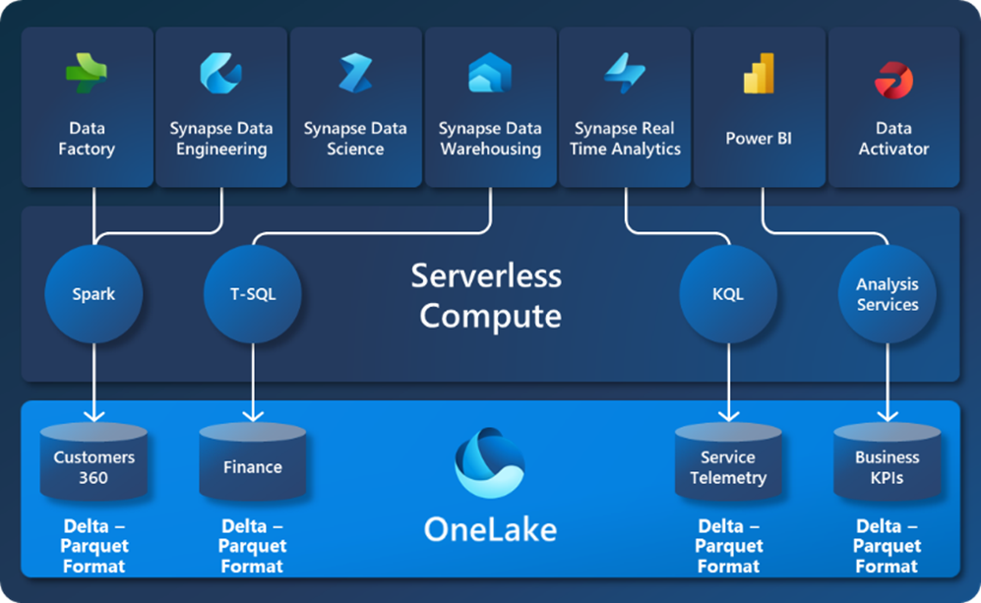




Fabric Capabilities

Slide 65




Fabric Capabilities
A single unified SaaS data lake that comes automatically provisioned with every tenant without additional infrastructure to manage
Simplicity of purchasing
Single source of truth
Maximize data investments
Open access
Simplified security
Automatically provisioned single storage service for all workloads
Bring in data from anywhere and reduce costs from data duplication by virtualizing your cross-cloud data in OneLake
Allows linking your existing third-party storage systems natively and makes it available to Microsoft Fabric analytics workloads
Open format democratizes access to multiple analytical engines, reducing additional resources needed to set up
Simplified security, governance, and data discovery in one place to reduce maintenance overhead

Slide 66


Platform Benefits
Ingest from various source
Transform data with clicks
Real-time analysis
Data Factory acts as the backbone for efficient data movement and transformation. Low-code tool makes the data movement easy for the user.
Data Wrangler Preset options for common tasks like filtering, aggregation, and joining data streamline tasks and eliminate the need for manual coding, enhances the transformation and cleaning of data easier.
KQL Borrows heavily from SQL, making it approachable for those with database experience.
Govern and classify;
Data Lineage
Don’t replicate the data
Faster BI reports
Azure Purview: Leverage pre-configured policies for common data types and regulations, speeding up implementation and ensuring compliance
OneLake Shortcuts: Objects in OneLake that point to other storage locations.
Unify your data across domains, clouds, and accounts by creating a single virtual data lake for your entire enterprise.
Direct Lake mode: Fast-path to load the data from the lake straight into the Power BI engine, ready for analysis.
Previously, Power Bi has Import and DirectQuery Mode.

Slide 67


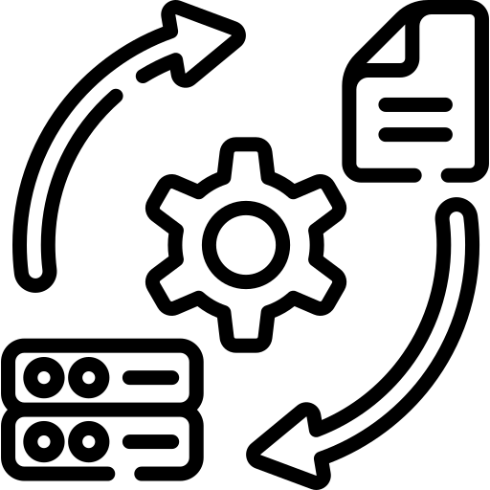

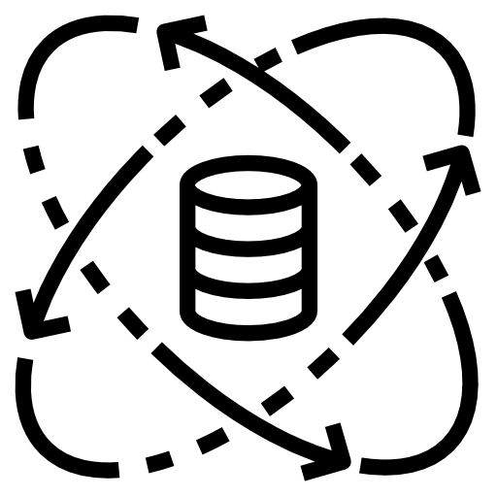






Microsoft Fabric I Unified Data Platform I Features and Outcomes
Data Engineering:
Large scale data transformation and data democratization through Lakehouse
Hybrid Deployment Options and Robust Data Pipelines
Data Factory:
More than 200 native connectors to connect to data sources combining the power of ADF and Power Query
Personalized Power BI Dashboards using Copilot
Data Science:
Build, deploy and operationalize machine learning models seamlessly
Automation and AI Integration
EKAA
Microsoft Fabric
Data Warehouse:
Provides industry leading SQL performance and scale
Real-Time Streaming Analytics & Automated Data Integration
Real-time Analytics:
Best in class engine for observational data analytics
Dynamic Report Narratives
Business Intelligence:
Access all data in Fabric quickly and intuitively to make better decisions with data using Power BI
Adaptive Security and enhanced flexibility

Slide 68








Key Highlights of Microsoft Fabric: Power of a Unified Data Platform
It's about embracing data as the driving force behind your success. So, weave the tapestry of your data journey with a Unified Data Platform using Microsoft Fabric and unlock the potential for growth, efficiency, and informed decision-making across your organization. Let's explore some of its most impactful highlights:
One Lake
Data Engineering
Data Factory
Data Science
A unified data lake for your whole organization & is designed to be the single place for all your analytics data
A unified platform for big data and data warehouse workloads, offering seamless integration, scalable processing, and advanced analytics capabilities.
A cloud-based data integration service that enables the creation, scheduling, and orchestration of data workflows for seamless ETL (Extract, Transform, Load) processes.
A cloud-based analytics service that unifies big data and data warehousing, providing an integrated environment for data preparation, exploration, and machine learning.
Data Warehousing
Real-Time Analytics
Power BI Copilot
Data Activator
A cloud-based data warehousing service that allows you to analyze and derive insights from massive volumes of structured and unstructured data.
Empowers you to analyze streaming data in real-time, providing actionable insights and facilitating rapid decision-making
Create Tailor-made reports using the power of large language models into Power BI at every layer to help you get more done and create more value from your data.
Enables you to create a system of detection that monitors analytics to drive timely human and automated actions across your organization

Slide 69
Data Governance

Slide 70

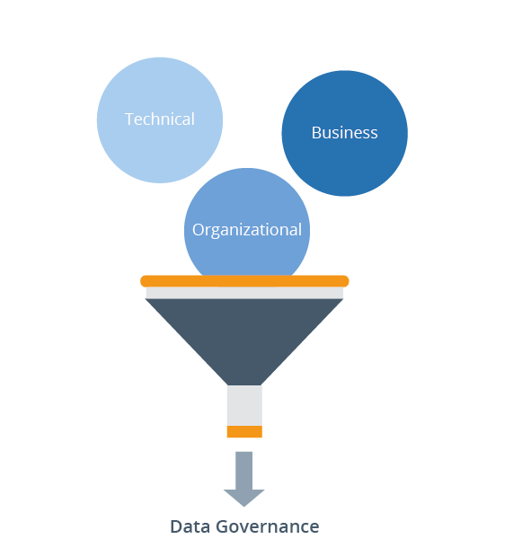





Our Principles
Making Data Governance Easier: DG Program Building Blocks
Data Quality ​
Meta Data Insights​
Data Catalog ​
Lineage Insights​
AI/ML-based Quality Checks and Data Sharing ​
Data Security​
Data Consistency​
Data Mapping and Classification​
Business Glossary​
Data Stewardship ​
Master Data Management​
Collaboration ​
Program Assessment backed by Maturity Model ​
Data Lineage​
Hybrid Ecosystem - Data & AI Governance
Microsoft Purview
Profisee
Azure ML
Open-Source

Slide 71
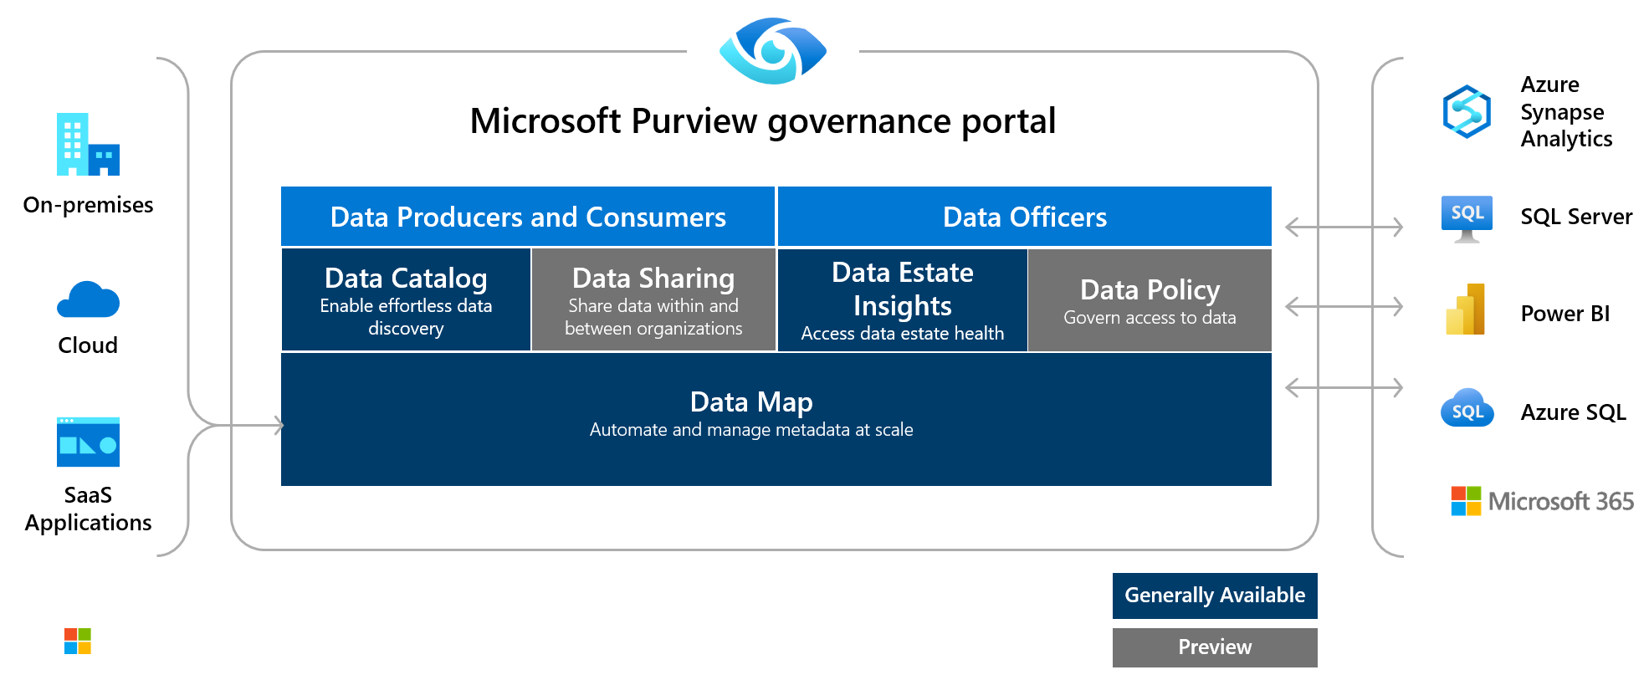
Unified Data Governance with Microsoft Purview
Microsoft Purview is a family of data governance, risk, and compliance solutions that can help your organization govern, protect, and manage your entire data estate.

Slide 72
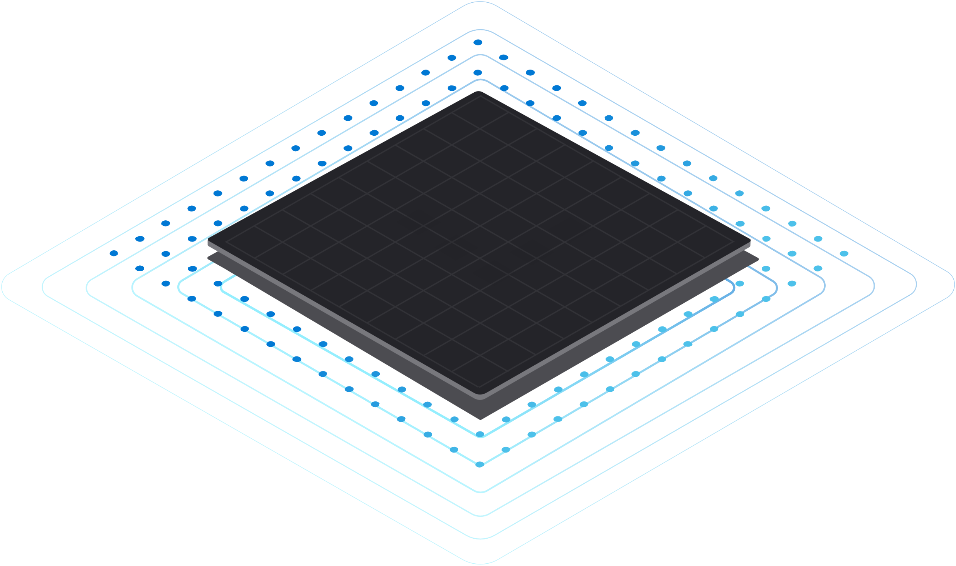

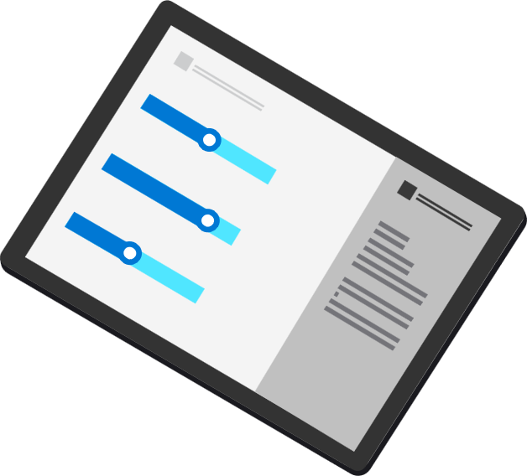
Elements of Successful Data Governance
Azure Purview
Data Insights
Manage growing data landscape
Overcome operational silos
Data Catalog
On-prem
Data Map
Multicloud
Increase data agility
Comply with industry regulations
SaaS
Notes:
Manage and govern operational, transactional and analytical data
Cloud-native, purpose-built service to address discovery and compliance needs
Fully managed, serverless, PaaS service
Eliminate manual, ad-hoc and homegrown solutions

Slide 73










Data Governance with Purview – Key Points
Architecture
Data Quality
Change Management
How well does the organization design, develop, deploy, and manage data architecture?
Is the organization able to consistently define, and measure data quality, and mitigate and data quality issues?
Are capabilities in place to adopt required organizational change and drive business value realization?
Policy
Business Rule Management
Metadata
How well does the organization define and manage organizational behavior using policy?
How well does the organization define, develop, and deploy, manage, the application of business rules across the enterprise?
How well does the organization capture, manage, and access business, technology, and operational information on key corporate data?
Organization & Stewardship
Privacy & Security
Regulation & Compliance
Are there formal organizations and roles for supporting, managing, and improving governance processes and capabilities?
Are appropriate considerations in place for protections of customer privacy and data security?
Is the organization correctly prioritizing activities to address people, process, and technology requirements for regulatory and compliance issues?
Notes:
Manage and govern operational, transactional and analytical data
Cloud-native, purpose-built service to address discovery and compliance needs
Fully managed, serverless, PaaS service
Eliminate manual, ad-hoc and homegrown solutions

Slide 74
Resources List & Profiling​

Slide 75
Resource Profile – Cloud Infra Architect
Timeline
Background
Relevant professional experience
7+ years of experience across various verticals
Experienced in Azure IaaS & PaaS components configuration and deployment
Experience in integrating 3rd party identity provider with Azure AD.
Experienced in Providing technical assistance to improve system performance, capacity and reliability scalability.
Adept at implementing industry best practices for data security, including encryption at rest and in transit, access control (RBAC), and data loss prevention (DLP).
Experienced in deployment Fabric capacity units with scabale SKUs.
Experienced in Landing Zone design implementation.
Experienced in delivering CAF workshops
UAE Government
Design and implement a secure data integration platform on Azure to consolidate patient data from disparate sources for a healthcare provider.
Role: Azure Infra Architect
Project Tasks and Accomplishments:
Designing Network architecture
Created Azure Infrastructure which include, VNet, Subnet, NSG, Storage Account and Azure AI Services
Creation of Private Endpoint of Azure Resources.
Configuration and linking of Azure private DNS Zone
Configuration of Azure Bastion
Utilized Azure Monitor for comprehensive logging and monitoring of data pipelines and resource activity.
Automating VM Start and Stop using Azure automation Account to optimize cost.
Tech Stack: Azure Firewall, Azure Monitor, Azure Bastion, Azure Virtual Network and Azure Private Link, Azure Active Directory, DNS configuration
Sports Media
The aim was to Develop a real-time data ingestion and analytics platform on Azure for a manufacturing company to monitor production lines and optimize operations.
Role: Azure Infra Architect
Project Tasks and Accomplishments:
Designing Network architecture
Created an ETL pipeline in ADF with a trigger to fetch the data from the On-premises server and loaded into Azure DataLake Gen2
Created Azure Infrastructure which include, VNet, Subnet, NSG.
Creation of Private Endpoint of Azure Resources.
Configuration and linking of Azure private DNS Zone
Configuration of Azure Bastion
Configuration of Virtual Machines based on workload
Tech Stack: Azure Data factory, Virtual Machine, Private Endpoints.
Certifications
Microsoft Azure Administrator(AZ-104) Microsoft Azure Security Engineer Associate (AZ-500)
Microsoft Azure Solution Architect (AZ-305)
Microsoft Azure Network Engineer (AZ-700)
Skills
Knowledge of Azure Infrastructure and Networking
Knowledge about Cloud Adoption Framework and Zero Trust Model.
Knowledge of Azure Data Platform Implementation Landing Zone
Infrastructure design and architecture
VPN Setup and Configurations
Securing ETL operations
Security and performance monitoring
Security, Governance and compliance best practice
Azure DevOps, CI/CD, Git
Azure Active Directory, Azure AD DS
Azure PaaS Services (Azure Data factory, Storage Accounts, Key vault, etc)
VDI and Azure WVD Configuration and deployment
Infrastructure design and architecture
DNS and name resolution setup for enterprises
Indian Largest Retail Company
The primary objective was to Migrate a legacy on-premises data lake to a secure and scalable Azure environment for a large retail chain.
Role: Azure Infra Architect
Project Tasks and Accomplishments:
Creation of ADF Pipeline for fetching data from Sharepoint
Created Azure Infrastructure with Hub Spoke Network Topology
Creation of Private endpoint of Azure resources
Designed and implemented a secure data lake architecture leveraging Azure Storage Accounts with customer-managed keys for encryption at rest.
Configuration and linking of Azure private DNS Zone
Setup S2S between on-premise and azure with best practices.
Tech Stack: Azure Data Lake Gen2 , Azure Data Factory, VPN setup, DNS
Indian Fashion Store Company
This project required providing the guideline for the development of ETL solutions with best practice with the Data Platform implementation of Azure Data Landing Zone for the Dev & Prod environment .
Role: Azure Infra engineer
Project Tasks and Accomplishments:
Creation of Data Landing Zone architecture including Networking, Data Platform and Data governance components.
Creation of Private endpoint of Azure resources
Configuration and linking of Azure private DNS Zone
Configuration of Azure Self Hosted Integration Runtime
Deployment and configuration of On-premises data gateway
Tech Stack: VNG , DNS Zone, DNS, Azure private Link, SHIR, ADF

Slide 76
Resource Profile – Cloud Infra Engineer
Background
Relevant professional experience
4+ years of experience across various verticals
Experienced in Azure IaaS, PaaS and SaaS components configuration and deployment
Experience in providing security and private connectivity to azure services .
Experienced in Providing technical assistance to improve system performance, capacity and reliability scalability.
Experienced in configuring connectivity between on-premises and azure cloud.
Experienced in configuring virtualized Environment (Hyper-V).
Experienced in configuration of networking and security components like VPN and firewall.
Experienced in configuring Data Factory and storage account and managing them.
Experienced in deployment of Microsoft Fabric maintaining private connectivity.
Experienced to monitor and manage cost analysis and logs on Azure.
India’s biggest Fertilizer-Manufacturing company
This project’s aim was to Integrate data from on-premises and cloud sources for a holistic business view while ensuring robust security and compliance.
Role: Azure Infra Engineer
Project Tasks and Accomplishments:
Assessment and discovery of On-Premises data sources.
Creating networking architecture.
Creating pre-requisites and access requirement sheet
Created a newly un-used virtual network with the required subnets including a dedicated subnet for app service.
Configuration of Site-to-site tunnel between on-premises and azure.
Deployment of Azure PaaS resources with private endpoints.
Establish connectivity between on-premise data sources with Azure to fetch their data.
Providing access to Azure services and users.
Configure private connectivity between Azure resources by providing managed identities.
Tech Stack: Infrastructure deployment, creating architecture with best practices.
An Auto Mobile Company
This project was related to Fabric where users integrate with existing enhanced data accessibility and analytics capabilities for business intelligence while prioritizing data security. Role: Azure Architect
Project Tasks and Accomplishments:
Creating networking architecture based on requirement gathering.
Implemented Microsoft Fabric for streamlined data access and analysis across diverse data sources. Employed private endpoints for Fabric to ensure secure communication within the vNet perimeter..
Providing security using Azure key vault by storing passwords or connection strings in secrets.
Configuring private connectivity by using endpoints and managed identities.
Provide required RBAC to the Azure services ad respective users.
Tech Stack: Azure Data factory, Microsoft Fabric, Azure Key vault
Certifications
Microsoft Azure Administrator(AZ-104) Microsoft Azure Security Engineer Associate (AZ-500)
Microsoft Azure Solution Architect (AZ-303 | AZ-304)
Microsoft Azure Network Engineer (AZ-700)
Microsoft 365 Security Administration (AZ-500)
Skills
Knowledge of Azure Infrastructure and Networking
VDC Setup and DNS resolution
VPN Setup and Configurations
PaaS integration and web hosting
Security and performance monitoring
Cost monitoring and logs monitoring
Security, Governance and compliance best practice
Working on Azure Data Factory and setting up connectivity from data sources to ADF.
DNS and name resolution setup for enterprises
Azure DevOps, CI/CD, Git
Azure Active Directory, Azure AD DS
Hyper-V Virtualization
Azure PaaS Services.
Azure Monitor
VDI and Azure WVD Configuration and deployment
Security including Microsoft Defender for cloud
Key vault and logic Apps
India’s biggest Airline company
This project was focused to Migrate a data warehouse on-premises to Azure while maintaining a high level of security and data privacy..
Role: Azure Infra Engineer
Project Tasks and Accomplishments:
Analysing on-premises data sources in requirement gathering and creating network architecture.
Creation of S2S tunnel between Azure and On-premises Server using Azure VPN gateway
Configured Azure Firewall within the vNet to further restrict inbound and outbound traffic.
Configuration of SHIR on Virtual Machine
Providing required access to PaaS services and users and establish private connectivity between azure resources .
Tech Stack: Azure Networking, Setup Infrastrucuture, Monitoring logs and cost management.
India’s biggest Paint Company
This project is related to DPI project where we are fetching data from their on-premise SAP service and using Data Factory and other PaaS services.
Role: Azure Network engineer
Project Tasks and Accomplishments:
Setup S2S between on-premise and azure.
Creation of Private endpoint of Azure resources
Configuration and linking of Azure private DNS Zone
Deployment of DNS Resolver In Azure VNet
Configuration of Azure Self-Hosted Integration Runtime for fetching data from SAP
Tech Stack: Express route, VPN, Azure private Link, SHIR, ADF, DNS configuration, VPN

Slide 77
Resource Profile – Data Engineer
Professional Experience
Data Engineer at Celebal Technologies.
He has over 4+ years of experience in SQL Server, data modelling, Azure Data Factory (ADF), Data Bricks, Microsoft Azure and Fabric
He holds Bachelor’s Degree in Mechanical Engineering.
He has previously worked on ADF, DataBricks SQL Data Warehousing Data Modelling, and ETL.
Manufacturing Company
Role: SQL Developer/ETL Developer
Date : Mar 2021 – Aug 2022
SAP Integration
Project Tasks and Accomplishments:
Integrated SAP system with the help Azure data factory which feeds us with meaningful insights into business processes
Data modelling.
Designed and developing ETL pipelined/jobs.
Works on Azure synapse (Views, Store Procedures, Functions)
Technologies Used: ADF/synapse
Chemical Manufacturing
Role: Data Engineer
Pick the data from SAP through ADF and load it to ADLS.
Inject data to Databricks through the ADF pipeline.
Perform migration of SAP in databricks.
Developed the SAP Hana view in databricks.
Developed BEX in Databricks with the help of SQL and python.
Apply best optimization techinc in databricks.
Technologies Used: ADF, Data Bricks,SQL,SAP
Projects
CT-SAP Surround Initiatives
Role: Data Engineer
Pick the data from SAP through ADF and load it to ADLS.
Send data to Databricks through the ADF pipeline.
Load the data in Databricks and perform ETL with the help of SQL and Py-spark.
Send data to synapse
Technologies Used: ADF, Data Bricks,SQL
Retail Company
Analysed, designed and implemented solutions based on the technical requirements.
Developed ETL Jobs using Sales Data and SQL scripts.
Role: SQL Developer/ETL Developer/Team lead
Date : JAN 2019 – Dec-2019
Project Tasks :
Responsible for maintaining quality reference data in SQL by performing operations such as cleaning, transformation, and ensuring Integrity in a relational environment
Implemented overall sales perspective for a Pharma Company.
Created Stored procedures and views For Error Handling And Data duplicity of Data.(Developed and Optimized Stored Procedures and Functions using T-SQL)
Used ADF to Create a pipeline that imports the data from ADF to the SQL server.
Created Staging and ODS Layer.
Created Dimension Views.
Maintain a repository for all required project documents.
Technologies Used: T-SQL, ADF,SSAS,SSIS
Pharmaceutical Company
Role: Data Engineer
Pick the data from SAP through ADF and load it to ADLS.
Built incremental pipelines in ADF.
Inject data to Databricks through the ADF pipeline.
Developed the T-code and ABAP code in Databricks.and Postgres.
Send developed code output to qlik developer through Databricks connectivity.
Optimized the table present in Delta Lake.
Apply best-optimized technic in code and Databricks notebook.
Technologies Used: ADF, Databricks,
Postgres,Qlik
Manufacturing Company
Role: Data Engineer
Project Tasks and Accomplishments:
Worked on Data Modelling
Worked on ETL (Extract Transform Load)
Worked on SQL Server (Views, Store Procedures, Functions, Indexes)
Technologies Used: ADF/Synapse/ Data Bricks

Slide 78
Resource Profile – DevOps Engineer
Professional Summary
Relevant Professional Experience
DevOps Engineer with 4+ years of experience in Azure DevOps Services.
Responsible for Continuous Integration (CI) and Continuous Delivery (CD) process implementation using Azure DevOps to automate routine jobs.
Responsible for configuring ADF CI-CD with Azure DevOps.
Responsible for configuring Databricks CI-CD pipeline with Azure DevOps.
Responsible for configuring CI-CD pipeline for deploying AKS cluster.
Clothing Brand
Role: DevOps Engineer
Technologies Used: Azure DevOps Service, Docker, Kubernetes, GIT.
Roles and Responsibilities:
Work with the product development team to resolve build-related issues in the application.
Performed and deployed Builds for various environments Productions QA, Integration, UAT.
Used GIT for source code version control and integrated code quality tracking and build tools like Maven.
Manage the integration of new software projects and products into the built environment.
Used different namespaces for different environments also configured RBAC.
Manage the integration of new software projects and products into the built environment.
Created various build and release pipelines on Azure DevOps Services for the project with manual approvals needed to deploy on the production environment.
Telecom Company
Role: DevOps Engineer
Technologies Used: Azure DevOps Services, Azure Databricks.
Roles and Responsibilities:
Automated build and deployment using Azure DevOps Service to reduce human error and speed up production processes.
Responsible for Continuous Integration (CI) and Continuous Delivery (CD) process implementation using Azure DevOps Services to automate routine jobs.
Configured and deployed Notebooks in Azure Databricks using Azure DevOps Services for Different environments like Dev, QA and Prod.
Used Pipeline Variables to store the value of token for the secret storage in Azure DevOps services.
Configured and deployed builds and releases for testing environments.
Created various build and release pipelines on Azure DevOps Services for the project with automatic deployments using triggers.
Skills
Azure Cloud
Azure DevOps Services
Azure Databricks
Azure Data Factory
Kubernetes
Docker
GIT

Slide 79
Resource Profile – DevOps Engineer
Manufacturing company
Role: DevOps Engineer
Technologies Used: Azure DevOps Services. Docker, Kubernetes and GIT.
Roles and Responsibilities:
Work with the product development team to resolve build-related issues in the application.
Performed and deployed Builds for various environments Productions QA, Integration, UAT.
Used GIT for source code version control and integrated, code quality tracking and build tools like Maven.
Manage the integration of new software projects and products into the built environment.
Writing Docker files for making docker images of the application and pushing that on on-premises Docker Registry.
Installed and managed Kubernetes cluster and write deployment files.
Created various build and release pipelines on Azure DevOps Services for the project with manual approvals needed to deploy on the production environment.
Real Estate Client
Role: DevOps Engineer
Technologies Used: Azure DevOps Services, Azure Data Factory.
Roles and Responsibilities:
Automated build and deployment using Azure DevOps Service to reduce human error and speed up production processes.
Responsible for Continuous Integration (CI) and Continuous Delivery (CD) process implementation using Azure DevOps Services to automate routine jobs.
Configured Azure Data Factory for the various environments like Dev, QA, and Prod.
Configured and deployed builds and releases for testing environments.
Created various build and release pipelines on Azure DevOps Services for the project with automatic deployments using triggers.

Slide 80
Resource Profile – Chatbot Developer
RFP Generator (Government Entities & Public Services)
Role: NLP Engineer
Project Description: The project aims to streamline the creation of Request for Proposal (RFP) documents using advanced NLP technology, enhancing efficiency and accuracy in vendor selection.
Roles and Responsibilities:
Collaborate closely with stakeholders to gather detailed functional and technical requirements for the RFP Generator solution.
Develop a comprehensive design and architecture plan for the RFP Generator and Proposal Evaluator Solution, leveraging Azure Services.
Implement the RFP Generator functionality, utilizing GPT-4 for content creation and customization features.
Develop an Azure Cognitive Search system to efficiently retrieve old RFP documents, utilizing semantic search techniques to enhance document relevance.
Ensure that the generated RFPs align with the organization's branding and style, providing a cohesive and professional appearance.
Collaborate with cross-functional teams to integrate the RFP Generator into organizational workflows and systems, ensuring seamless usability and functionality.
Proposal Generator and RFP evaluation Government Entities & Public Services)
Role: NLP Engineer
Project Description: The project aims to streamline the evaluation of Proposal documents using advanced NLP technology, enhancing efficiency and accuracy in vendor selection and also creating a model that helps in proposal generation.
Roles and Responsibilities:
Collaborate closely with stakeholders to gather detailed functional and technical requirements for the RFP Generator solution.
Develop a comprehensive design and architecture plan for the Proposal Generator and Proposal Evaluator Solution, leveraging Azure Services.
Implement the Proposal Generator functionality, utilizing GPT-4 for content creation and customization features.
Develop an Azure Cognitive Search system to efficiently retrieve old RFP documents, utilizing semantic search techniques to enhance document relevance.
Ensure that the generated RFPs align with the organization's branding and style, providing a cohesive and professional appearance.
Collaborate with cross-functional teams to integrate the RFP Generator into organizational workflows and systems, ensuring seamless usability and functionality.
Clothing Brand
Role: AI/ML Engineer
Technologies Used: Azure OpenAI service, Python, Microsoft Fabric
Roles and Responsibilities:
Successfully executed data generation tasks using Python.
Utilized the Azure OpenAI's GPT-3.5-Turbo model through API integration for marketing content creation.
Employed prompt engineering methodologies including cues, Few-shot learning, Chain of thought and ReAct to enhance the efficiency of content generation.
Leveraged functionalities of Microsoft Fabric, such as Data Wrangler for low-code data manipulation, and Data Factory for constructing pipelines to fetch data from various sources like ADLS.
Leveraged the Auto Create Report feature within Microsoft Fabric's ecosystem to automatically generate Power BI reports, drawing insights from the provided semantics model.
Utilized Flask to implement a user-friendly interface for the display of both generated content and Power BI reports.

Slide 81
Resource Profile – Chatbot Developer
Background
Relevant professional experience
OpenAI (NLP) Engineer with over 6+ years of hands-on experience specializing in Natural Language Processing (NLP) and AI-driven solutions.
Proficient in the end-to-end NLP model development process, including text preprocessing, feature engineering, model training, and deployment. Well-versed in Generative AI models, including GPT-3 and its variants, Codex models, etc.
Skilled in implementing cutting-edge OpenAI algorithms and techniques, including advanced prompt engineering methods like RAG Pattern, Chain of Thoughts, and vector search algorithms.
Expertise in generating embeddings and leveraging them for tasks such as semantic search, document clustering, and recommendation systems.
CT-Miner: Automated Knowledge Mining System
Role: NLP Engineer
Project Description: CT-Miner, an Automated Knowledge Mining System, leverages Azure Form Recognizer, Azure Cognitive Search, and other modules for data extraction, entity extraction, document retrieval, text summarization, and Q&A. It employs advanced NLP techniques to analyze unstructured data, extract insights, and serves as an Enterprise Knowledge Advisor to enhance decision-making and overall performance.
Roles & Responsibilities
Collaborate in project initiation, requirements gathering, and technical analysis to define AI-driven objectives.
Develop and fine-tune models for data extraction, entity recognition, text summarization, and question-answering using OpenAI’s APIs and tools.
Implement Retrieval Augmented Generation techniques to enhance the quality of generated responses and query recommendations within the CT-Miner system.
Contribute to the development and refinement of Langchain LLM Agents, utilizing advanced NLP techniques to improve language understanding and generation capabilities.
Collaborate with cross-functional teams, including front-end developers, to ensure seamless integration of NLP functionalities and user-friendly interactions within the CT-Miner system.
Intelligent Search Engine (Insurance Services)
Role: NLP Engineer
Project Description: This project focuses on developing an Intelligent Search Engine, powered by artificial intelligence and advanced search technologies, to deliver a personalized and seamless search experience. The goal is to empower customers to swiftly and efficiently locate information, products, and services, while also enriching the search experience with features including translations, voice search, trending searches, and search history.
Roles & Responsibilities
Design and establish scraping pipelines on Azure Virtual Machines (VMs) for efficient data retrieval from sitemaps.
Utilize the Azure OpenAI Ada Model to generate embeddings for unstructured textual data extracted during scraping and PDF data extraction phases.
Ensure that scraped data stored within Azure Cosmos DB is effectively indexed and organized to serve as the primary source for Azure Cognitive Search.
Configure and manage Azure Container Instance hosting a Redis Container for conducting vector searches between query embeddings and embeddings fetched from Azure Cosmos DB.
Collaborate on the development of prompts that utilize Azure OpenAI LLM to generate text responses for search queries, using the most relevant sections as context.
Design features for storing and presenting search history to users, enabling them to revisit past searches, and consider user profiles for enhancing personalization.
Certifications
Microsoft Certified: Azure Fundamentals (AZ-900)
Microsoft Certified: Azure Administrator Associate (AZ-104)
Microsoft Certified: Azure DevOps Engineer Expert (AZ-400)
Microsoft Certified: Azure Solutions Architect Expert (AZ-303 )
Microsoft Certified: Azure AI Engineer Associate (AI-100)
Skills
Languages: Python
Cloud Services: Azure
Database: Azure Cosmos DB, Azure SQL Server
Libraries & Frameworks: Azure OpenAI, Langchain, Redis, Gensim, SciPy, Pandas, Matplotlib, Plotly, Seaborn, TensorFlow, Keras, Bot Framework, AI Search.

Slide 82
Resource Profile – ML Engineer
Background
Roles and Responsibilities
ML Engineer with 4+ years of broad-based experience in building data-driven solutions, Overcoming complex architectural and scalability in diverse industries.
Proficient in predictive modelling, Data Processing, Data visualization and data mining algorithms in scripting language Python.
Strong Base in generalizing MLOPS concept in various use cases using azure services and CI/CD pipelines with proper functionality in azure Devops and Github actions
Proficient in building robust Machine Learning and Deep Learning models on large datasets using Azure Cloud Services and Amazon Web Services (AWS).
Hands on synapse analytics data transformation pipeline for ETL Jobs.
Participated in requirement gathering and technical
Analysis during the project lifecycle.
Scraped articles from data sources and make a general logic of scraping by analyses on over 200 websites
Made a scalable machine to run the concurrent Jobs of scraping
Feature engineering for machine learning models.
labelled the collected data and made a classification model for category
Deployed machine learning model on azure Kubernetes server.
Implemented Logging and monitoring using azure monitor.
Used Azure MLOps and CI/CD Pipelines to automate the training.
PREDICTIVE LEAD SCORING
Role: Senior ML Engineer
Project Tasks and Accomplishments:
Implemented lead scoring for online and offline leads.
Several data pre-processing and data transformation techniques before feature engineering in which we feature engineered around 5-10 new features.
Performed EDA on data with more than 2 crore rows and more than 300 columns.
Created customized loss function to increase
Performance of machine learning model, after deploying our solution customers lead
conversion rate increased 5 times that is from 3% to 15% in initial phase
Certificates
Microsoft Certified: Azure AI Engineer Associate
Microsoft Certified: Azure Machine Learning Engineer Associate
Microsoft Certified: AI-900: Microsoft Azure AI Fundamentals
Microsoft Certified: Azure Machine Learning Specialty
Skills
Languages: Python 3.8
Tools: Github, Github Actions, Azure Devops, Azure ML Studio
Gitlab Runner, Gitlab CI/CD, Azure Synapse Analytics
Cloud Services: Azure, Amazon Web Services
Database: MySQL, Azure Cosmos DB, Azure Blob Storage
Libraries: PySpark, NumPy, SciPy, Pandas, Matplotlib, Plotly, Seaborn,
Scikit Learn, PyTorch
Deployment: Azure Kubernetes Service, Azure Container Instances• Real time calls streams are received through web-sockets, where audio analysis
Other: Kafka, Azure Functions, Linux, Azure Data Factory

Slide 83
Resource Profile – Data Scientist
Background
Data Scientist with 3+ years of broad-based experience in building data-driven solutions, overcoming complex architectural and scalability in diverse industries.
Proficient in predictive modelling, data processing and data visualization using Python.
Experienced in utilizing various statistical techniques in order to analyze and solve machine learning problems.
Expertized in Python data extraction and data manipulation, and widely used python libraries like Scikit-Learn,PyTorch,Keras,NumPy, Pandas, and Matplotlib for modelling and data analysis.
Hands-on experience with various cloud services of Azure which includes Azure Machine Learning Studio, LUIS, and Cognitive Services of Azure.
Worked with consultancies, manufacturing, and BFSI clients and provided them extensive solutions.
CUSTOMER CHURN PREDICTION
Client: Retailer
Role: Data Scientist
Employee Attrition
Client: Corporate Sector
Role: Data Scientist
Project Description: The goal of this project was to predict and identify the customers who are at high risk of churning out based
on historical data.
Roles and Responsibilities:
Participated in requirement gathering and technical analysis during the project lifecycle.
Analyzed historical sales data using Exploratory Data Analysis and finding out patterns and insights.
Feature engineering for machine learning models was done to aid the training process
Predicted the set of customers who are at a high risk of churning out, with predictive analytics machine learning models based on historic sales data.
Controlling of changes in the sales process led to reduced customer churn and competitive advantages through increased sales effectiveness & improved customer retention period.
Deployed machine learning model on Azure Kubernetes server.
Implemented Logging and monitoring using Azure monitor.
Brainstormed on the requirement gathering and developing the project lifecycle on ML Studio platform.
Used statistical techniques to identify important features and also to get more insights about the dataset
Perform some feature engineering and statistical round of calls with client to eliminate the non relevant features.
Used ML studio platform to develop the Models using clusters.
Registered the models in model registry and used the latest versioned models for deployment.
Model retraining pipeline was made in AML that train the models every month
Certifications
Microsoft Certified: Azure Data Scientist
Microsoft Certified: Azure Data Scientist Associate
Microsoft Certified: Azure Machine Learning Engineer Associate (DP-200 | DP-201):
Languages: Python, JavaScript
Cloud Services: Azure
Database: MySQL, Azure SQL Server, MongoDB
Libraries: Keras, PyTorch , NumPy, Pandas, Scikitlearn, Matplotlib, Seaborn, Selenium, Flask
NLP Libraries: Spacy, NLTK
Other: GitHub, Linux
Skills

Slide 84
Resource Profile – Power BI Developer
Background
Relevant professional experience
Over 6 years of specialized experience as a results-oriented BI Consultant in Microsoft Power BI.
Certified as a Microsoft Certified Data Analyst.
Expertise in Power BI Premium setup, optimization, and best practices.
Proficient in the CRISP-DM methodology.
Thrives in collaborative, cross-functional environments and consistently meets tight deadlines through effective teamwork.
Advanced skills in crafting sophisticated Advanced-Data Expression Analytics (DAX), leveraging AI features for insightful report creation, and committed to excellence in seamless Row-level security integration, upholding data privacy in the evolving business landscape.
Energy
Enhanced reports with incremental logic, KPIs, self-serve training, improved UX/UI, secure data gateway, Power BI Premium.
Role: Sr. Power BI Developer
Project Tasks and Accomplishments:
Generated progressive team reports and consolidated summaries for senior management.
Focused Dashboard KPI’s related to Energy Production Metrics, Operational Efficiency, Cost Metrics, Environmental Impact, Grid Performance
Implemented a secure Data Gateway in Power BI.
Empowered various teams within the organization to make more informed and prompt decisions through the utilization of data-driven reports.
Tech Stack: Power BI and Cosmos DB
Supply Chain
Imported Azure Synapse SQL data, designed supply chain dashboard.
Role: Sr. Power BI Developer
Project Tasks and Accomplishments:
Imported data from Azure Synapse SQL​.
Developed user-friendly Dashboard incorporating major KPI’s related to supply chain covering Inventory Management, Sales & Delivery and Returns.
Collaborated closely with departments in both inventory and sales to formulate KPIs to their specific needs.
Discussed and provided with the access to the stake holders depending upon there Hierarchy.​
Helped client in resolving issues and bottle necks in the data flow.​
Tech Stack: Power BI, SQL and Azure Synapse
Certifications
Microsoft Power BI Data Analyst (PL-300)
Azure Fundamentals (AZ-900)
Skills
Financial Firm
Developed KPIs from Chatbot logs, built interactive Power BI dashboard, and bilingual support.
Role: Sr. Power BI Developer
Project Tasks and Accomplishments:
Understanding of logs and building KPIs that were generated by different Chatbots.
Build an interactive Dashboard to provide insights on the performance and consumption of the Chatbot across the organization.
Implemented Cross report drill-through so that users can navigate between reports with just a click enhancing the performance of the Report.
Provided bilingual Dashboard in English & Arabic.
Tech Stack : Power BI and Cosmos DB
International Telecommunication Company
Create reports, merge databases and enhance logic.
Role: Sr. Power BI Developer
Project Tasks and Accomplishments:
Participated in requirement gathering & technical analysis during the project life cycle.​
Suggesting Power BI features to the clients enabling them to use Power BI’s latest features​.
Worked with client feedbacks to make custom Power BI report for their consumption
Leveraged various custom visuals to present information in an interactive and engaging manner.
Reports designed to accommodate both English and Arabic-speaking users seamlessly
Tech Stack: Power BI, SQL
Power BI
Power BI Embedding
Power BI Report Builder
SSMS
Python
Azure Fundamentals
Azure Data Factory

Slide 85
Resource Profile – Power BI Developer
Background
Relevant professional experience
2.5+ years experience in development using Microsoft Power BI.
Expert in using AI Features of Power BI to create insightful reports such as smart narrative and key influencers.
Collaborating with users to develop optimal data visualizations that enhance organizational insights and expedite decision-making processes with greater efficiency and effectiveness.
Expertise in writing complex DAX calculations and delivering high quality code, ensuring good performance with large datasets.
I Have setup of Power BI best practices and optimization guidelines for clients.
Good Understanding of the Financial KPIs​
Expertise creating Mobile layout in Power BI.
BFSI
Project modernized client's BI landscape for timely data delivery, empowering stakeholders with informed decision-making.
Role: Power BI Developer
Project Tasks and Accomplishments:
Created reports for Financial Ratio and Stock Analysis data.
Applied drill through, drill down, bookmarks, and many more features.
Applied multiple hierarchies to show data from the top level to the most granular level.
Created dashboard on power BI service, app, and mobile view for users.
Implemented secure Data Gateway.
Tech Stack: Power BI and SSMS
Telecommunication Company
Integrated multiple sources - SQL, Flat-files and OneDrive. To create reports for Core Teams.
Role: Power BI Developer
Project Tasks and Accomplishments:
Participated in technical analysis and requirements gathering throughout project lifecycle.
Engaged in activities such as report optimization, unit testing, conducting peer report reviews, and ensuring the maintenance of high report quality standards.
Successfully implemented a composite model in Power BI, seamlessly combining the advantages of both direct query and import mode.
Slicing and Dicing functionalities for choosing of Various Drill Down.
Tech Stack: Power BI and Cosmos DB
Certifications
Microsoft Power BI Data Analyst (PL-300)
Skills
Power BI
Tableau
SSMS
Power BI report builder
Security Services Company
Created multiple reports, merged databases, enhanced logic and efficiency.
Role: Power BI Developer
Project Tasks and Accomplishments:
Analyzed document workflow, create insightful reports for each stage.
Enhanced UI for better user experience.
Deployed mobile versions of reports.
Setup Alerts and Email Subscriptions for monitoring reports.
Implemented cross-report drill-through to enhance report navigation and performance.
Tech Stack : Power BI and Sharepoint
International Telecommunication Company
PBI implementation for several internal departments.
Role: Power BI Developer
Project Tasks and Accomplishments:
Transformed unstructured data into a structured format and subsequently designed a dashboard that meets business requirements.
Worked on report optimization, unit testing, peer report review , and maintaining report quality.
Leveraged various custom visuals to present information interactively and engagingly.
Reports designed to accommodate both English and Arabic-speaking users seamlessly.
Tech Stack: Power BI and SSMS

Slide 86
Resource Profile – Power BI Developer
Background
Relevant professional experience
A skilled BI Developer with 2.5 years of experience in delivering end-to-end business intelligence solutions
Extensive experience in ETL processes, data integration, and data quality assurance.
Utilized Power BI to create data model and various analytical dashboards and reports that depict critical KPIs.
Strong experience in design, development, management and analysis of databases, and implementation, reports and Dashboard development.
Familiar with Power BI Embedded.
Created Dynamic Visuals as per the Client Requirements.
Expertise in using advanced level calculations on the dataset.
Hands on experience on writing SQL queries.​
Expertise in writing complex DAX calculations and delivering high quality code, ensuring good performance with large datasets.
International Telecommunication Company
Working on Customer Sentiment & post call analysis
Role: Power BI Developer & UI Developer
Project Tasks and Accomplishments:
Took part in technical analysis and requirement collecting over the course of the project.​
Recommending Power BI features to clients so they can take advantage of the most recent features available.
I worked on maintaining report quality, peer review, unit testing, and report optimization.​
Created a custom Power BI report based on input from clients for their use.
Reports created to easily accommodate customers who speak Arabic and English
To create entire dashboards from the ground up, including connecting to data sources, putting ETL procedures into place, designing visual elements, and publishing the finished reports.
Convert unstructured data (audio) into a structured text format, then create a dashboard that satisfies the client's unique needs.
Tech Stack: Power BI​ & Figma
Pharmaceutical Company
Developed a series of comprehensive reports on the ASM level to provide detailed insights and enhance understanding.
Role: Power BI Developer
Project Tasks and Accomplishments:
Enhance dashboards to ensure a smooth and uninterrupted flow of data.
Data was imported from SSMS via Direct and Import mode and utilized to create a dashboard.
Scheduled Automatic refresh and scheduling refresh in Power BI service.​
Create a Custom Gauge Chart for their program performance
Responsible for imparting functional domain and technical knowledge to team members and organizing scrum calls
Generated detailed reports at a transactional level incorporating incremental logic for the core team, while providing aggregated reports tailored for top management, all derived from shared datasets.
Tech Stack: Power BI​ & SSMS
Certifications
Power BI Data Analyst Associate(PL-300) Microsoft Azure Fundamentals (AZ-900)
Power BI
Python
SSMS
Power BI report builder
ADF
Group entity leading in BFSI sector.
Created multiple reports for Banking and Finance data
Role: Power BI Developer
Project Tasks and Accomplishments:
Contributed to setting up the entire environment for Power BI and Created dynamic measures and title in reports.
Accountable for transferring both functional domain expertise and technical knowledge to team members while coordinating and facilitating scrum calls.
Also worked on code optimization, unit testing, peer code review and maintaining code quality.
Played a proactive role, regular adaptation and refinement of reports were undertaken to align with the specific daily requirements of clients.
Implemented a Dynamic Row Level Security, secure Data & Gateway for the bank to facilitate the safe transmission of on-premise data within Power BI. Deployed Power BI Premium within the organization, following industry-leading best practices.​
Tech Stack: Power BI​ & Sharepoint
Employee Attrition Report
This HR Recruitment report for India's premier recruitment company offers meticulous analysis of data from multiple channels, focusing on offers, jobs, open positions, and Turnaround Time (TAT). Internal reports also cover Attrition and Retention Analysis, aiding talent management decision-making.
Role: Power BI Developer
Project Tasks and Accomplishments:
Participated in technical and previous report analysis during the project life cycle.​ Imported data from SSMS Database.
Interacted with users and delivered the results up to their requirements.​
Created various Power BI Reports involving a variety of features like Slicers, Bookmarks, Buttons, Selections, Sync Slicers, and Drill-through page features in Power BI.
Implemented Row Level Security as part of security.
Established Scheduled Refresh to update the data in the report automatically.​
Tech Stack: Power BI​ & Azure Synapse
Skills

Slide 87
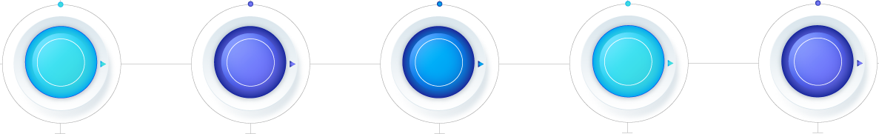





Resource Pool with CT
200+
300+
250+
800+
100+
Azure Infra Team
Data Platform
PBI skilled team
AI Team
Network & Security
Celebal Tech, with its global presence and diverse clientele, strategically maintains a dynamic talent pool comprising 7 to 10% of its workforce. This resourceful bench not only facilitates seamless onboarding for new projects but also serves as a reservoir for expansion initiatives. With the agility to align resources, both English and Arabic speaking within a week following business approvals, we ensure swift adaptability and readiness to meet evolving demands and opportunities.

Slide 88
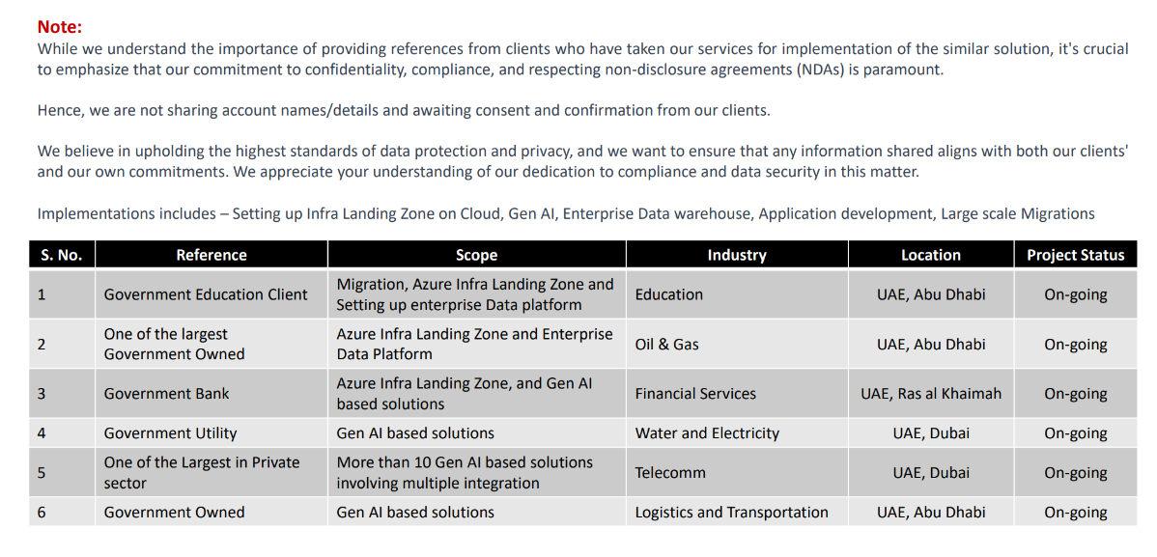
References

Slide 89
Delivery and Project
Methodology Approach

Slide 90
Project Excellence Team
PET In Celebal established to assist Project Managers and Business Analyst throughout the organization in implementing Project Management principles, practices, methodologies, tools, and techniques.
01
Defining the program management processes and procedures that will be followed
02
Assist project teams in all phases of their projects from project definition to rollout
03
Supporting effective resource management across the program
04
Providing document and configuration management (knowledge management)
05
Providing centralized support for managing changes and tracking risks and issues

Slide 91

Implementation Approach and Methodology
Implementation Approach Plan
This section provides a detailed description of the activities the Celebal team will perform for each of the tasks identified in SOW. Included in the description is a mapping to all project deliverables and the resources necessary to complete the task. Described briefly in below chart as per PMBOK Standards
PROJECT INITIATION
PROJECT PLANNING
PROJECT MONITORING AND
CONTROL
Project Charter
Project Scope Statement
Stakeholder Management Strategy
Business Case Document
Test Execution
Performance Testing and Tuning
Security/Role Testing
Early Warning Report
Project Plan
Quality Management Plan
Risk Management Plan
Scope Management Plan
Test Strategy
PROJECT EXECUTION
PROJECT CLOSURE
Defect Tracking Log
UAT Scenarios Development
Test Case Development
Risk Summary Sheet
Project Acceptance
Post Project Review
Lessons Learned Document

Slide 92
Project Excellence Team
The following overview of our strategy for successfully managing this engagement is illustrated below.
Project Kick – off
Project Evaluation
Project Definition
Project SOW
Agile Project Charter
Agile Team Charter
Agile Project Charter
Agile Project Plan
Project Timelines
Project SOW Closure
Project Resource
Project Execution
Sprint /Product Backlog
Project Status Review
Sprint Review Meeting
Project Phase Review
Data gathering
Analytics
Project Documentation
Project Acceptance
Project Knowledge Transfer
Sprint Retrospective Meeting
Project Sign-off
PROJECT
INITIATION
Sales Account Manager - Project Manager
PROJECT
PLANNING
Project Manager – Solution Architecture – Technical Lead
PROJECT
EXECUTION
Project Manager – Technical Lead – Project Engineers
PROJECT
CLOSURE
Sales Account Manager – Project Manager – Technical Lead

Slide 93





Delivery Methodology: Agile Scrum Methodology
Celebal follows the Agile Scrum Methodology for the Project Delivery
SPRINT PLANNING
As part of Sprint Planning, Agile Team Charter, Agile Project Charter, and Agile Project plan is prepared for effective communication between the Celebal Team and ADCCI team
SPRINT EXECUTION
Sprint Backlog and Agile Product Backlog is prepared to document a prioritized list of all the work that remains to be done on the Project and will act as a live document.
DAILY SCRUM MEETINGS
Celebal will have the daily scrum, also called the standup, is a short daily meeting designed to let the team plan out its work for the day and identify any obstacles that could impact that work.
SPRINT REVIEW MEETINGS
The sprint review is an informal meeting with the Team where the Celebal team gives a demo ADCCI of the deliverable and will determine what is finished and what isn't, in other words, is a meeting to demonstrate and determine the usability of a piece of software
SPRINT RETROSPECTIVE
MEETINGS
The sprint retrospective is a recurring meeting held at the end of a sprint used to discuss what went well during the previous sprint cycle and what can be improved for the next sprint.

Slide 94
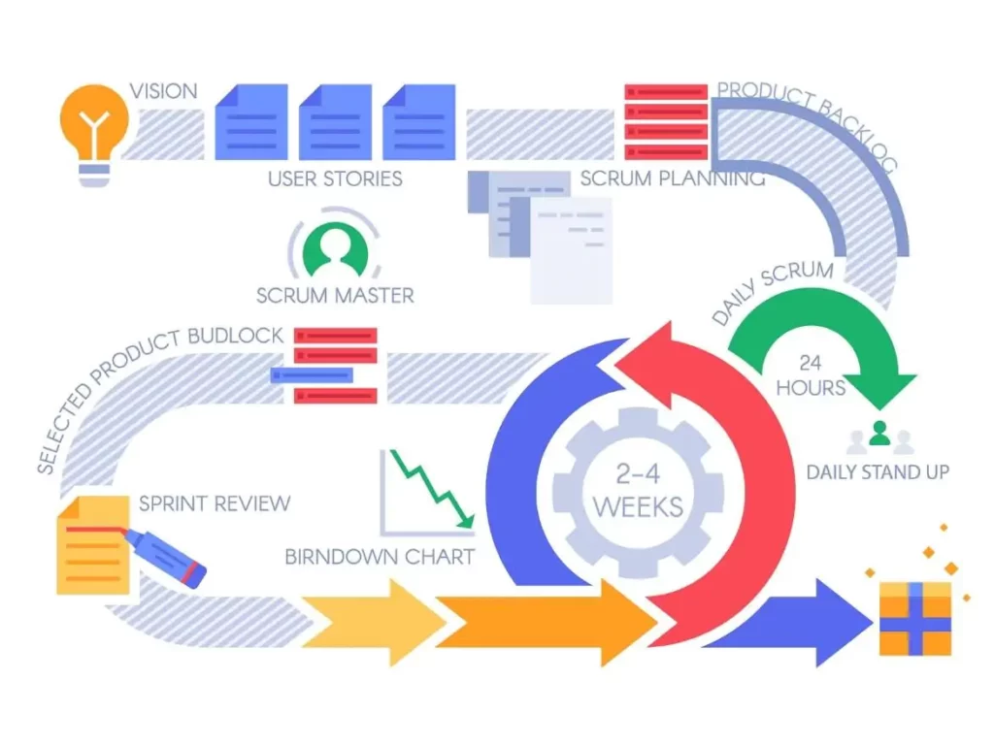
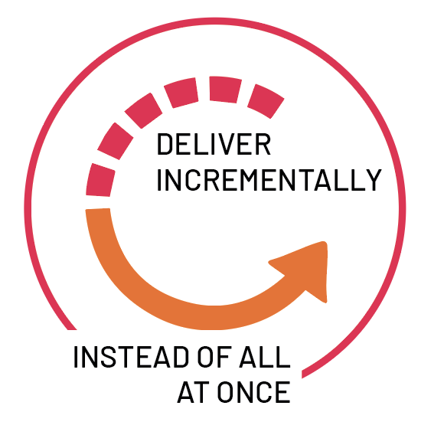
Governance | Agile - Scrum Methodology
Celebal follows Agile Approach to develop the project, which involves constant collaboration with stakeholders and continuous improvement at every stage. Once the work begins, the project team cycles through constant planning, executing, and evaluating.

Slide 95
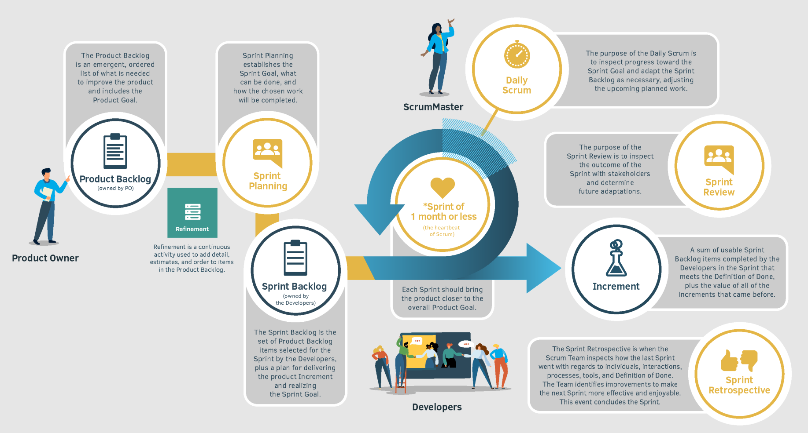
Agile – Scrum Artifacts & Commitments

Slide 96
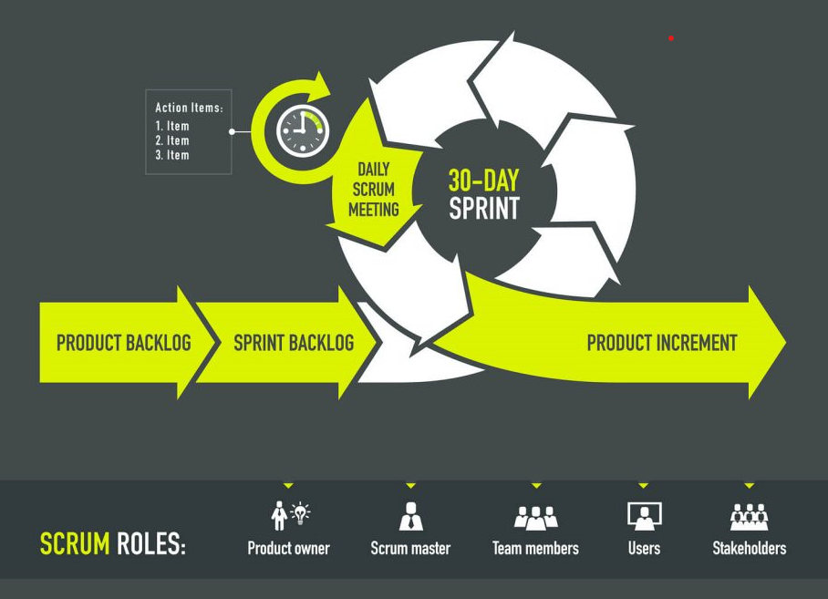
Agile - Scrum Roles And Process
SPRINT PLANNING
Who: The entire Scrum Team
Timebox: Maximum of 8 hours for a month-long Sprint.
Shorter timebox for shorter Sprints.
DAILY SCRUM
Who: The Developers, but if the Product Owner or Scrum Master
are actively working on items in the Sprint Backlog, they
participate as Developers
Timebox: Maximum of 15 minutes
SPRINT REVIEW
Who: The entire Scrum Team. Stakeholders are invited to provide
feedback on the increment.
Timebox: Maximum of 4 hours for a month-long Sprint.
Shorter timebox for shorter Sprints
SPRINT RETROSPECTIVE
Who: The entire Scrum Team.
Timebox: Maximum of 3 hours meeting for a month-long Sprint.
Shorter timebox for shorter Sprints.

Slide 97
Quality Assurance

Slide 98






Quality Assurance
The issue resolution and quality assurance (QA) approach and methodology are designed to meet diverse and demanding needs. Our QA services serve to mitigate potential issues to help ensure the quality of IT projects by providing, for example:
Recommendations for QA best practices, tools, and techniques
Project plan input as it relates to building in QA best practices
The intent of the QA process is to verify and validate the interim work products of each major phase of the project. QA is intended to provide “another set of eyes” to review deliverables of all kinds, to ensure that they conform as closely as possible to best practices.
The Management team will set up different checkpoints according to which it evaluates the quality of the project activities at each project stage. To ensure regular quality inspection and working as per the schedule.
At each layer three level testing will be performed i.e., Unit testing, Integration testing and Module testing
A Formal technical review will be done to evaluate the quality and design of the prototype. We will have a multi testing strategy where multiple approaches for testing will be performed to ensure better quality.
Unless approved in change management, we will follow the time-frames mutually decided for each activity prior to the project.

Slide 99


Quality Assurance
The development process will stick to the defined procedures which will include the following:-
Project Evaluation
This activity confirms that the project is meeting the requirements that were discovered in the project management plan. It ensures that the set standards for the project are followed correctly.
Process Monitoring
This activity verifies if the correct steps were taken during development. This is done by matching the taken steps against the documented steps.
By validating the change requests, evaluating the nature of change and controlling the change effect, it will be ensured that the quality is maintained during the development and maintenance phases. For this purpose, we use a proper document which allows managers and developers to observe the activities and proposed changes from the beginning till the end of SDLC and initiate corrective action wherever required.
Necessary documentation related to Quality assurance will be created.

Slide 100
Escalation Matrix

Slide 101
Escalation Matrix
Timely resolution of issues is critical to maintaining program control and Customers’ satisfaction. Celebal Tech’s issue escalation process will help make sure that issues are identified and resolved in a timely manner per SLA requirements. The escalation process provides a mechanism to alert project managers and other management personnel to issues not being resolved. this section includes the issue-escalation path and provides details on whom to contact when and about what.
Escalation Level | Role (CT) | Triggers when
1st Level Escalation | Business Analyst | - Delivery Issues
 |  | - Resource Issues
 |  | - Delay in Delivery
 |  | - Reason 4
2nd Level Escalation | Project Manager | - Reason 1
 |  | - Reason 2
3rd Level Escalation | Account Manager | - Reason 1
 |  | - Reason 2
Weekly Cadence to track week on week progress.
A steering review will be held every 15 days with the Key Management Personnel of the client.
The meeting shall be attended by the Account Manger from Celebal Team.

Slide 102
Risk Mitigation

Slide 103







Risks And Mitigation
Availability of data in an unorganized state
Data may have multiple versions when it is first created from scratch. Messes typically arise from duplicates of data incomplete data sets
Inadequate data protection
Data loss is inevitable during data transfer, primarily at the organization level. It is difficult to rely on new content right away because of data loss. Losing data can be highly disturbing
Incorrectly formatted data
The organization’s data and the compatibility of files are to be checked during data migration
Analysing and mapping data
When new data is transferred from the old database, mapping refers to determining where the new data goes.
Bringing data into the system
When new data is transferred from the old database, mapping refers to determining where the new data goes.
Lack of coordination among teams
Working in silos and creating more data silos can lead to inconsistencies and decrease productivity.
Lack of integration process
Data and its design will not be transferred smoothly between the analysis, development, testing, and implementation stages if disparate technologies are used. Information may be lost during the transition.

Slide 104
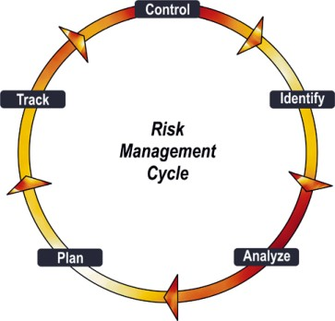
Risk Mitigation Strategy
Risk | Mitigation
Unrealistic expectations on project outcomes/ benefits | Clear Communication on project scope to all concerned stakeholders. Well-defined user expectations in the form of User Requirement document.
Functional requirement not clearly stated | Deep involvement and ownership of users in defining the To-Be state and system requirements
Delays in mobilizing the business team, project team members | Mobilization of the core team before the project kick off
Change/ Creep in Scope | Celebal would assess and freeze the scope in the design phase. However, should there be a need for some change in the business process due to business compelling needs, CT change control methodology would assess the impact of the change with the budget and schedule.
Delay in input of artefacts from the Client | The Client would identify a SPOC for this project who will be responsible for providing required inputs/artefacts as requested by Bidder
Delay on the part of the Client to provide feedback &/or signoff on the project deliverables | Timely feedback and signoff. Deemed acceptance after 5 working days
Delay in logistics for Implementation Team e.g., PC, building access, etc. | Celebal would help the Client by providing necessary details of entire implementation team well in advance before the project kick off
DC & DRC space allocation | The Client will identify and allocate space before the project kick off
Availability of all users during training | Celebal will share as early as possible
Transaction Load much larger than accounted for. | Identify optimization of hardware and software configuration
Continuous Risk Cycle
Proactive Action Plan
Risk Monitoring Log
Timely Escalation

Slide 105
Terms & Conditions

Slide 106






Terms & Conditions
Services
Warranty
IPR ownership
Price
Services are for information purposes only and are on an as-is basis. You are requested to get in touch with the respective SPOC from the Company for further details.
Warranty for services shall be limited, at Company’s sole discretion.
Pre-modified services intellectual property rights are solely owned by the Company.
Prices are indicative and exclusive of taxes and will be modified on a case-to-case basis, subject to agreement in the definitive Agreement.
Additional Cost
Non-disclosure and confidentiality
Limited Validity
Any additional cost beyond the stipulated amount as stated shall be borne by the client on the mutually agreed terms and conditions and scope of work.
Any information shared by way of this proposal and/or by any other means including emails, telephonic conversations, and alike shall form part of the confidential information and shall be kept in utmost secrecy and confidence by the recipients, always.
The validity of this Proposal shall be for a limited period and the same shall expire post 31st August 2024.

Slide 107




Terms & Conditions
Non-binding terms
Modification rights
This proposal constitutes only a preliminary, non-binding statement of the intentions of the Parties, does not contain all matters upon which agreement must be reached for the transactions to be possibly consummated, and creates no legal obligations on the part of the Company hereto with respect to the execution thereof. A binding commitment with respect to the transactions will result only from the execution of the definitive Agreement.
The company reserves the right at any time to make changes in any of the stated clauses in this Proposal, including delivery and method of execution. If any such change causes an increase or decrease in the cost of, or the time required for the performance of any part of the work under this proposal, whether changed or not changed by any such order, Company reserves the right to make an equitable adjustment in the price, delivery schedule, or deliverables, or all or any combination of the three, and this adjustment will be defined in a definitive agreement and/or work order/ statement of work that, once signed by both parties, will alter this Proposal accordingly.
No publicity
Relationship
The contents of this proposal are confidential in nature and Parties agree that there shall be no publicity of the said proposal and/or any clause/quote thereof as mentioned in this proposal since the same are altered on client-to-client, case to case basis.
The relationship between the Parties of independent contractors.

Slide 108






Terms & Conditions
Non-exclusive and Non-binding
No Liability
Modification right
The Parties agree that the proposal is Non-Exclusive, and the clauses as stated herein are Non-binding on parties.
There arises no liability from any act/ omission of either Party arising out of the contents of this Proposal and/or for any loss that may arise in case anyone acts on the indicative information given in this proposal. The company holds no obligation for any loss/liability.
With time, Company reserves the right to revise and improvise the contents of this Proposal.
Delivery timelines
Change in government policies
Jurisdiction and Governing Law
Timelines for delivery are tentative and may depend on actual transactions.
The prices and services as indicated in this proposal are subject to change with the change in government policies and/ or any other guidelines with respect to COVID-19 or any similar incident, arising out of circumstances which are not in control of Parties.
Contents of this proposal shall be governed by laws of UAE wherein courts of Abu Dhabi, UAE shall have exclusive jurisdiction to deal with any dispute that may arise with respect to the contents of this proposal.

Slide 109



Happy to Connect at
mea.enterprise@celebaltech.com
+971-43812090
Mradul Nagpal – Account Manager
mradul.nagpal@celebaltech.com
+91-8005507416
Abhishek Goyal – Head of Sales, CEMA abhishek.goyal@celebaltech.com
+971-585112076
Thank You
Elite Partner

Slide 110
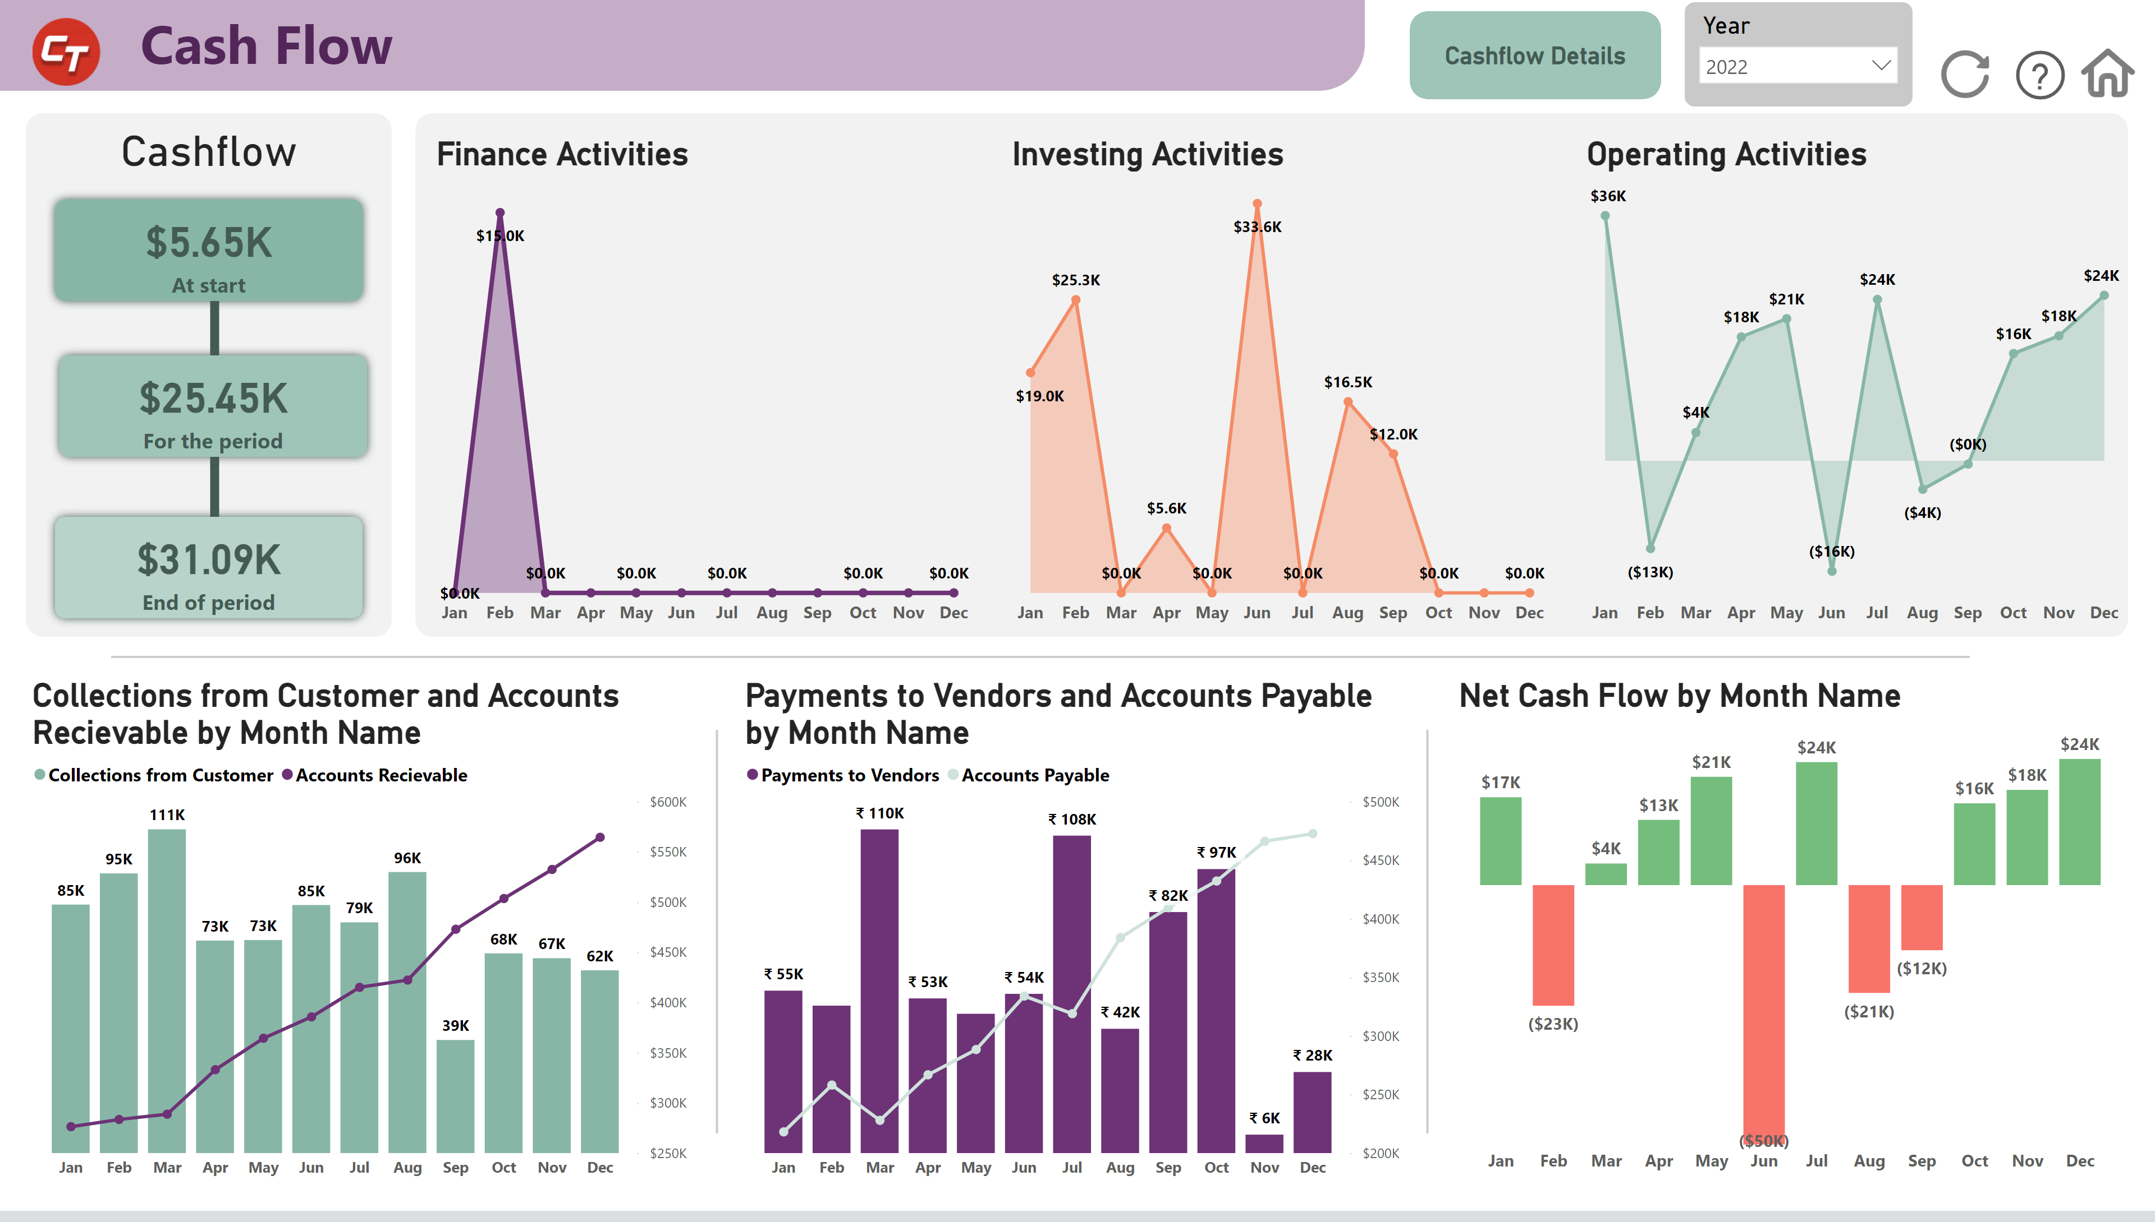
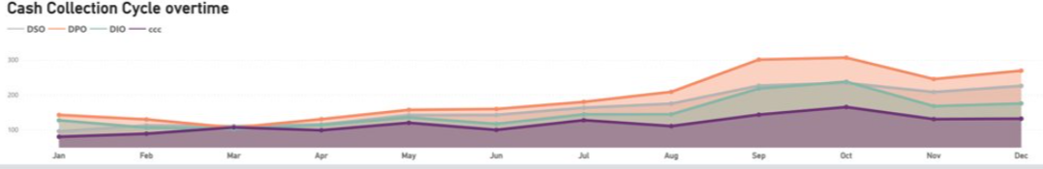
Use Case 2 - Analysis of Cashflow along with Payables and Receivables
Business Scenario
The Organization was seeking to comprehensively analyze its Cashflow from Financing, Investing and Operating Activities along with analysis of Payables and Receivables.
A digital infrastructure for seamless processing of their production data. They have in place a manual process to collect data from multiple sources like SAP S/4 HANA, Oracle, etc. This data was used to create daily reports. This whole process took them around 6-7 hours every day​
Solution and Benefits
Celebal Tech provided a solution that automated data integration and established Power BI for reporting.
Our solution streamlines the financial analysis process. It enables stakeholders to make data-driven decisions promptly, identify potential risks, align budgets with actual performance, and spot trends that influence strategic directions.
Azure Data Factory was used to manage the workflow of ingesting data from disparate sources and pushing them onto the data warehouse. Azure Synapse was implemented as the cloud data warehouse. Power BI was used for the creation of reports based on the collected data.

Slide 111
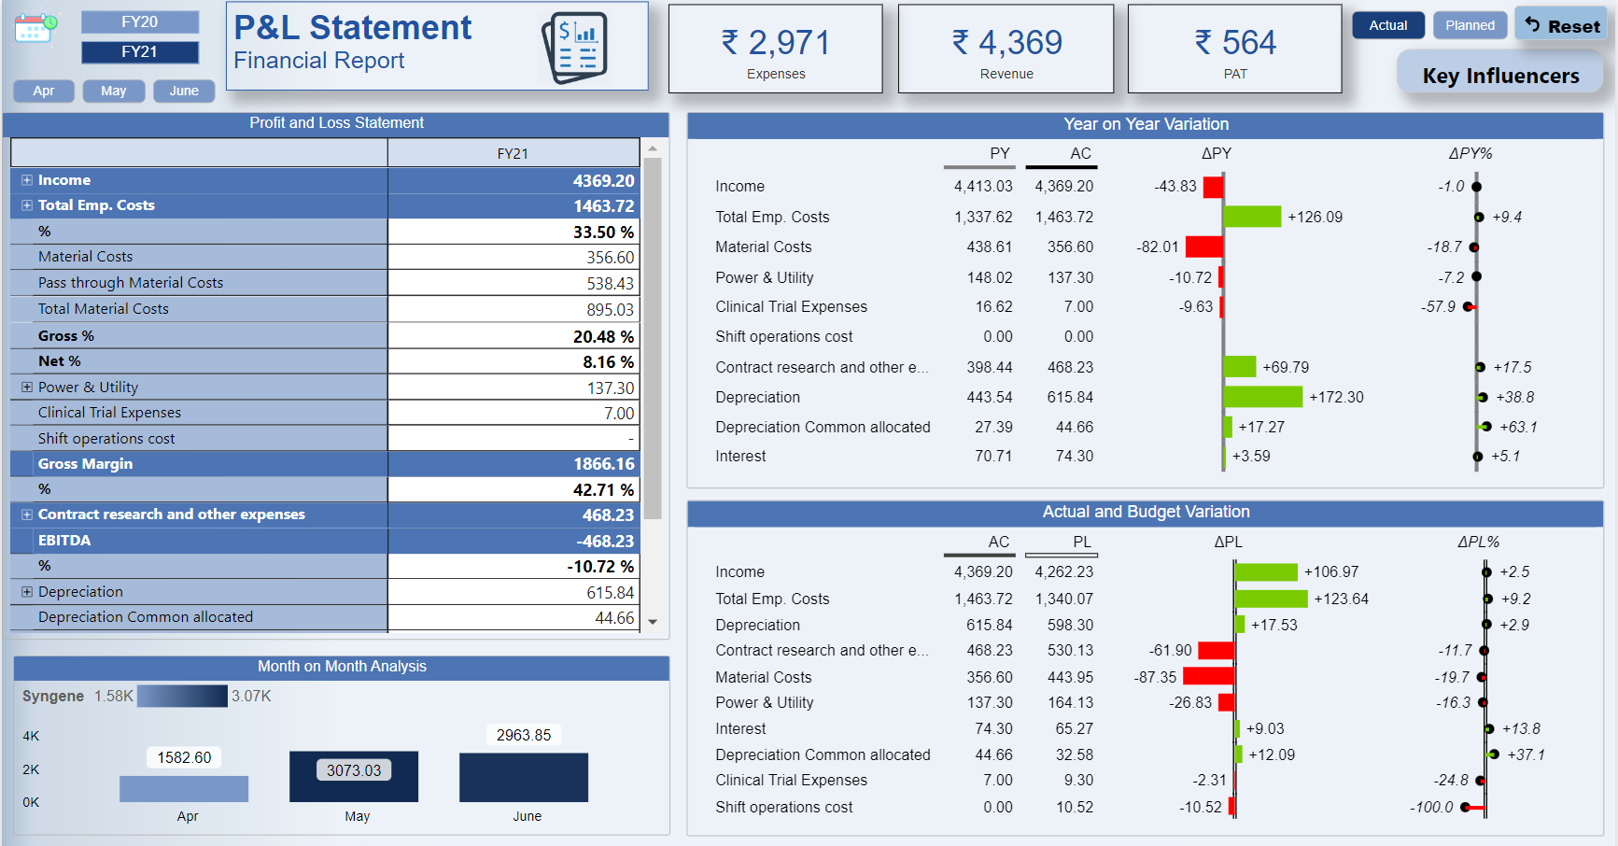
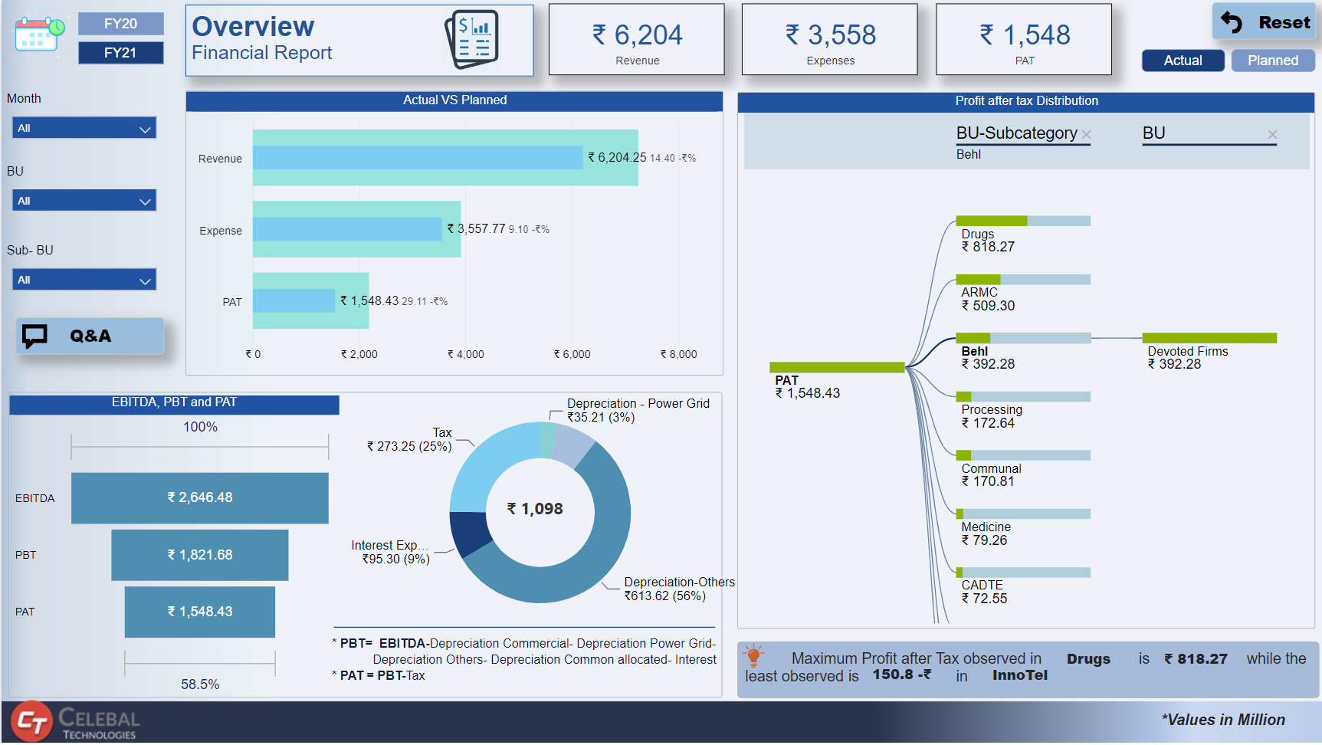
Use Case 3 - In-depth Analysis of Financial Statements
Business Scenario
The client was seeking comprehensive financial statement analysis to drive strategic decision-making. They require detailed reports covering Ratio Analysis, Budget vs Actuals, Risk Assessment, Trend Analysis, and Comparative Analysis.
Due to unavailability of centralized data warehouse, major challenge was to manage multiple data sources for same set of data as it was maintained by multiple stakeholders
Solution and Benefits
Celebal Tech team understood the challenges & provided an end-to-end holistic solution which allows the client to ingest data from multiple sources, transform & apply business logic at a centralized data warehouse and finally visualize the data for better decision making.
Azure services such as Azure Data Factory, Azure Data Lake, Azure Synapse is utilized for data ingestion, storage, preparation & creation of curated reports. Implementation was done to address the keying concerns fixing the data integrity issues.
Our solution streamlines the financial analysis process. It enables stakeholders to make data-driven decisions promptly, identify potential risks, align budgets with actual performance, and spot trends that influence strategic directions.

Slide 112
Major aspects of Implementation– Part 3/7
12. Reporting Layer
6. Data Visualization
9. Data Management
Development of 1 Report based on the specified use cases considering 4-5 KPIs and 6-7 pages per report.
Create wireframe templates in Power BI containing relevant KPIs using test data.
Facilitating regular reviews and discussions with the management team to address any updates or modifications to the KPI framework.
Design an efficient data model for querying and analysis.
Implement any necessary calculations or business logic within the reports using DAX (Data Analysis Expressions).
Implement minor Power Query transformations within Power BI for transforming data in the required format if necessary.
Power BI Functionalities such as Drill Down, Drill Through, Bookmarks, What-if Parameters, Row-Level-Security (RLS), etc. will be implemented. Implementation of functionalities may vary according to the requirement.
Implement advanced inbuilt Power BI AI features like Q&A, Key Influencer, and Decomposition Tree based on business requirements. These features are built into Power BI and do not require external tools.​
Committing to continuous improvement by regularly assessing the relevance and effectiveness of the established KPIs and proposing refinements as needed.
Sanity testing of the complete report from the Celebal team to ensure the implementation of logics, wireframe, and UI meets the customer’s expectations.
Deployment of the report on Power BI service.
Implement Schedule refresh to keep the data updated.
UAT of report from ADCCI team business stakeholders to provide their feedback and its implementation.
5. Language Translation
6. Deployment in Development Environment

Slide 113
Scope of Work - Phase2 (To be defined in Phase 1)

Slide 114



Sample Solution Screenshots

Slide 115
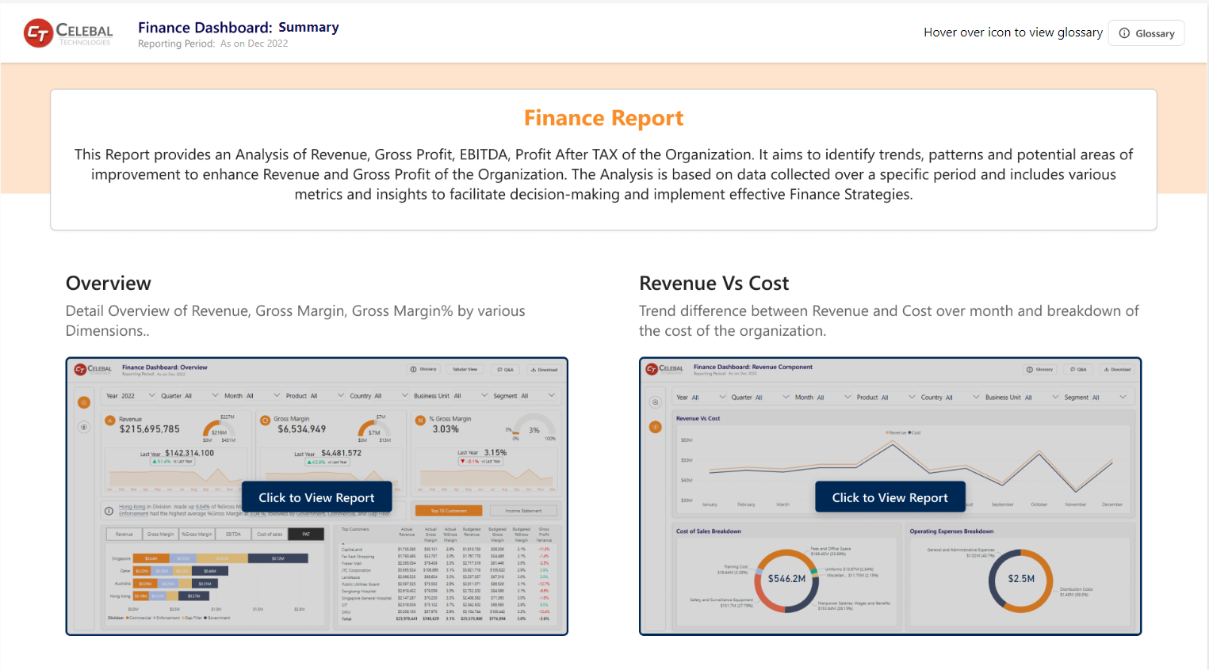
Sample BI Reports

Slide 116
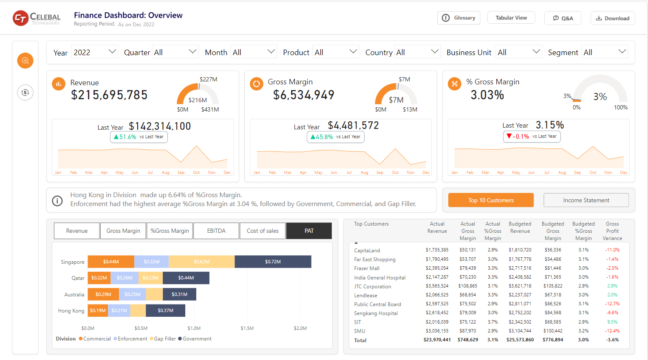
Sample BI Reports

Slide 117
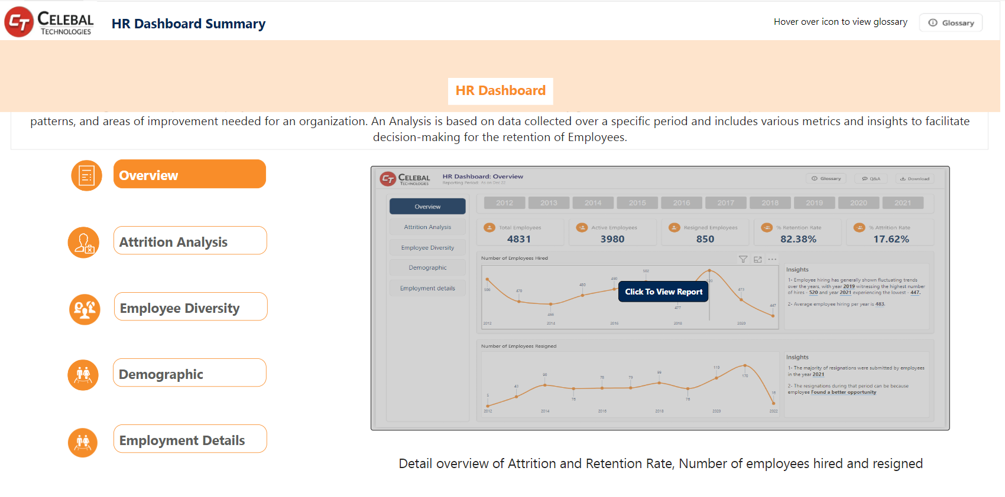
Sample BI Reports

Slide 118
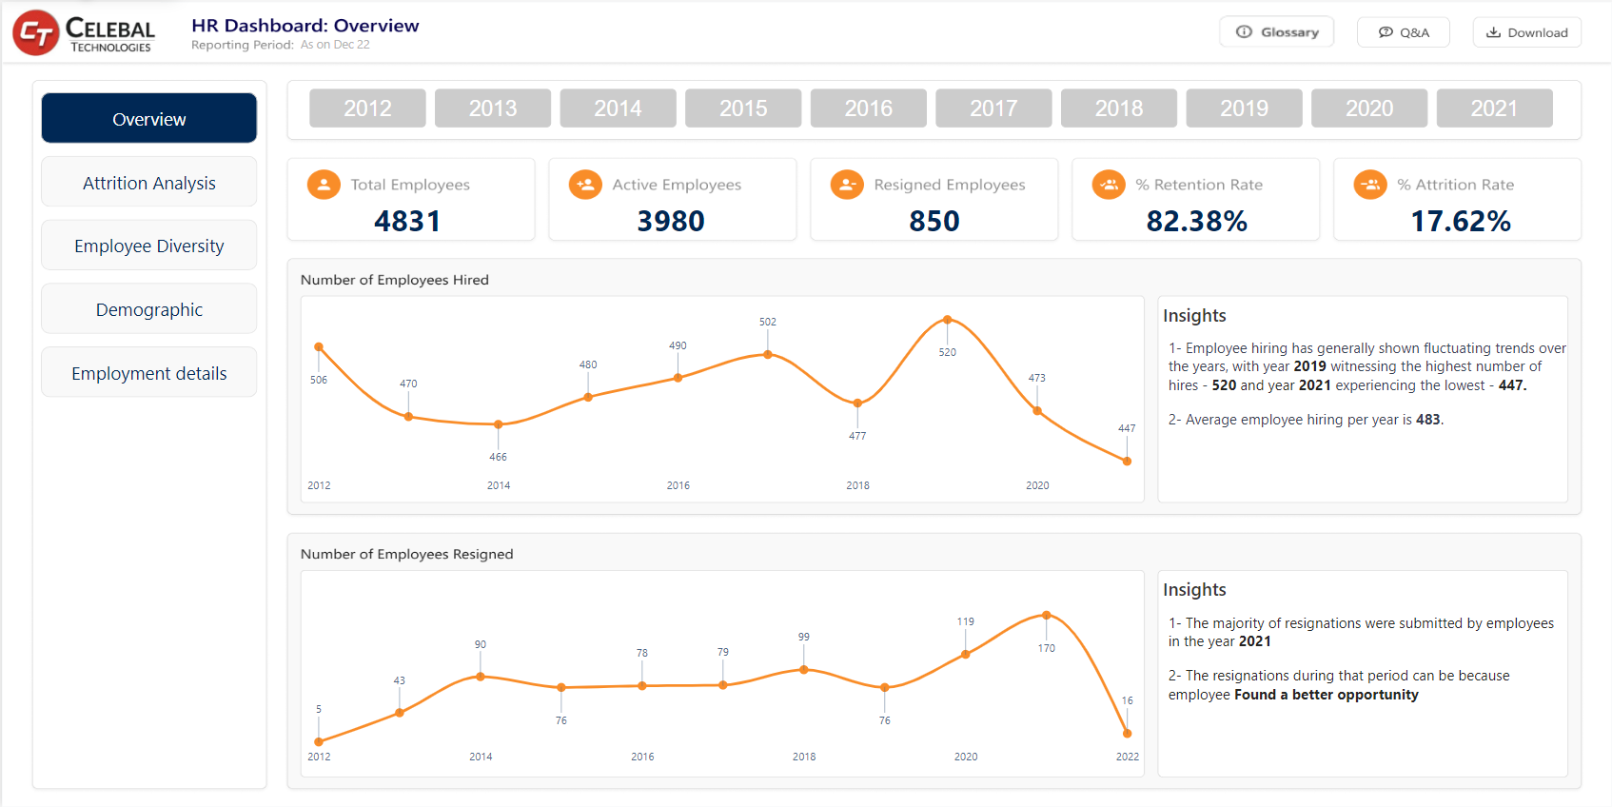
Sample BI Reports

Slide 119
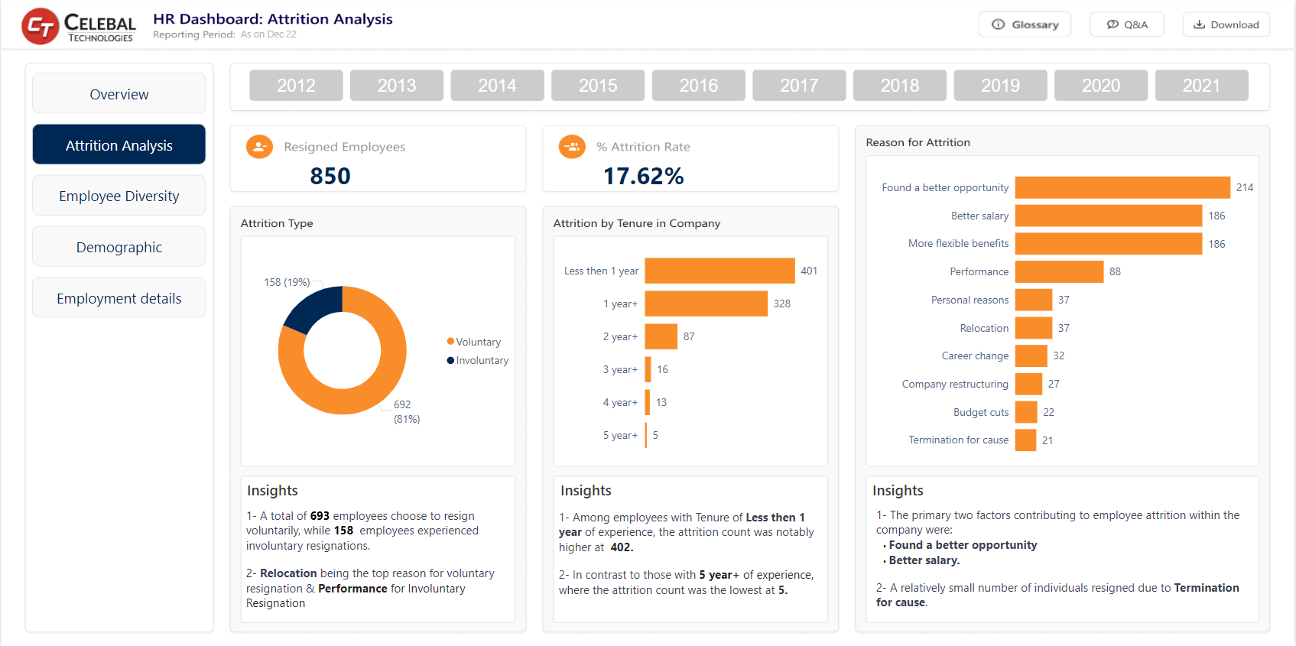
Sample BI Reports

Slide 120
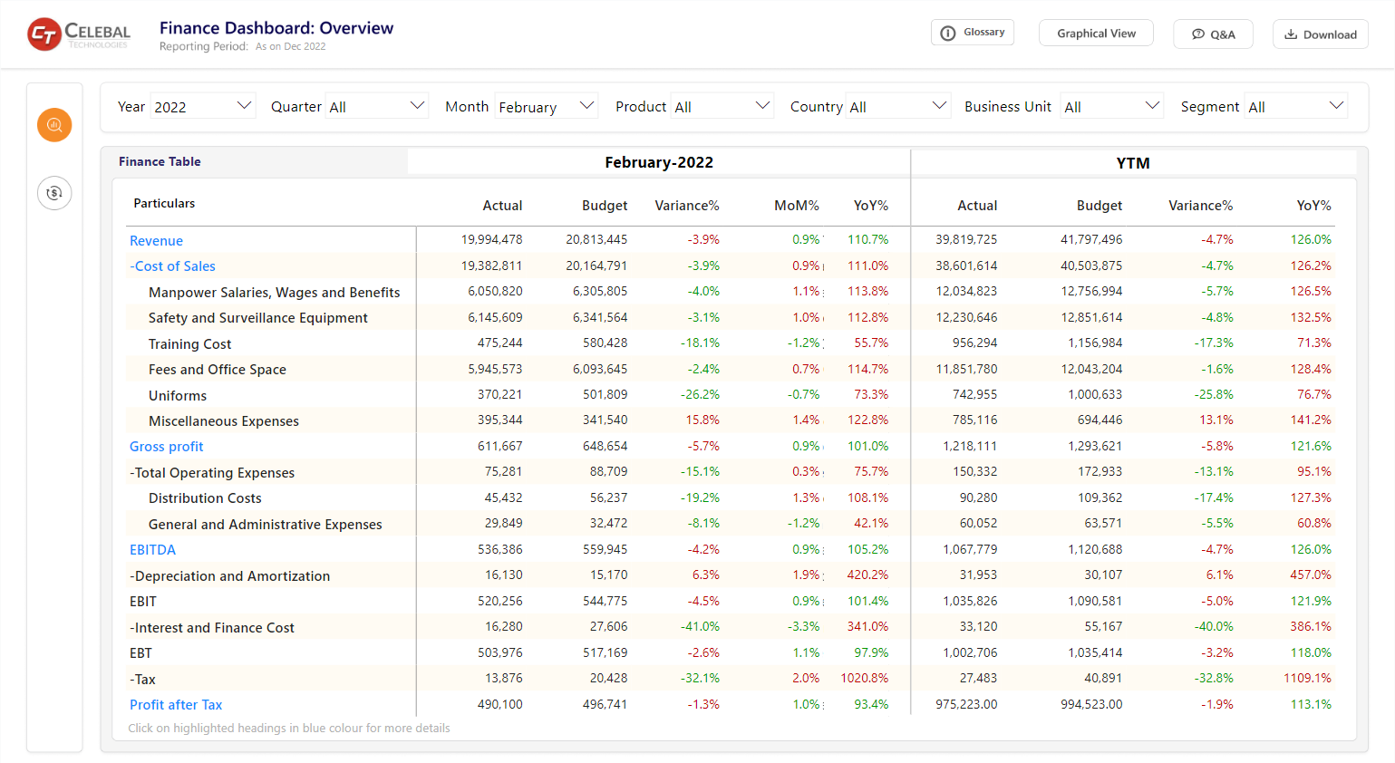
Sample BI Reports

Slide 121
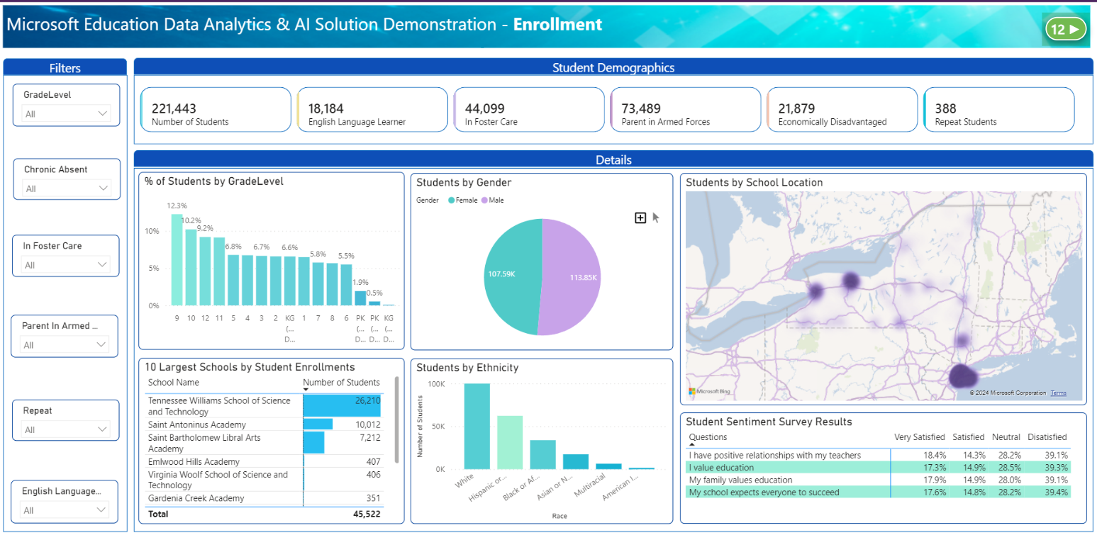
Sample BI Reports
University Data Analytics & Al Solution Demonstration - Enrollment

Slide 122
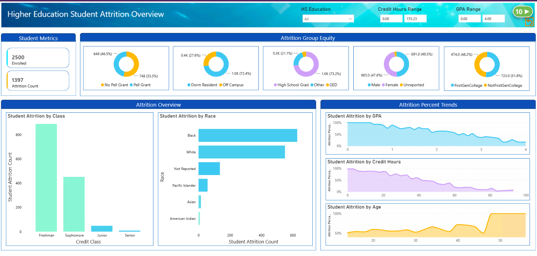
Sample BI Reports

Slide 123
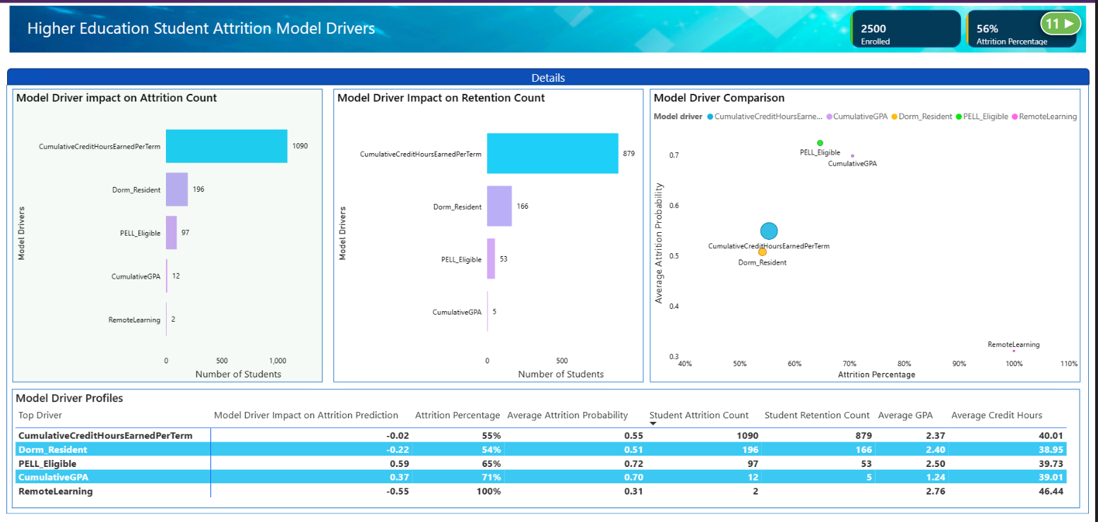
Sample BI Reports

Slide 124
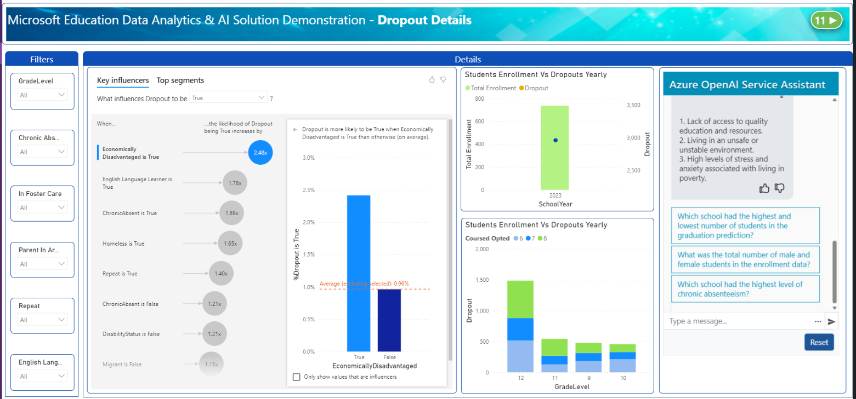
Sample BI Reports
University Data Analytics& Al Solution Demonstration – Dropout Details

Slide 125
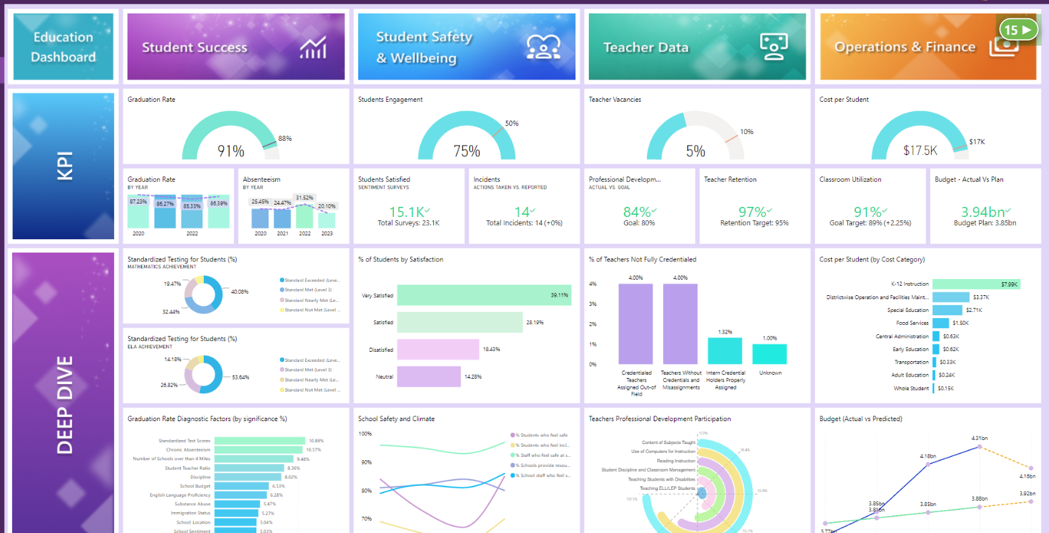
Sample BI Reports

Slide 126

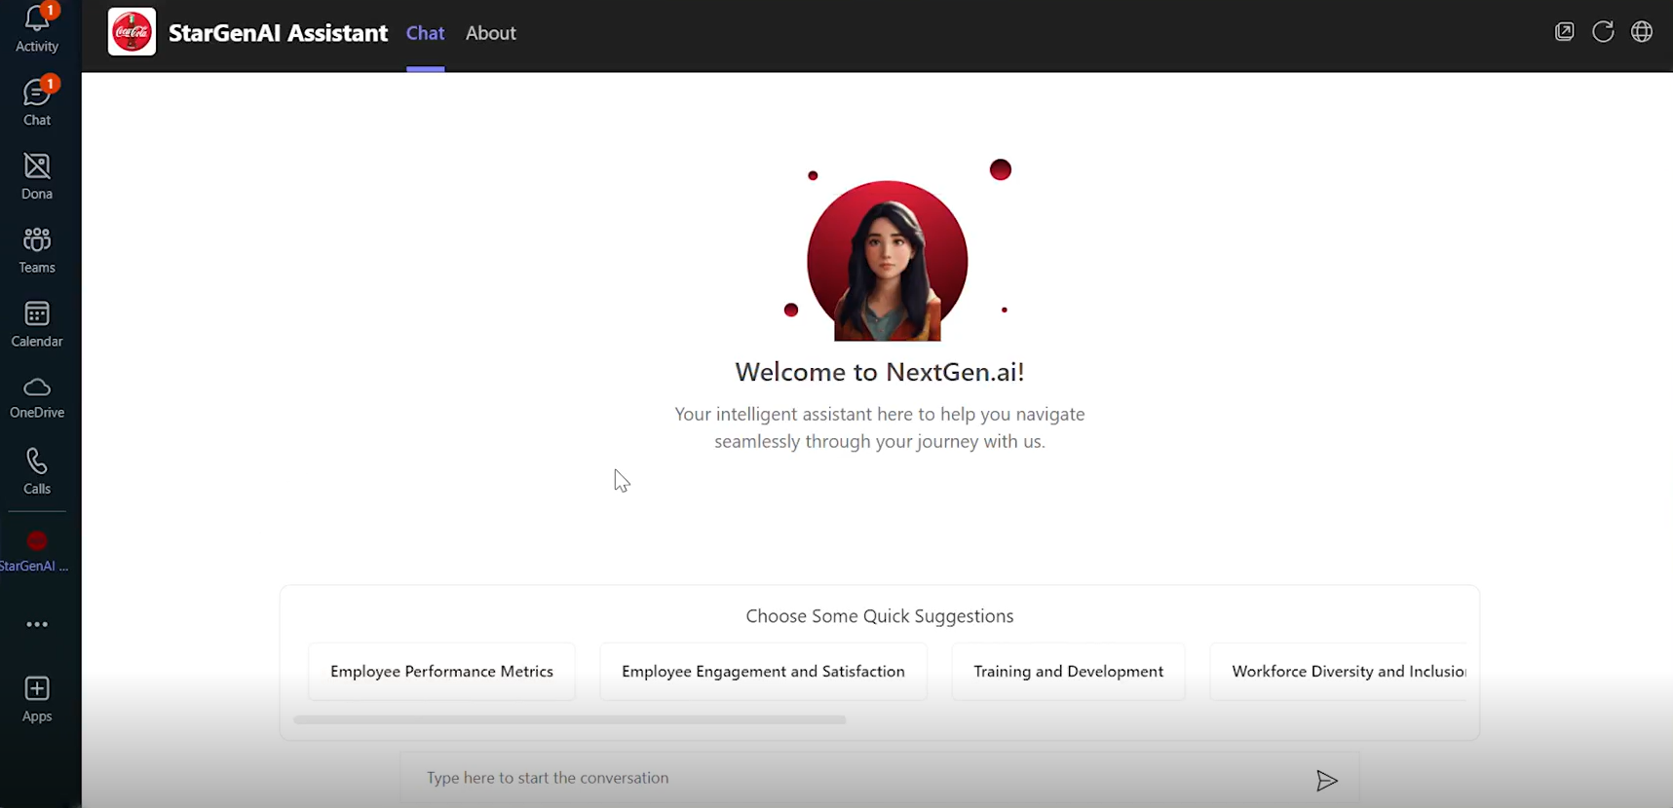
Sample Knowledge Mining Chatbot

Slide 127
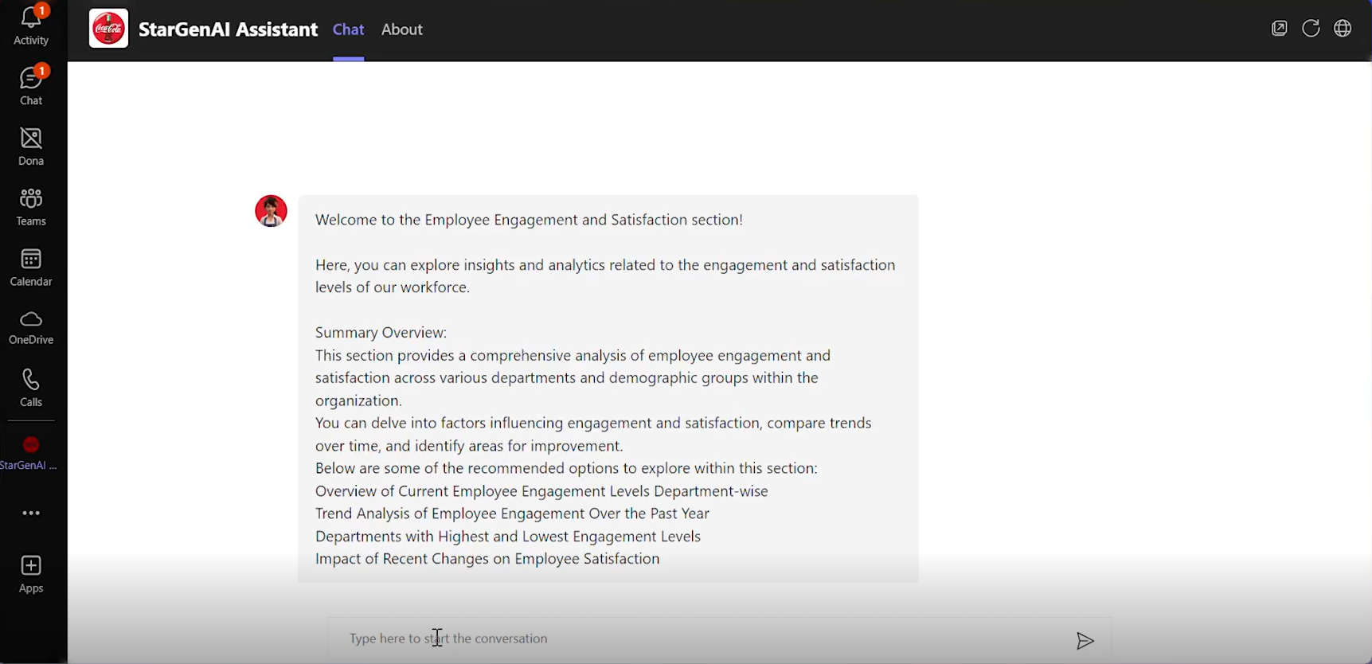
Sample Knowledge Mining Chatbot

Slide 128
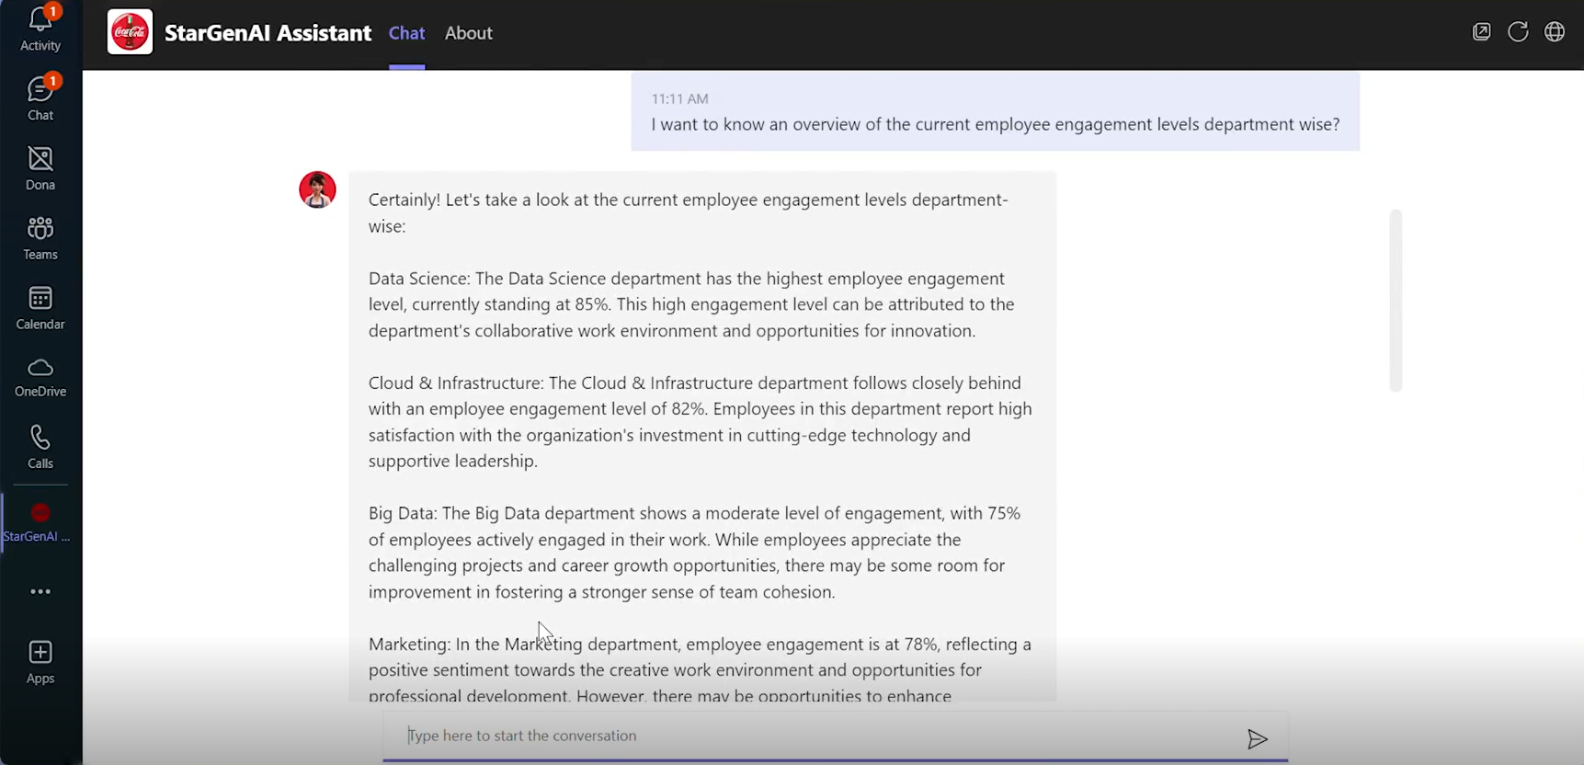
Sample Knowledge Mining Chatbot

Slide 129
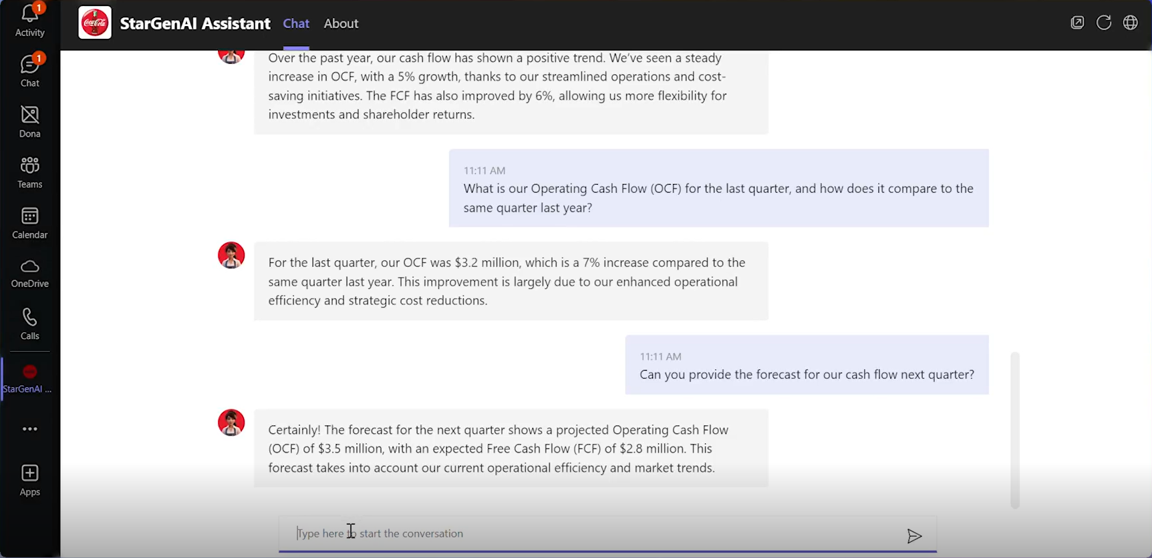
Sample Knowledge Mining Chatbot

Slide 130
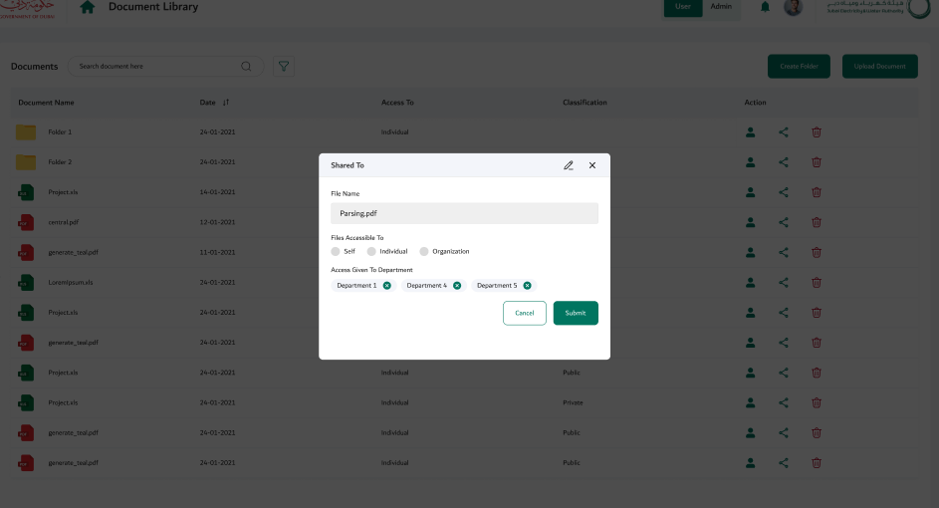
Sample Document sharing and management system

Slide 131
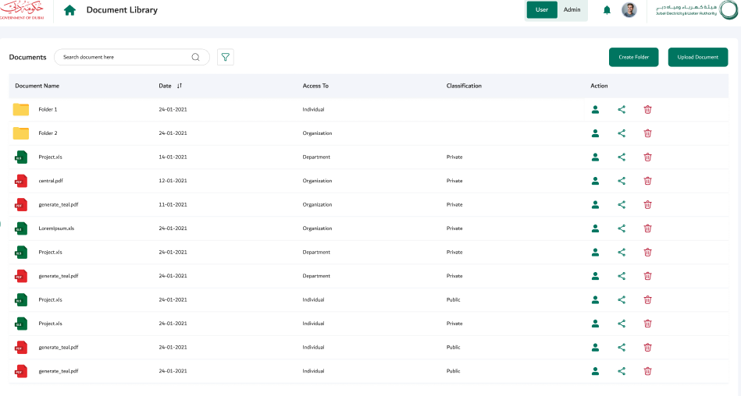
Sample Document sharing, archiving and management system

Slide 132
Relevant Case Studies​

Slide 133




Case Study 1
Business Challenge
Customer was looking to build a modern data warehouse to embark on its digital journey and visualize the below reports which are based on POS, DBR, and PMS ecosystems.
Customer Centric & Customer 360 reports- Daily.
Daily Business reports- Daily.
F&B report- monthly.
Solution Provided
Built Azure Data Lake by ingesting the data from POS, PMS, Oracle, SAS, and various other sources to Azure Data Lake via ADF to Synapse. The Finished data was then sent to Power BI ( via native connectors ) for a live/periodic view of KPIs for business users.
Business Impact
Implementation of an enterprise data warehouse has helped Customers govern the business’s data accurately through interactive dashboards showcasing KPIs with live/periodic refreshes
The business users were empowered to derive deep business insights through interactive dashboards.
The solution enabled controlled, secure, and self-service business data access for consumption.
The customer was able to run a unified, consistent, single source of truth and centralized data platform.

Slide 134


Case Study 2
Business Challenge
To attain the desired outcome of their data processes and track key business metrics readily because of their ROGUE & SILOED data, the inability to integrate analytical data from multiple platforms inhibits their view of business, thus creating delays in data-driven business decisions. Substandard data quality is impacting the overall business processes and decisions.
Use Case
End-to-end solutions (ETL & Modelling) required for business reporting and dashboarding to showcase various key business data metrics like GMV, Customer Acquisition, Sales Commission, Digital Customer Journey, Sales Offers & promotions, Customer surveys and feedback, App performance, Loyalty Program etc. utilizing the Lakehouse features.
Use case success criteria
Business Impact Metrics
Built a scalable and future-ready data warehouse. This empowered them to accommodate growing data volumes, easily adapt to evolving business needs, and seamlessly incorporate new data sources and technologies. Reduction in data redundancy and manual toil & errors and empowering data quality by leveraging Databricks Lakehouse best practices.
Streamlined Data Delivery: Leveraged the transformed data to serve real-time/batch-time data to business key metrics reports.
Enhanced ETL Control and Performance: Experienced a significant boost in performance and gained improved control over their ETL processes and Delta Lake, resulting in streamlined and efficient data management with improved data quality.

Slide 135
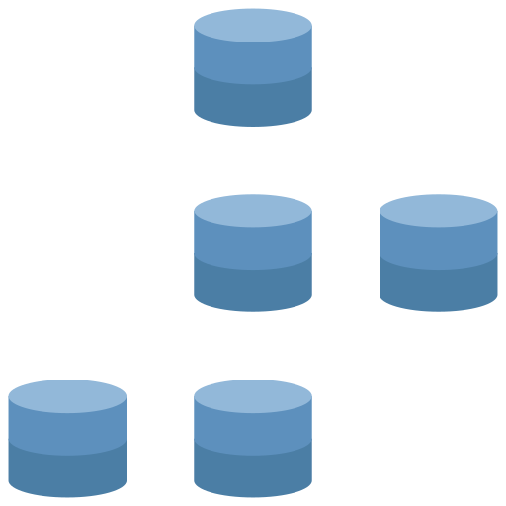

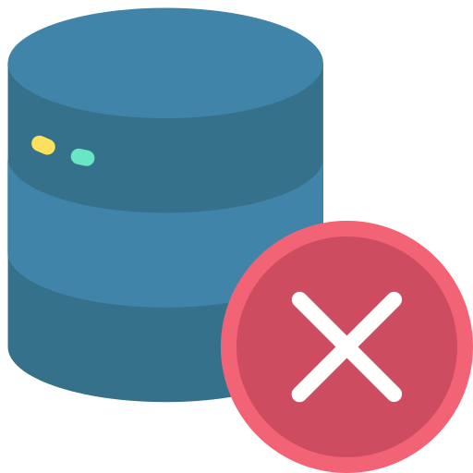

Case Study 3: (1/3)
Our client is driven by a vision to excel in the development, manufacturing, and distribution of affordable, high-quality products in the marketplace. This vision is realized through a combination of established portfolio offerings and the strategic integration of new vertically integrated manufacturing capabilities.
3
Limited and scattered data access was hindering the client's ability to make effective decisions, resulting in a lack of innovation, reduced time to market, and an increased cost of service.
Conclusion
1
A web-based Q&A platform for the End user & Admin to control, powered by GPT
Celebal Technologies Assists to Unlock Data-Driven Insights to Enhance Decision-Making with BI Dashboards
They lacked a unified data platform that could aggregate information across all data sources and leverage advanced analytics for insights.
2
The platform should be secure and reliable
The main objective was to deploy a modern data platform into their existing architecture that could assist with data accessibility, insights generation, and data-driven decision-making.

Slide 136
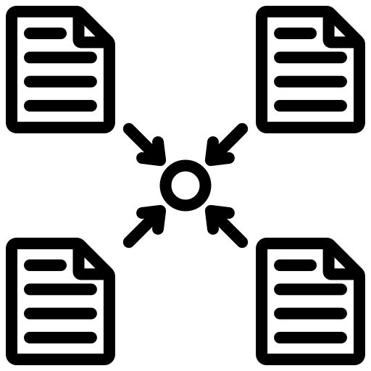


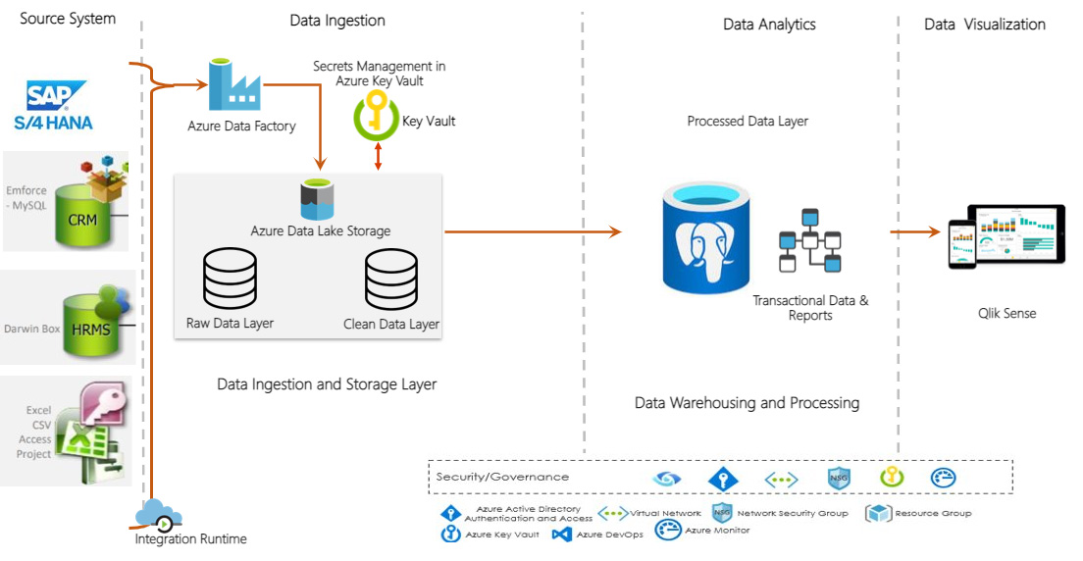




Case Study 3: (2/3)
Our Solution: Celebal Technologies executed the project in 3 phases.
Phase 1
Phase 2
Phase 3
Technical Architecture
ADF was used to connect data sources to the Azure Data Lake. Flat files and SAP ECC on HANA were the data sources to be integrated. Data pipelines were created, and a data lake was developed for all metrics. A self-hosted integrated runtime was provided to ensure seamless data integration.
Azure PostgreSQL was integrated into AD for data warehousing, ad-hoc SQL analytics, and data modeling.
The data visualization layer was created by leveraging Power BI. 7 BI reports, embedded with 28 KPIs, were created, covering various aspects of sales and revenue.
The intelligent enterprise solution by Celebal Technologies served as a foundation for better decision-making, leading to improved innovation, time to market, user delight, and cost of service.
Technologies Used
Azure Data Factory
Azure Data Lake Storage
Azure Key Vault
Azure DevOps
Power BI

Slide 137

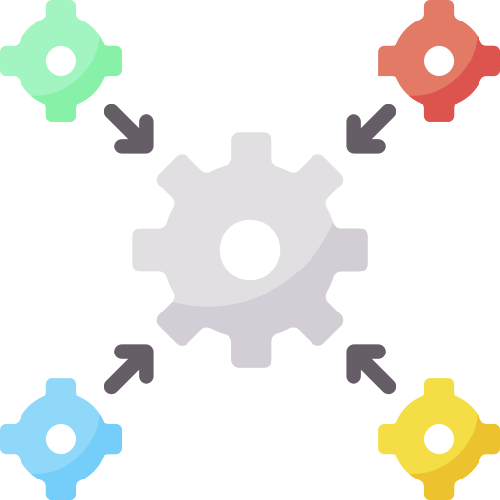


Case Study 3: (3/3)
Key KPI’s
Interactive Reporting
Utilize dynamic reports and displays to glean insights from your data that are pertinent to making decisions.
Seamless Integration
Add multiple data sources to the Power BI visualization to build a single source of truth across the organization.
Real-time Analytics
Real-time analytics of operations allow for quick corrections & proactive handling of circumstances before they become risks.
Real-time Analytics
Flawless Collaboration
Foster a collaborative culture among employees where they can share reports and stay connected from anywhere.
Business Impact
40%
Enhanced Decision-Making
3X
Increased Efficiency
5X
Better Customer Insights
45%
Improved Agility & Innovation

Slide 138
Bill of Materials

Slide 139
BoM: Dev
Microsoft Azure Estimate
ADCCI BoM – DEV
Service category | Service type | Custom name | Region | Description | Estimated monthly cost
Analytics | Microsoft Fabric |  | UAE North | F64, 64 Capacity units x 730 Hours, OneLake storage 5,000 GB | $10,404.90
Analytics | Microsoft Purview |  | UAE North | Elastic Data Map: 1 Capacity Unit hour, 730 hours, Automated Scanning and Classification: 90 Total scan duration in hours x 1 Total vCores across scans (For other data sources), Other features: 90 Resources Set hours, Microsoft Purview Data Catalog: C1 Service, Microsoft Purview Data Policy: 25 Policies x 730 Hours | $424.91
Compute | Virtual Machines | Purview SHIR | UAE North | 1 D4s v5 (4 vCPUs, 16 GB RAM) x 330 Hours (Pay as you go), Windows (License included), OS Only; 1 managed disk – E10; Inter Region transfer type, 5 GB outbound data transfer from UAE North to East Asia | $149.79
Analytics | Event Hubs | Streaming Ingestion | UAE North | Basic tier: 10 Throughput unit(s) x 730 Hours, 1000 million Ingress events | $181.50
Security | Key Vault | Purview Key Vault | UAE North | Vault: 10,000 operations, 10,000 advanced operations, 0 renewals, 0 protected keys, 0 advanced protected keys; Managed HSM Pools: 0 Standard B1 HSM Pool(s) x 730 Hours | $0.19
Security | Key Vault | Fabric Key Vault | UAE North | Vault: 10,000 operations, 10,000 advanced operations, 0 renewals, 0 protected keys, 0 advanced protected keys; Managed HSM Pools: 0 Standard B1 HSM Pool(s) x 730 Hours | $0.19
Compute | Virtual Machines | PBI VM | UAE North | 1 D4s v5 (4 vCPUs, 16 GB RAM) x 330 Hours (Pay as you go), Windows (License included), OS Only; 1 managed disk – E10; Inter Region transfer type, 5 GB outbound data transfer from UAE North to East Asia | $149.79
Networking | Virtual Network | Spoke |  | UAE North (Virtual Network 1): 100 GB Outbound Data Transfer; UAE North (Virtual Network 2): 100 GB Outbound Data Transfer | $4.00
Networking | Azure Private Link |  | UAE North | 5 Endpoints X 730 Hours, 100 GB Outbound data processed, 100 GB Inbound data processed | $38.50
Networking | Azure DNS |  |  | Zone 1, DNS, Private; 4 hosted DNS zones, 1 DNS query | $2.40
DevOps | Azure Monitor |  | UAE North | Log analytics: Log Data Ingestion: 1 GB Daily Analytics logs ingested, 0 GB Daily Basic logs ingested, 1 months of Interactive Data Retention, 0 months of data archived, 0 GB data restored for 0 days, 0 Basic Log Search Queries per day with 0 GB data scanned per query, 0 GB of Log Data Exported per day, Platform Log Data Processed per day: 0 GB with Destination to Storage or Event Hub and 0 GB with Destination to Marketplace Partners, 0 Search job Queries per day with 0 GB data scanned per query; 0 SCOM MI Endpoints; Managed Prometheus: 0 AKS nodes in cluster, 10000 Prometheus metrics per node, 30 seconds of Metric collection interval, 0 Average daily Dashboards users, 7 Dashboards, 50000 Data samples queried per dashboard, 25 promql alerting rules, 25 promql recording rules; Application Insights: 3 months Data retention, 0 Standard Web Tests, 5 Minutes Execution frequency, Executing for 730 hours; 0 resources monitored X 1 metric time-series monitored per resource, 0 Log Alerts at 5 Minutes Frequency, 0 Additional events (in thousands), 0 Additional emails (in 100 thousands), 0 Additional push notifications (in 100 thousands), 0 Additional web hooks (in millions) | $82.25
Developer tools | Azure DevOps |  |  | 5 Basic Plan license users, 0 Basic + Test Plans license users, Free tier - 1 Microsoft Hosted Pipeline(s), 1 Self Hosted Pipeline(s), 0 GB Artifacts | $0.00
 |  |  | Total |  | $11,438.41

Slide 140
BoM: UAT
Microsoft Azure Estimate
ADCCI BoM – UAT
Service category | Service type | Custom name | Region | Description | Estimated monthly cost
Analytics | Microsoft Fabric |  | UAE North | F32, 32 Capacity units x 730 Hours, OneLake storage 2,000 GB | $5,189.80
Analytics | Event Hubs | Streaming Ingestion | UAE North | Basic tier: 10 Throughput unit(s) x 730 Hours, 1000 million Ingress events | $181.50
Security | Key Vault | Fabric Key Vault | UAE North | Vault: 1,000 operations, 1,000 advanced operations, 0 renewals, 0 protected keys, 0 advanced protected keys; Managed HSM Pools: 0 Standard B1 HSM Pool(s) x 730 Hours | $0.19
Compute | Virtual Machines | PBI VM | UAE North | 1 D4s v5 (4 vCPUs, 16 GB RAM) x 330 Hours (Pay as you go), Windows (License included), OS Only; 1 managed disk – E10; Inter Region transfer type, 5 GB outbound data transfer from UAE North to East Asia | $149.79
Compute | Virtual Machines | SHA VM | UAE North | 1 D2s v5 (2 vCPUs, 8 GB RAM) x 330 Hours (Pay as you go), Windows (License included), OS Only; 1 managed disk – E10; Inter Region transfer type, 5 GB outbound data transfer from UAE North to East Asia | $80.82
Networking | Virtual Network | Spoke |  | UAE North (Virtual Network 1): 100 GB Outbound Data Transfer; UAE North (Virtual Network 2): 100 GB Outbound Data Transfer | $4.00
Networking | Azure Private Link |  | UAE North | 2 Endpoints X 730 Hours, 100 GB Outbound data processed, 100 GB Inbound data processed | $16.60
Networking | Azure DNS |  |  | Zone 1, DNS, Private; 2 hosted DNS zones, 1 DNS query | $1.40
DevOps | Azure Monitor |  | UAE North | Log analytics: Log Data Ingestion: 0.5 GB Daily Analytics logs ingested, 0 GB Daily Basic logs ingested, 1 months of Interactive Data Retention, 0 months of data archived, 0 GB data restored for 0 days, 0 Basic Log Search Queries per day with 0 GB data scanned per query, 0 GB of Log Data Exported per day, Platform Log Data Processed per day: 0 GB with Destination to Storage or Event Hub and 0 GB with Destination to Marketplace Partners, 0 Search job Queries per day with 0 GB data scanned per query; 0 SCOM MI Endpoints; Managed Prometheus: 0 AKS nodes in cluster, 10000 Prometheus metrics per node, 30 seconds of Metric collection interval, 0 Average daily Dashboards users, 7 Dashboards, 50000 Data samples queried per dashboard, 25 promql alerting rules, 25 promql recording rules; Application Insights: 3 months Data retention, 0 Standard Web Tests, 5 Minutes Execution frequency, Executing for 730 hours; 0 resources monitored X 1 metric time-series monitored per resource, 0 Log Alerts at 5 Minutes Frequency, 0 Additional events (in thousands), 0 Additional emails (in 100 thousands), 0 Additional push notifications (in 100 thousands), 0 Additional web hooks (in millions) | $32.90
 |  |  | Total |  | $5,657.00

Slide 141
BoM: Production
Microsoft Azure Estimate
ADCCI BoM – PROD
Service category | Service type | Custom name | Region | Description | Estimated monthly cost
Analytics | Microsoft Fabric |  | UAE North | F128, 128 Capacity units x 730 Hours, OneLake storage 5,000 GB | $20,683.30
Analytics | Microsoft Purview |  | UAE North | Elastic Data Map: 1 Capacity Unit hour, 730 hours, Automated Scanning and Classification: 90 Total scan duration in hours x 2 Total vCores across scans (For other data sources), Other features: 90 Resources Set hours, Microsoft Purview Data Catalog: C1 Service, Microsoft Purview Data Policy: 50 Policies x 730 Hours | $530.88
Compute | Virtual Machines | Purview SHIR | UAE North | 1 D4s v5 (4 vCPUs, 16 GB RAM) x 730 Hours (Pay as you go), Windows (License included), OS Only; 1 managed disk – P10; Inter Region transfer type, 5 GB outbound data transfer from UAE North to East Asia | $338.13
Analytics | Event Hubs | Streaming Ingestion | UAE North | Basic tier: 20 Throughput unit(s) x 730 Hours, 1000 million Ingress events | $326.04
Security | Key Vault | Purview Key Vault | UAE North | Vault: 100,000 operations, 100,000 advanced operations, 0 renewals, 0 protected keys, 0 advanced protected keys; Managed HSM Pools: 0 Standard B1 HSM Pool(s) x 730 Hours | $1.90
Security | Key Vault | Fabric Key Vault | UAE North | Vault: 100,000 operations, 100,000 advanced operations, 0 renewals, 0 protected keys, 0 advanced protected keys; Managed HSM Pools: 0 Standard B1 HSM Pool(s) x 730 Hours | $1.90
Compute | Virtual Machines | PBI VM | UAE North | 1 D4s v5 (4 vCPUs, 16 GB RAM) x 730 Hours (Pay as you go), Windows (License included), OS Only; 1 managed disk – P10; Inter Region transfer type, 5 GB outbound data transfer from UAE North to East Asia | $338.13
Compute | Virtual Machines | SHA VM | UAE North | 1 D2s v5 (2 vCPUs, 8 GB RAM) x 330 Hours (Pay as you go), Windows (License included), OS Only; 1 managed disk – P10; Inter Region transfer type, 5 GB outbound data transfer from UAE North to East Asia | $101.56
Networking | Virtual Network | Spoke |  | UAE North (Virtual Network 1): 200 GB Outbound Data Transfer; UAE North (Virtual Network 2): 200 GB Outbound Data Transfer | $8.00
Networking | Azure Private Link |  | UAE North | 5 Endpoints X 730 Hours, 100 GB Outbound data processed, 100 GB Inbound data processed | $38.50
Networking | Azure DNS |  |  | Zone 1, DNS, Private; 4 hosted DNS zones, 1 DNS query | $2.40
DevOps | Azure Monitor |  | UAE North | Log analytics: Log Data Ingestion: 2 GB Daily Analytics logs ingested, 0 GB Daily Basic logs ingested, 1 months of Interactive Data Retention, 0 months of data archived, 0 GB data restored for 0 days, 0 Basic Log Search Queries per day with 0 GB data scanned per query, 0 GB of Log Data Exported per day, Platform Log Data Processed per day: 0 GB with Destination to Storage or Event Hub and 0 GB with Destination to Marketplace Partners, 0 Search job Queries per day with 0 GB data scanned per query; 0 SCOM MI Endpoints; Managed Prometheus: 0 AKS nodes in cluster, 10000 Prometheus metrics per node, 30 seconds of Metric collection interval, 0 Average daily Dashboards users, 7 Dashboards, 50000 Data samples queried per dashboard, 25 promql alerting rules, 25 promql recording rules; Application Insights: 3 months Data retention, 0 Standard Web Tests, 5 Minutes Execution frequency, Executing for 730 hours; 0 resources monitored X 1 metric time-series monitored per resource, 0 Log Alerts at 5 Minutes Frequency, 0 Additional events (in thousands), 0 Additional emails (in 100 thousands), 0 Additional push notifications (in 100 thousands), 0 Additional web hooks (in millions) | $180.95
Security | Microsoft Defender for Cloud |  | UAE North | Microsoft Defender for Cloud Workload Protection: 0 Plan 1 servers x 730 Hours, 6 Plan 2 servers x 730 Hours, 0 Container vCores x 730 Hours, 0 additional container image scans, 0 App Service nodes x 730 Hours, 0 SQL Database servers on Azure, 0 SQL Database servers outside Azure x 730 Hours, 0 MySQL Instances, 0 PostgreSQL Instances, 0 MariaDB Instances x 730 Hours, Cosmos DB 0 x100 RU/s x 730 Hours, 0 Storage accounts x 730 Hours with 0 million total overage of transactions across each storage account and 0 GB storage scanned for malware, 4 Key Vault(s), 0 Subscription(s) | $88.59
 |  |  | Total |  | $22,640.26

